Slide 1
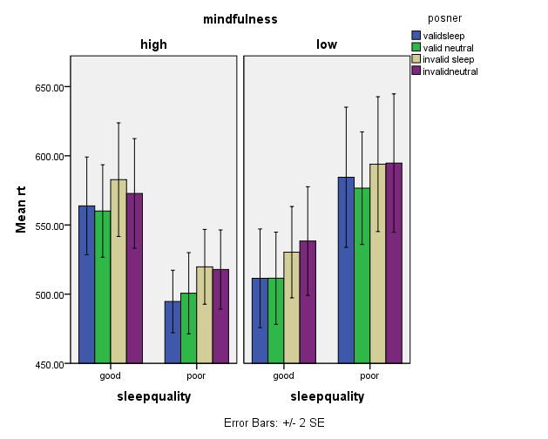
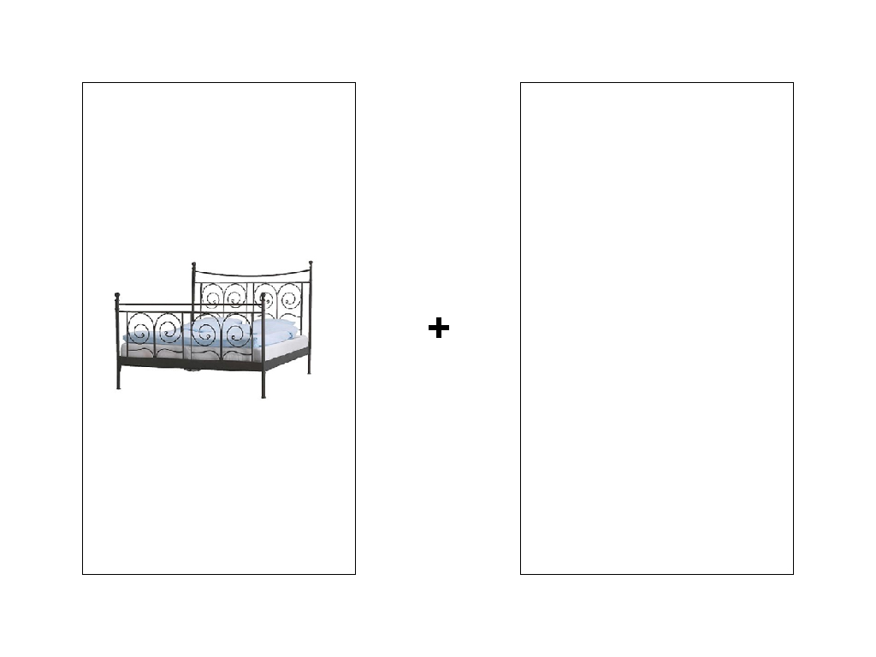
Mindfulness and attention allocation in insomnia.
Heather Cleland Woods¹, Vesa Korhonen², Stephany M. Biello¹
1 School of Psychology, University of Glasgow, UK
2 University of Eastern Finland, Finland.
Espie and colleagues (2006) outlined a pathway into PI with three main components including selective attention to sleep. The University of Glasgow have pioneered this work using various paradigms and stimuli (Jones et al 2005, Marchetti et al 2006, MacMahon et al 2006, Woods et al 2009). Attention and awareness are constant features of how we function normally. Brown and Ryan (2003) stated that mindfulness is about present awareness with people low in mindfulness prone to pay attention to internal cues. Mindfulness meditation has been integrated into CBT-I with sleep-related benefits of the intervention maintained at 12-month follow-up (Ong et al 2009). Our aim was to integrate our objective attentional methodology with a subjective mindfulness measure to explore the hypothesis that high mindfulness will decrease selective attention to sleep.
Results
High mindfulness
Low mindfulness
Trial type
Valid sleep
Valid neutral
Invalid sleep
Invalid neutral
Mean reaction time (ms)
Mean reaction time (ms)
Methods
Figure 1. An example of a sleep stimulus. If the target proceeding this image was presented on the left the trial would be valid and on the right side, the trial would be invalid.
A pictorial modified Posner was used to obtain reaction time measurement (ms) with PSQI and clinical interview used to establish sleep quality. The MAAS was used to establish mindfulness level (high and low). The four trial types were valid sleep, valid neutral, invalid sleep and invalid neutral. The stimuli presented were images of items typically found in a bedroom (sleep) and kitchen (neutral).
24 good sleepers (GS, <5 on PSQI) and 24 individuals with insomnia (PI, >5 on PSQI) participated in this study. 14 of GS rated high in mindfulness and 10 low compared to 11 PI scoring high and 13 as low in mindfulness.
Error bars +/- 2 SE
Conclusion
These findings suggest that mindfulness influences attentional allocation. A mindful approach involves awareness, attention and being present with rather than reacting to a stimuli (Brown, Ryan and Cresswell , 2007) which suggests that overriding selective attention may contribute to the efficacy of CBT-I with mindfulness meditation treatment integrated.
A possible future direction for this work would be to use a cognitive probe paradigm such as the paradigm outlined here to objectively measure the efficacy of treatment.
References:
Espie, C.A., Broomfield, N.M., Macmahon, K.M.A., Macphee L.M. and Taylor, L.M. (2006) The attention-intention-effort pathway in the development of psychophysiological insomnia: A theoretical review. Sleep Medicine Reviews, 10, 215-245.
Howell, A.J., Digdon, N.L., Buro, K. and Sheptycki, A.R. (2008) Relations among mindfulness, well-being, and sleep. Personality and Individual Differences, 45, 773-777.
Posner, M.I. (1980) Orienting of attention. Quarterly Journal of Experimental Psychology 32A, 3-25.
Woods et al. (2009) The clock as a focus of selective attention in those with primary insomnia: An experimental study using a modified Posner paradigm. Behavior Research and Therapy, 41, 231-236.
A significant interaction was found between sleep quality and level of mindfulness (p<0.05) over all 4 trial types with a negative correlation between PSQI and MAAS (r= -0.35, p<0.01). When high in mindfulness, PI were significantly faster than GS. When low in mindfulness, PI were significantly slower than GS. As sleep quality decreases, mindfulness decreases.
No significant effect (P>0.05) of stimuli type (sleep vs neutral) was observed between GS and PI.
University of Glasgow, charity number SC004401

