Slide 1
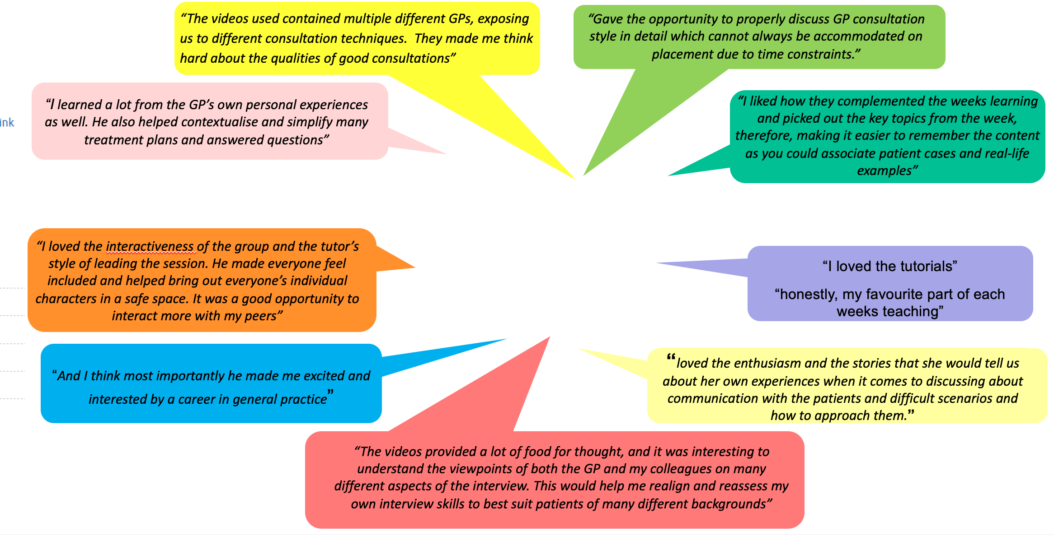
Expanding and evolving: the GP curriculum at Glasgow
Dr Zoe Noonan, Dr Katie Brown, Professor Lindsey Pope
School of Medicine, Dentistry and Nursing, University of Glasgow Correspondence to Zoe.Noonan@glasgow.ac.uk
Aligned with the government directive to increase undergraduate GP curriculum time^{1,2}, Glasgow medical school has expanded its GP teaching curriculum (11.5 days in 2019/2020 to 32.5 days in 2022/23). With increasing medical student numbers^{3, 4} and challenges in GP placement capacity⁵, we describe evolving and innovative teaching used to scaffold and augment learning in general practice to year 3 undergraduate medical students in Glasgow.
Expanding… student (and tutor) numbers and GP teaching time
Student feedback
Student numbers will continue to grow (predicted to reach 500 by 2024/25)
GP teaching time has doubled this year.
Tutor numbers are relatively static.
New models of teaching developed to meet shortfall in clinical placement capacity.
A blended teaching model, incorporating virtual and face to face teaching, has proved a resilient and positive GP teaching model at Glasgow.
Summary of teaching methods used to deliver curriculum in 2023
Thematic GP learning
Vertical strands in communication skills, professionalism, resilience and QIA develop and extend prior learning
Placement time
‘Traditional’ GP learning model – students practice clinical and consultation skills
Results
Zoom telephone triage⁷
Enables a ‘safe’ space to practice telephone consultation with simulated patents, with peer and tutor feedback
Evolving GP Curriculum
Virtual tutorials
based on VPC video resource⁶ – real life video patient cases deconstructed in tutor led zoom tutorials
Evolution in curriculum design has enabled delivery of augmented GP teaching time to increasing numbers of students at Glasgow. Collaboration with colleagues, engagement with new teaching resources and ideas, active participation in national working groups and pilot projects for teaching innovation have been vital in this process.
Conclusions
Isabel platform
Case based learning centred on clinical reasoning, following a patient whose medical and social needs increase in complexity, with tutor facilitated debrief
Online content
Bespoke online student resources, aligned to curriculum
Further teaching evolutions will be informed by student, tutor, and administration staff feedback. Innovation can bring administrational challenge; flexibility in module design can present issues in terms of equity of student experience; students’ expectations and learning needs evolve quickly.
Composite narrative animation
Use of ‘Nadya’ case to consider psychological wellbeing
The Scottish Government. Undergraduate medical education in Scotland: enabling more general practice based teaching. The Scottish Government; 2019 Oct. Available from: https://www.gov.scot/publications/undergraduate-medical-education-scotland-enabling-more-general-practice-based-teaching/documents/
Cottrell E, Alberti H, Rosenthal J, Pope L, Thompson T. Revealing the reality of undergraduate GP teaching in UK medical curricula: a cross-sectional questionnaire study. Br J Gen Pract 2020; 70(698): e644-e50.
General Medical Council. The state of medical education and practice in the UK. London; 2021.
The Medical Schools Council. The expansion of medical student numbers in the United Kingdom. London; 2021.
Barber JRG, Park SE, Jensen K, et al. Facilitators and barriers to teaching undergraduate medical students in general practice. Medical Education 2019; 53(8): 778-87.
Virtual Primary Care Resource. A repository of 150 GP consultations created in 2020 by the medical schools council and the society of academic primary care heads of GP. Available from: https://www.medschools.ac.uk/our-work/education/virtual-primary-care
Dunsmore, A et al. 12 tips. Submitted to Medical Teacher Jan, 2023.
Notes:
1

