Slide 1







Is first-hand fieldwork still the best way into a career in marine sciences?
Highlighting digital twinning of the oceans as a complementary and more inclusive pathway into a career in the marine sciences
Anna McGregor¹, Ben Fisher², Chelsey A. Baker³, Carol Robinson⁴, Gillian M. Damerell⁴, Cecilia M. Liszka⁵, Natasha Simmonds⁶, Sophie Fielding⁵, and Pilvi Muschitiello⁵
3
5
2
4
6

Slide 2

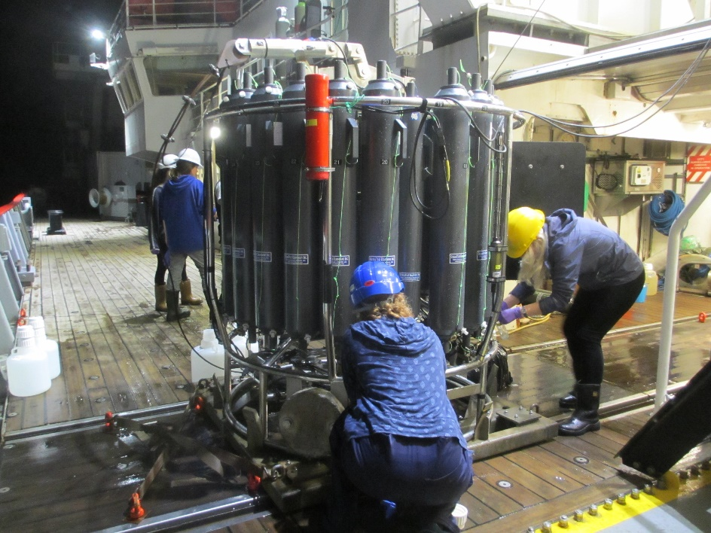
Motivation
Project Summary
Fieldwork is seen as entry-way into marine science career
Limitations of fieldwork may create barriers
Is this true for both incoming and established scientists?
How can we raise awareness of alternative routes into the discipline?

Slide 3
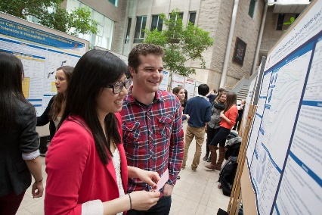
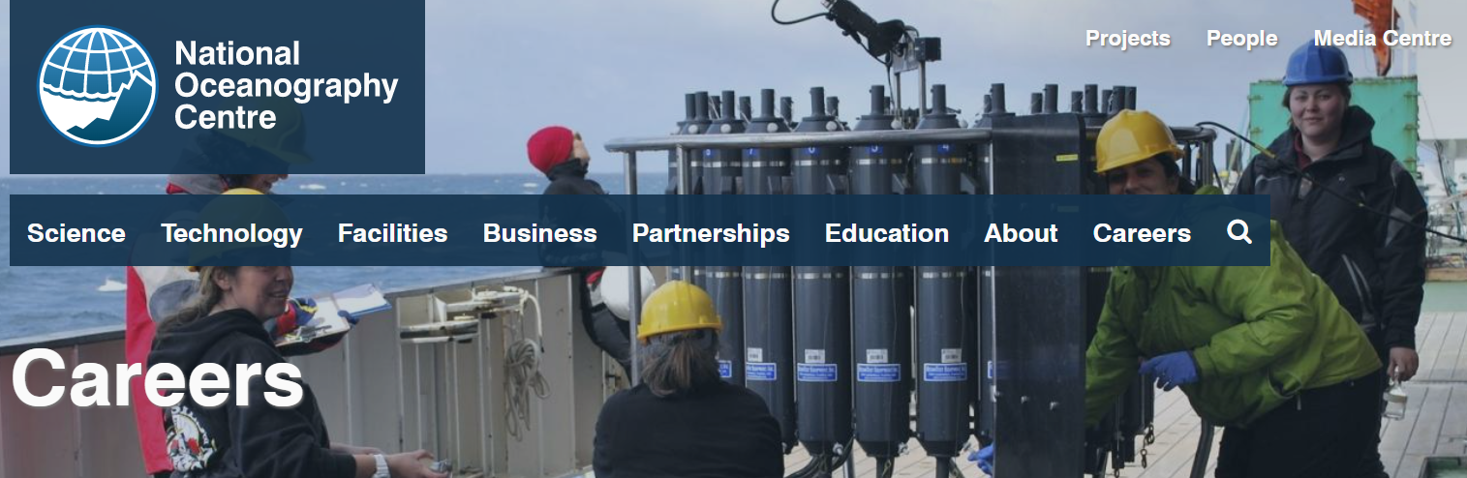
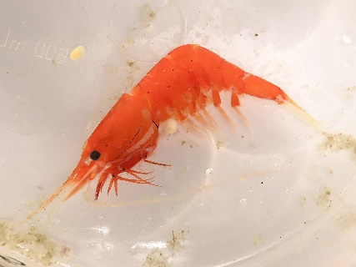
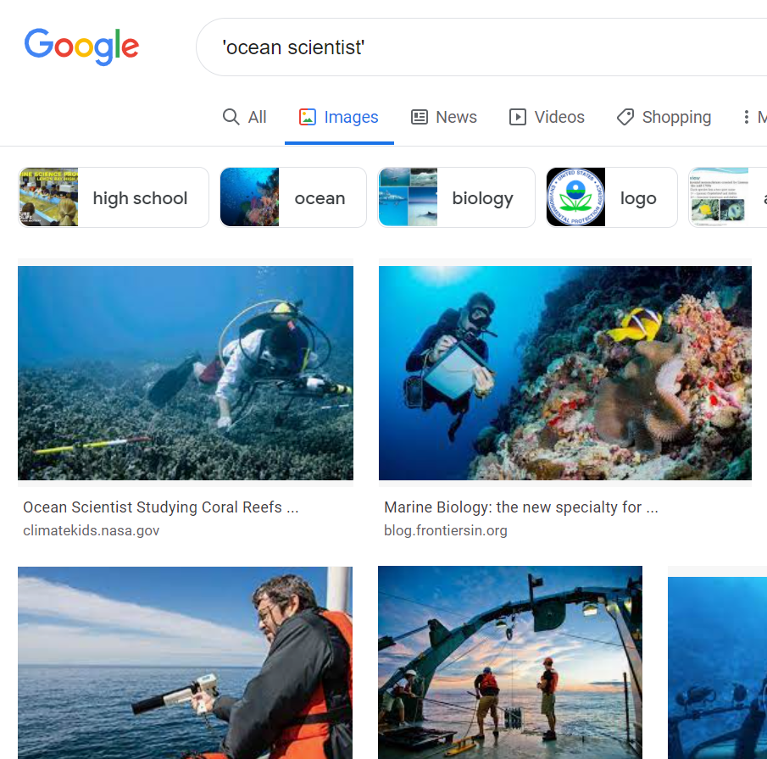
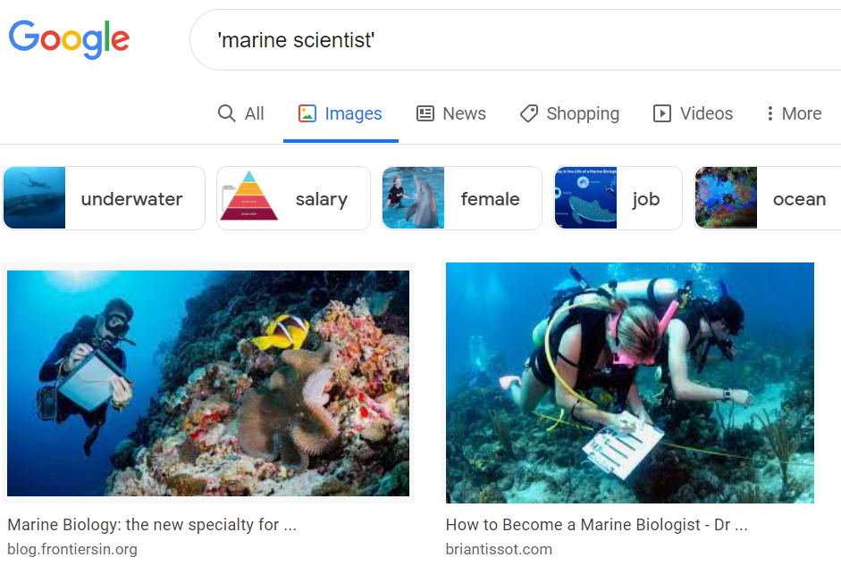
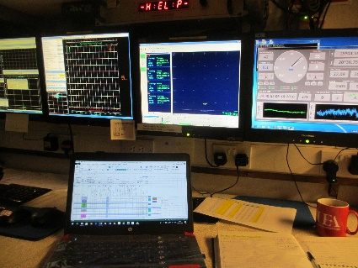

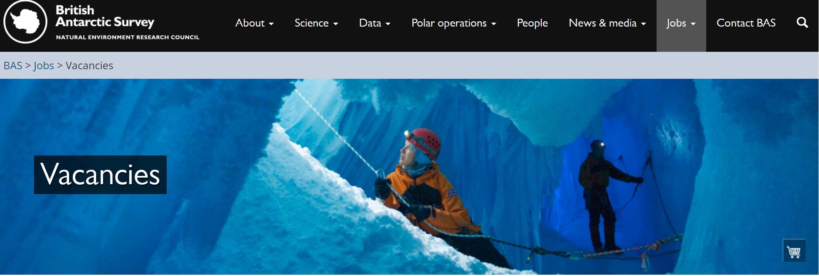
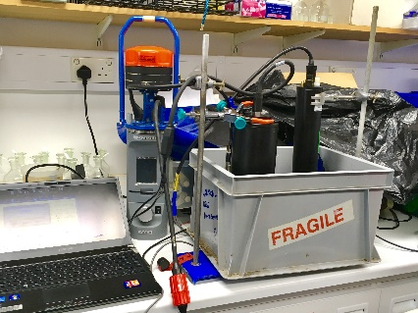
Perceptions of Marine Science
In reality…
Marketing of the discipline does not match up with the range of skills required
[Mol & Atchison, 2019]

Slide 4

What do people entering the field think is required?
Student questionnaire & focus group
What do those IN the field expect for a career?
Questionnaire
How do we raise awareness of other aspects of the career?
Workshops
Online course
How does the field appear externally?
Review of job adverts
Image analysis of websites
Study Themes & Outcomes

Slide 5
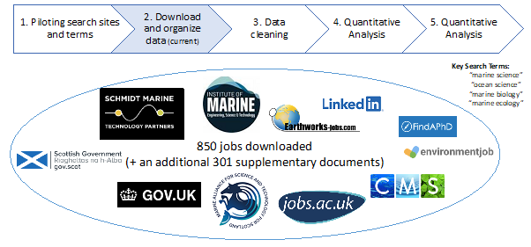
Systematic Review Progress

Slide 6
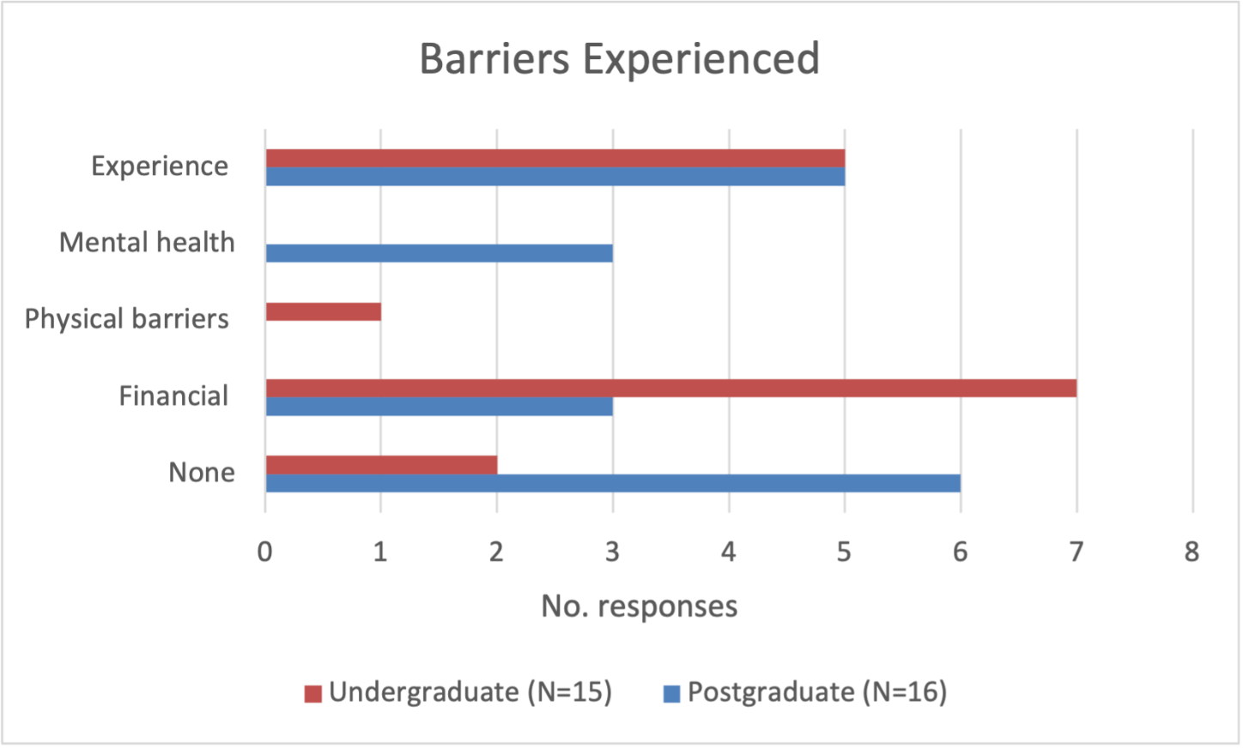
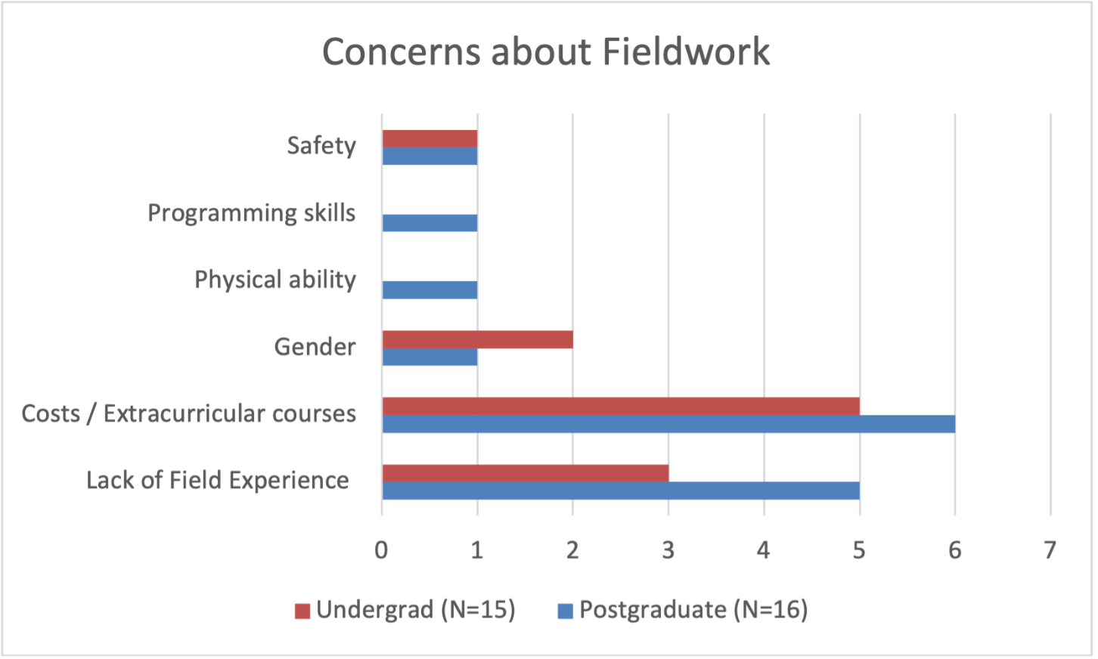
Student perceptions – thematic analysis

Slide 7
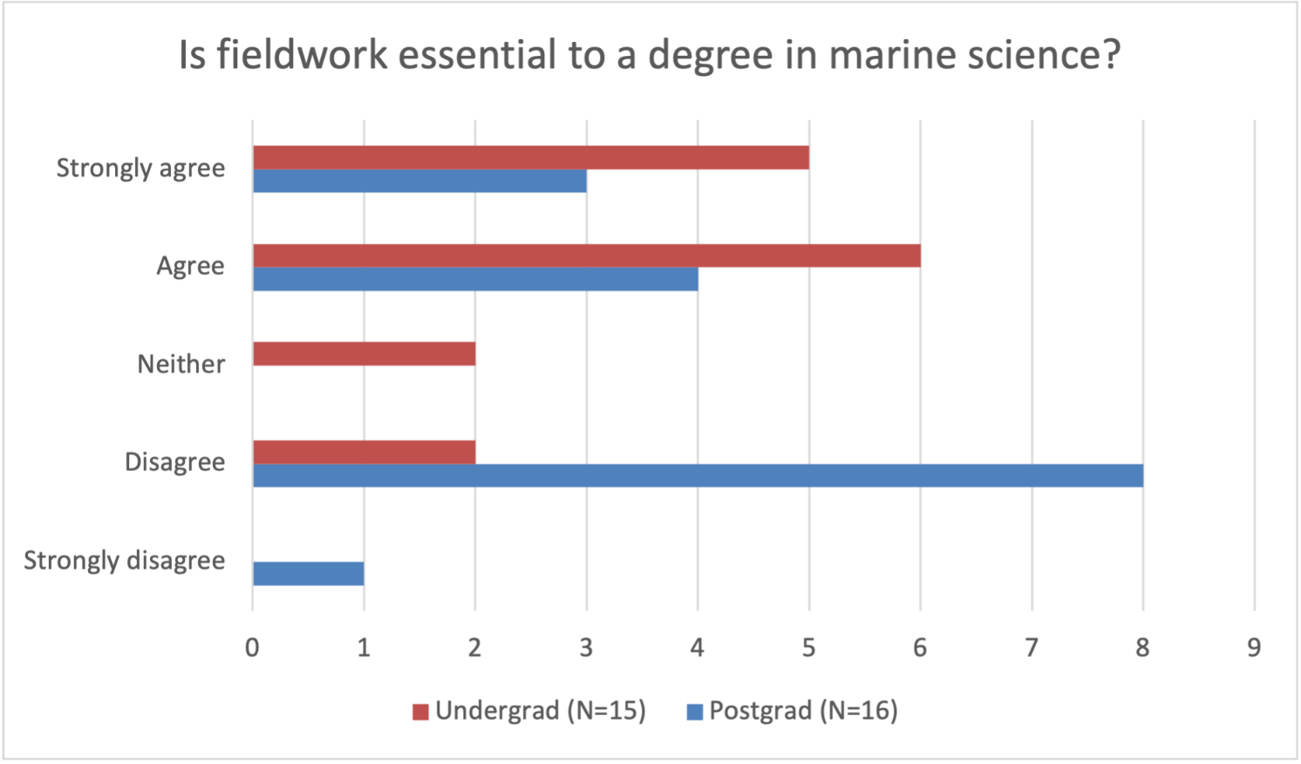
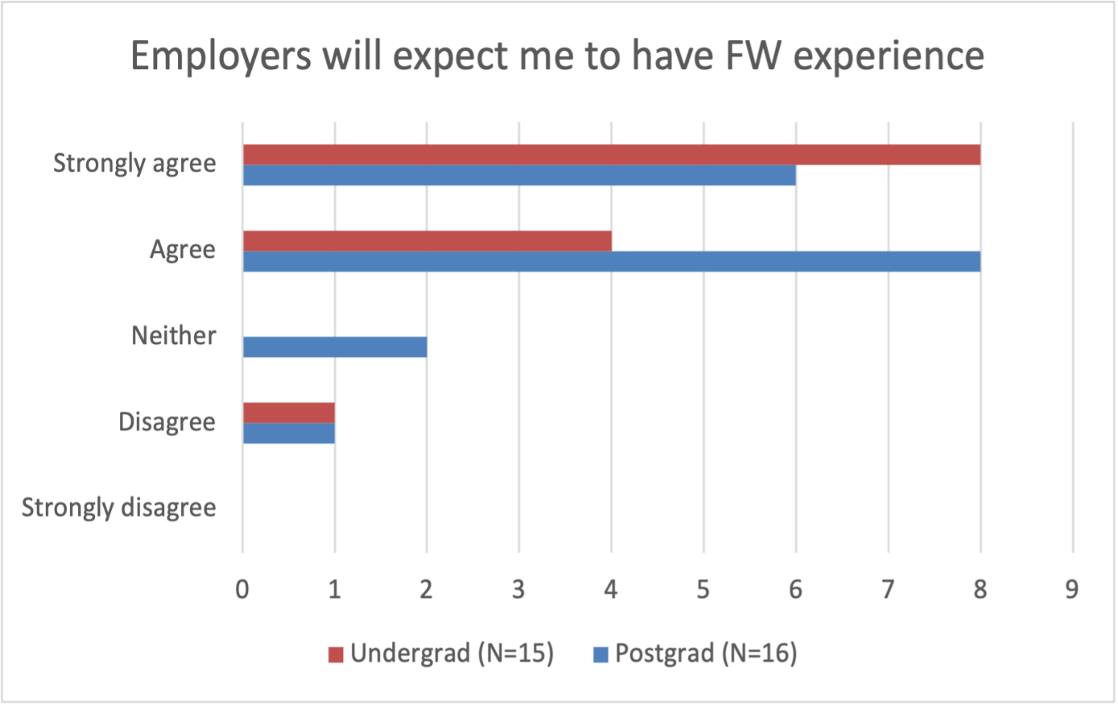
Student perceptions – Likert-scale

Slide 8
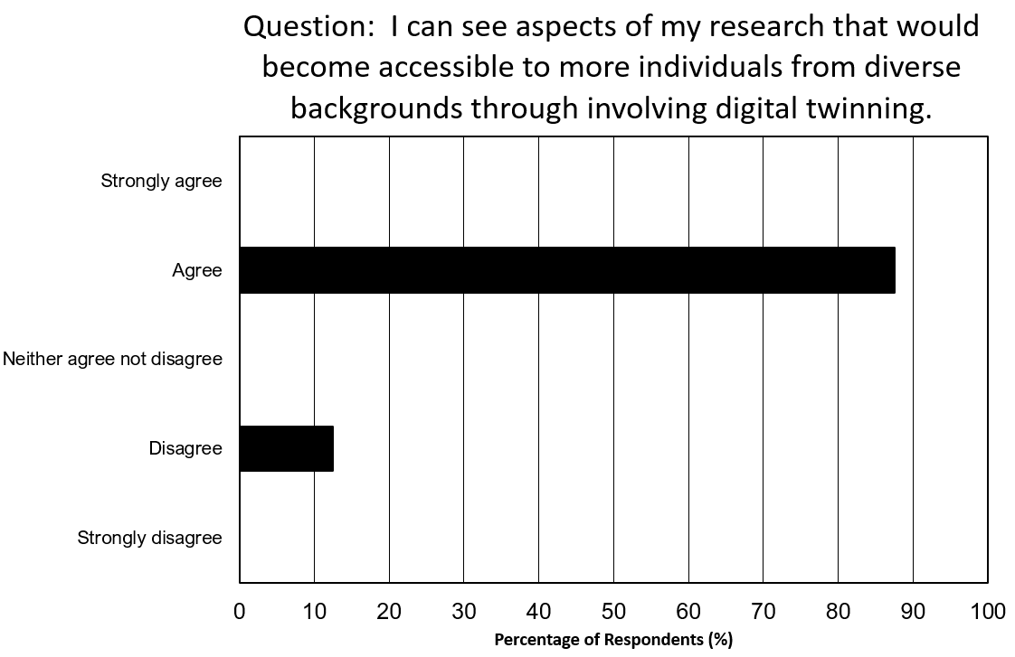
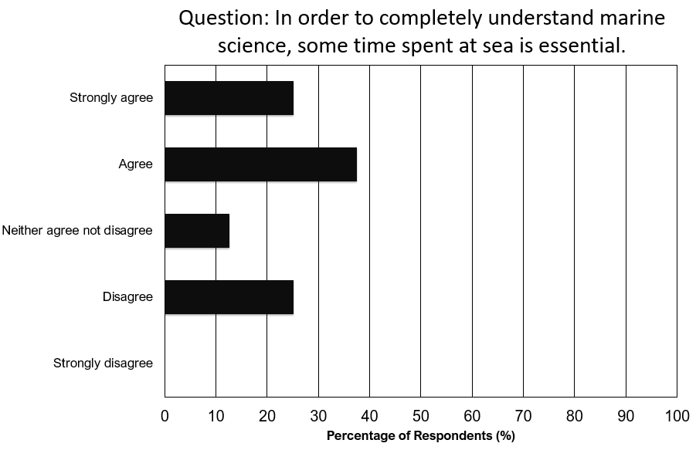
Staff perceptions
Notes:
Incorporating digital twinning more closely with traditional fieldwork will make marine science more accessible, both to those within the field and those who interact with it. From our survey we can see the general the consensus is that aspects of research could be made more accessible through involving digital twinning. But to make this work within marine science, digital twins needs to be included at the proposal stage of research programmes and therefore it is crucial to raise awareness of these issues and opportunities with senior scientists and PIs.

Slide 9
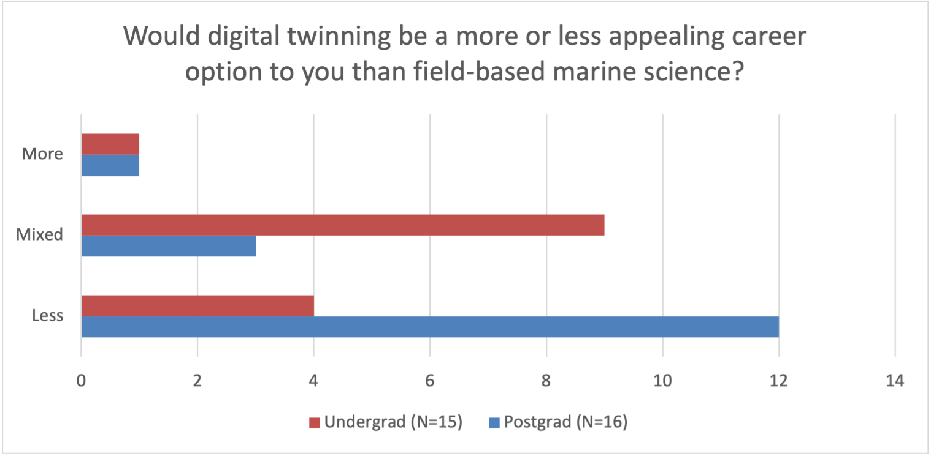
In summary
Conclusions
Disconnect between students & staff
Majority view is barriers are financial
Good appreciation for digital skills, but not motivator to join discipline

Slide 10
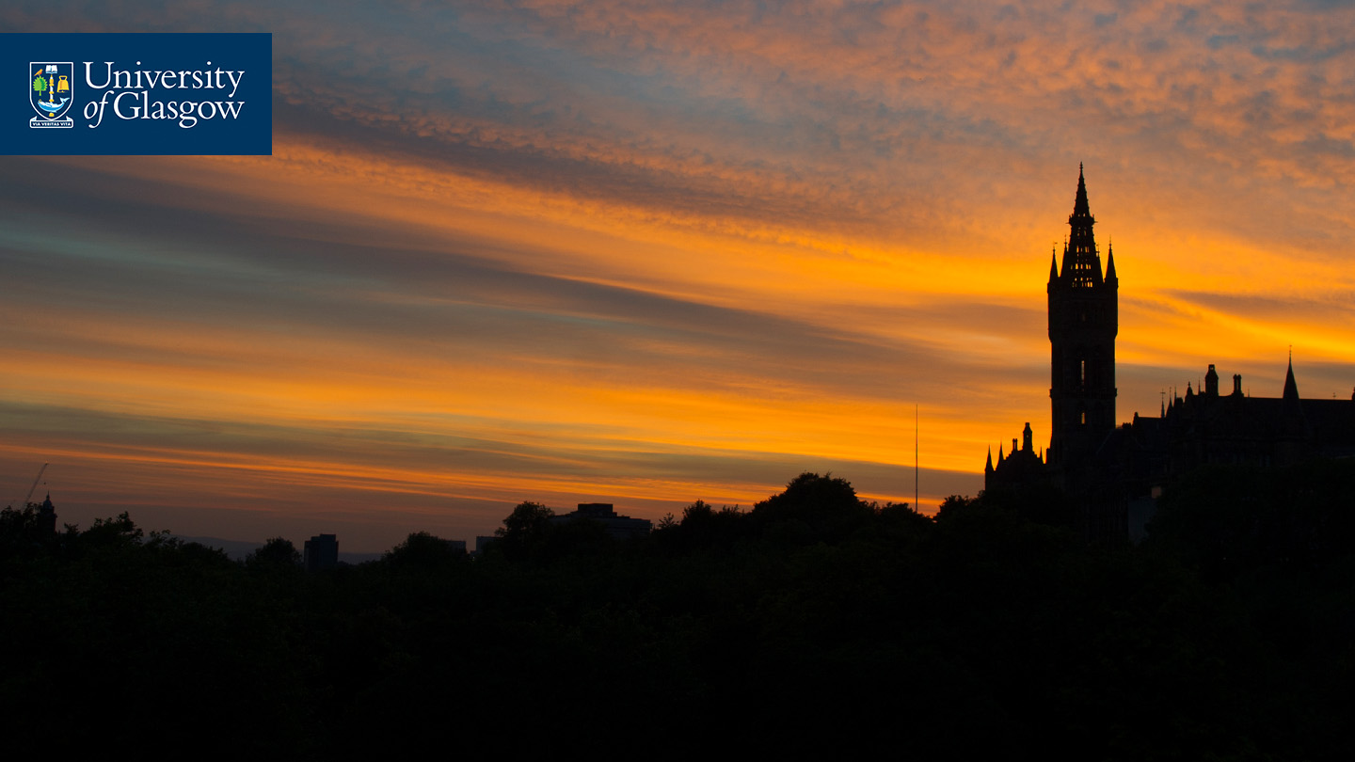

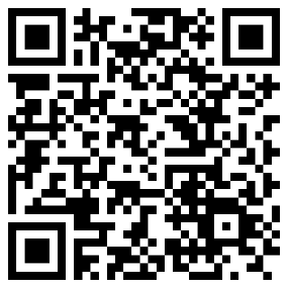
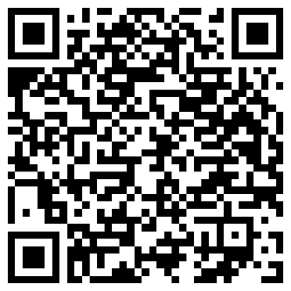



Thank you! anna.mcgregor@glasgow.ac.uk
@AENMcGregor
Staff Survey
Student Survey
References
Mol & Atchison (2019). Journal of Geography in Higher Education, 43(4), 544-567.
Giles et al. (2020) Nat Rev Earth Environ 1, 77–78
John & Khan (2018) Mental health in the field. Nature Geosci 11, 618–620
Stokes et al. (2019) Geosphere 15 (6): 1809–1825.
Hall & Healey, M., (2005) Area, v. 37(4):446-449
#UofGWorldChangers
@UofGlasgow

