Slide 1
3x10 Musical Actions for Three Performers
Björn Heile (2021)
Performer 3
On moving to the next slide, automatic slide changes take effect, and each slide is projected for 30 seconds or 1 minute. Each slide contains a musical action, in different forms of notation, timed to last for the duration of the slide. You can rearrange the slides in any order, according to your preference or as discussed with the other performers (the letters are for orientation only).
A progress bar at the bottom of the screen shows you approximately how much time has elapsed.

Slide 2
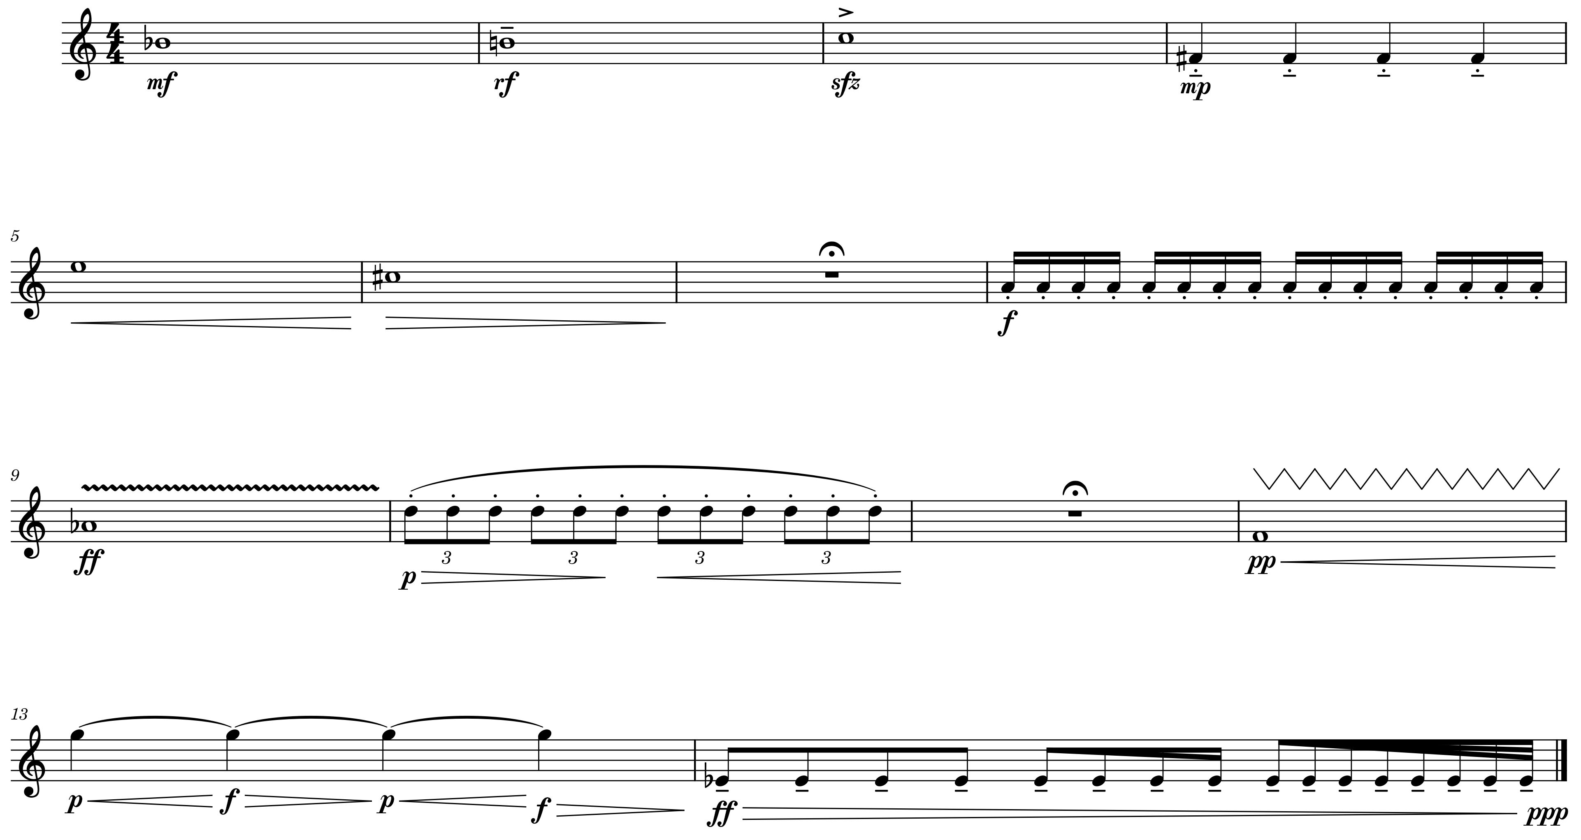
E3
Warm-up 3 – with apologies to the ghosts of Varèse and Kagel
Play a couple of warm-up exercises as you normally would or that are typical of your instrument. Do not avoid irregular rests, hesitations, fluffed notes etc. characteristic of warming-up. If you can, focus on sustained notes and note repetitions. Below are some examples, as indications only.

Slide 3
D3
Cage Was Here 3
Do not play anything. Look at no-one in particular but at your music stand, your instrument or on the ground in front of you. You can remain in meditative stillness or fidget about, as you prefer.

Slide 4
C3

Slide 5
B3
Imitation is the sincerest form of flattery 3
Observe and listen to the performer on your right. If there is no-one on your right, choose the performer opposite to you. Try to continue the last thing they have played. If, for example, it is a melody, how could it carry on? Or maybe there should be a contrasting element? The length of the passage that you extend in this way is up to you. If the performer is not playing anything or engages in an action other than performing music, your continuation should likewise respond to their action or lack thereof.

Slide 6
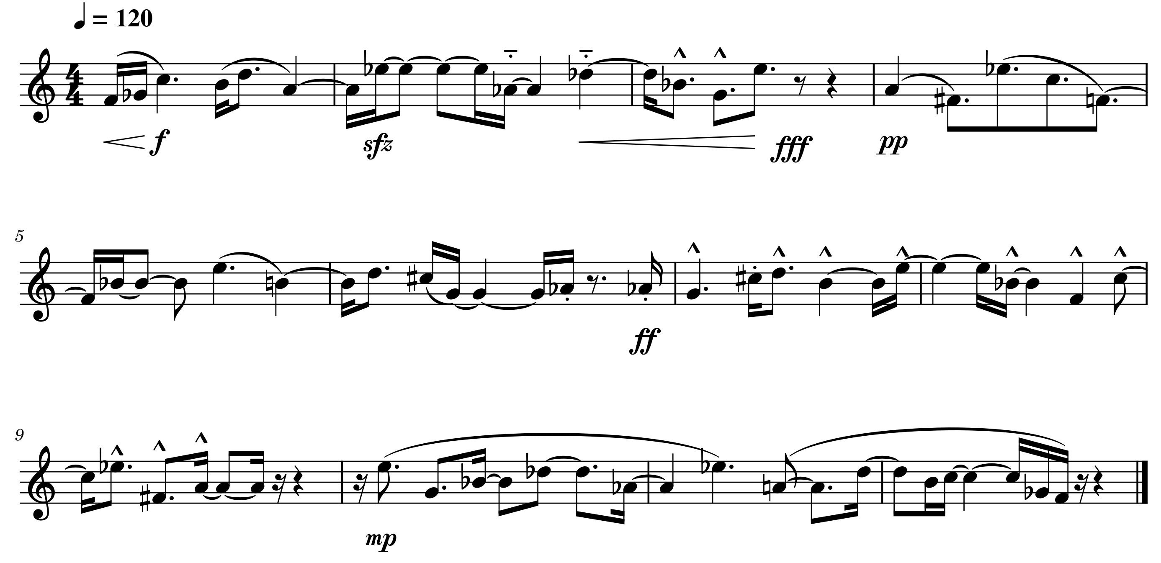
A3

Slide 7
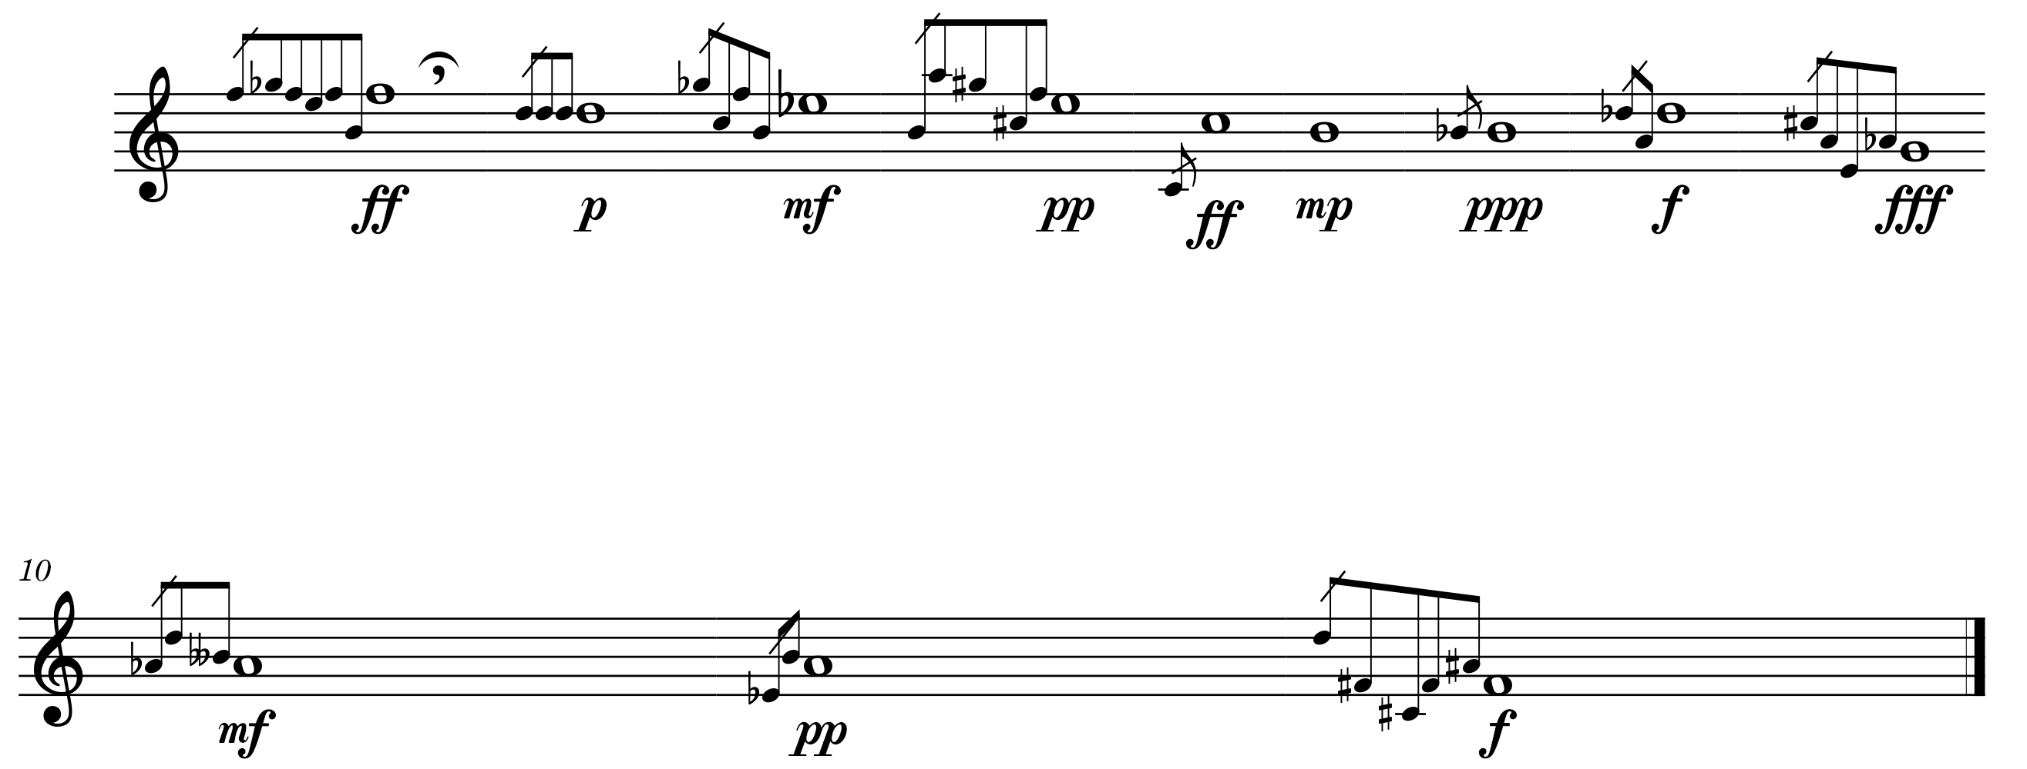
J3
Note for Note 3

Slide 8
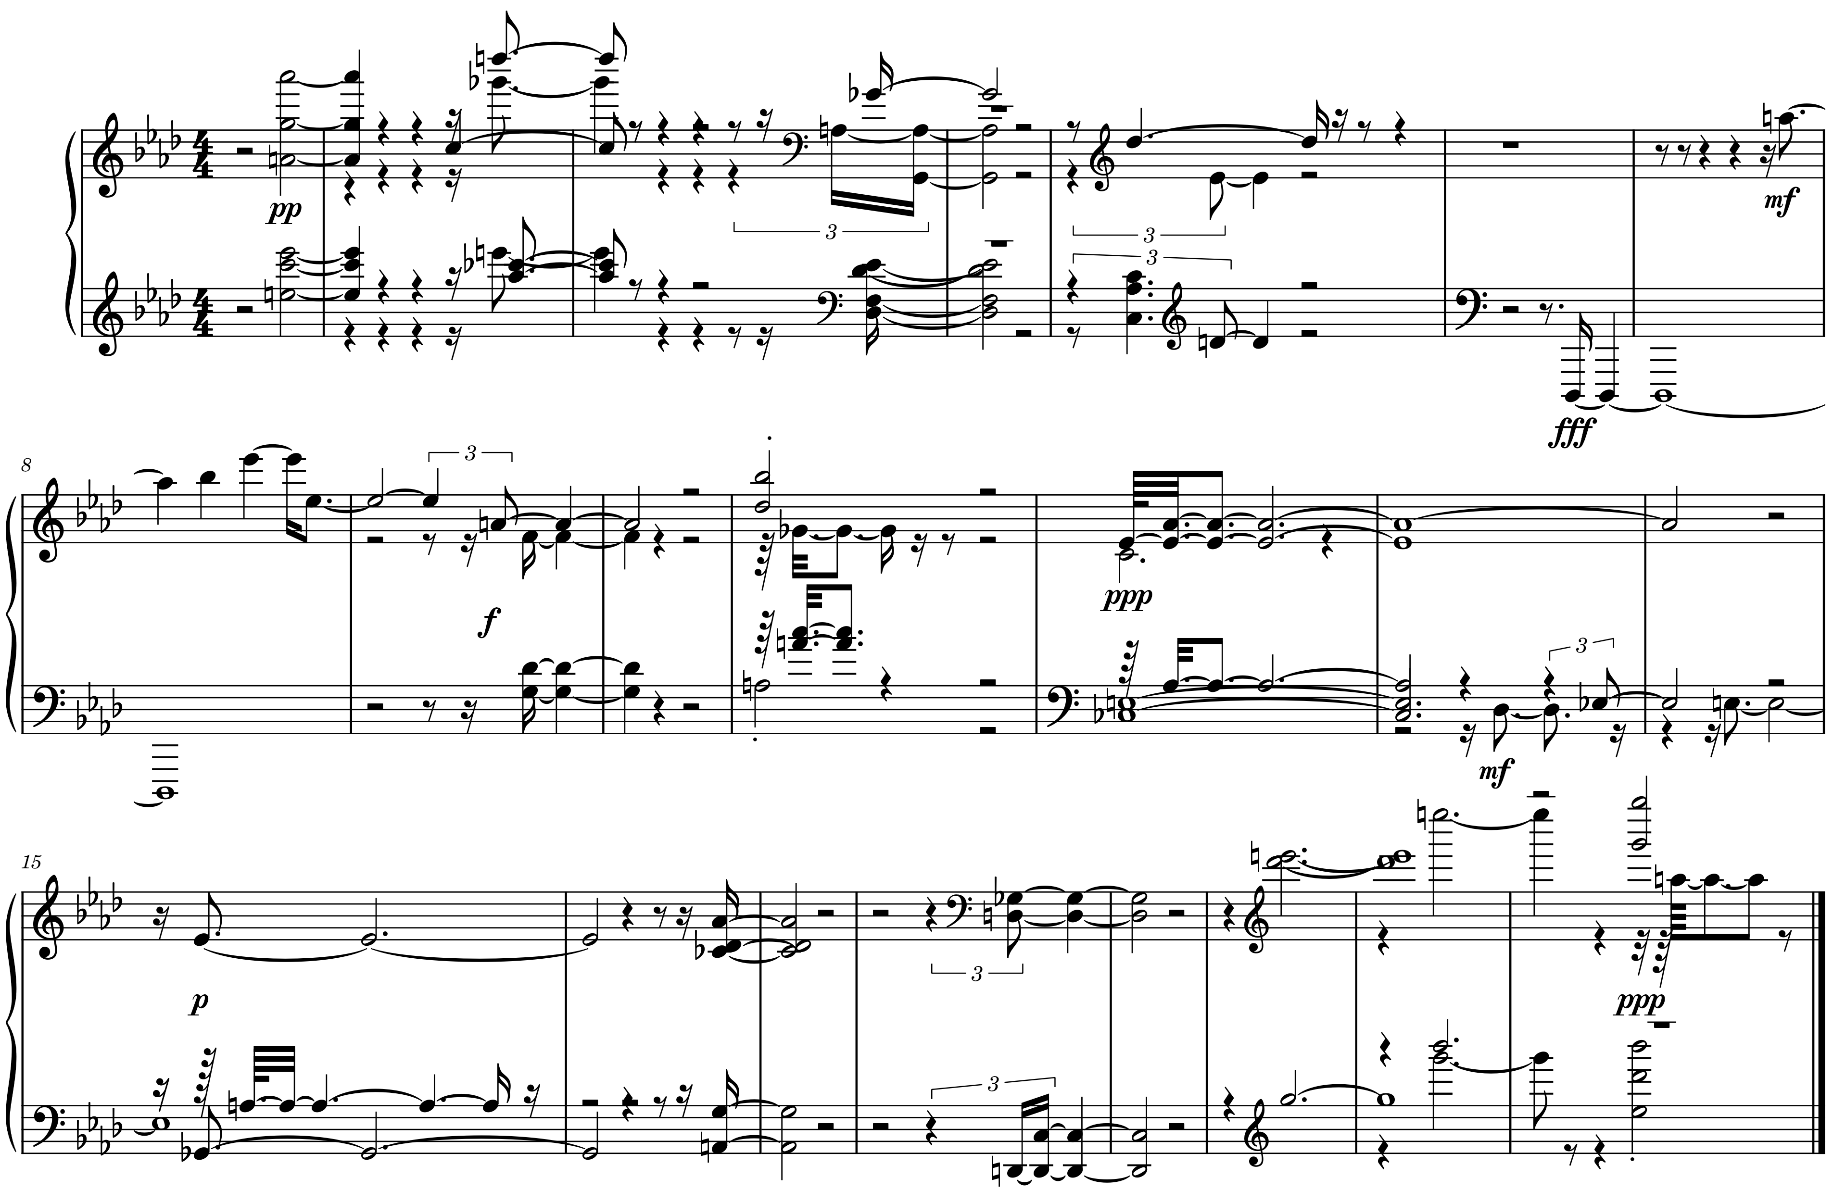
I3
Straight from the Horse’s Mouth 3
Using your speaking voice, try to describe the music below. You can name precise details or convey an impression or general character. You can also sing or use other vocal sounds to imitate the sound.

Slide 9
H3
Words can’t describe…3
Below verbal instructions for playing music will be provided in 20 sec intervals.
1: Take a deep breath. Play something or don’t, as you prefer.
2: Listen deep inside yourself (mind/body/’spirit’). Play what you hear or what resonates with what you hear.
3: Become one with your instrument. What does it want you to play?

Slide 10
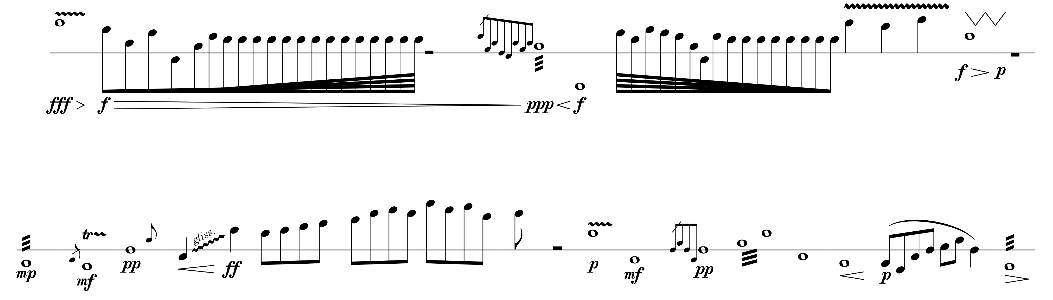
G3
Close Enough 3

Slide 11
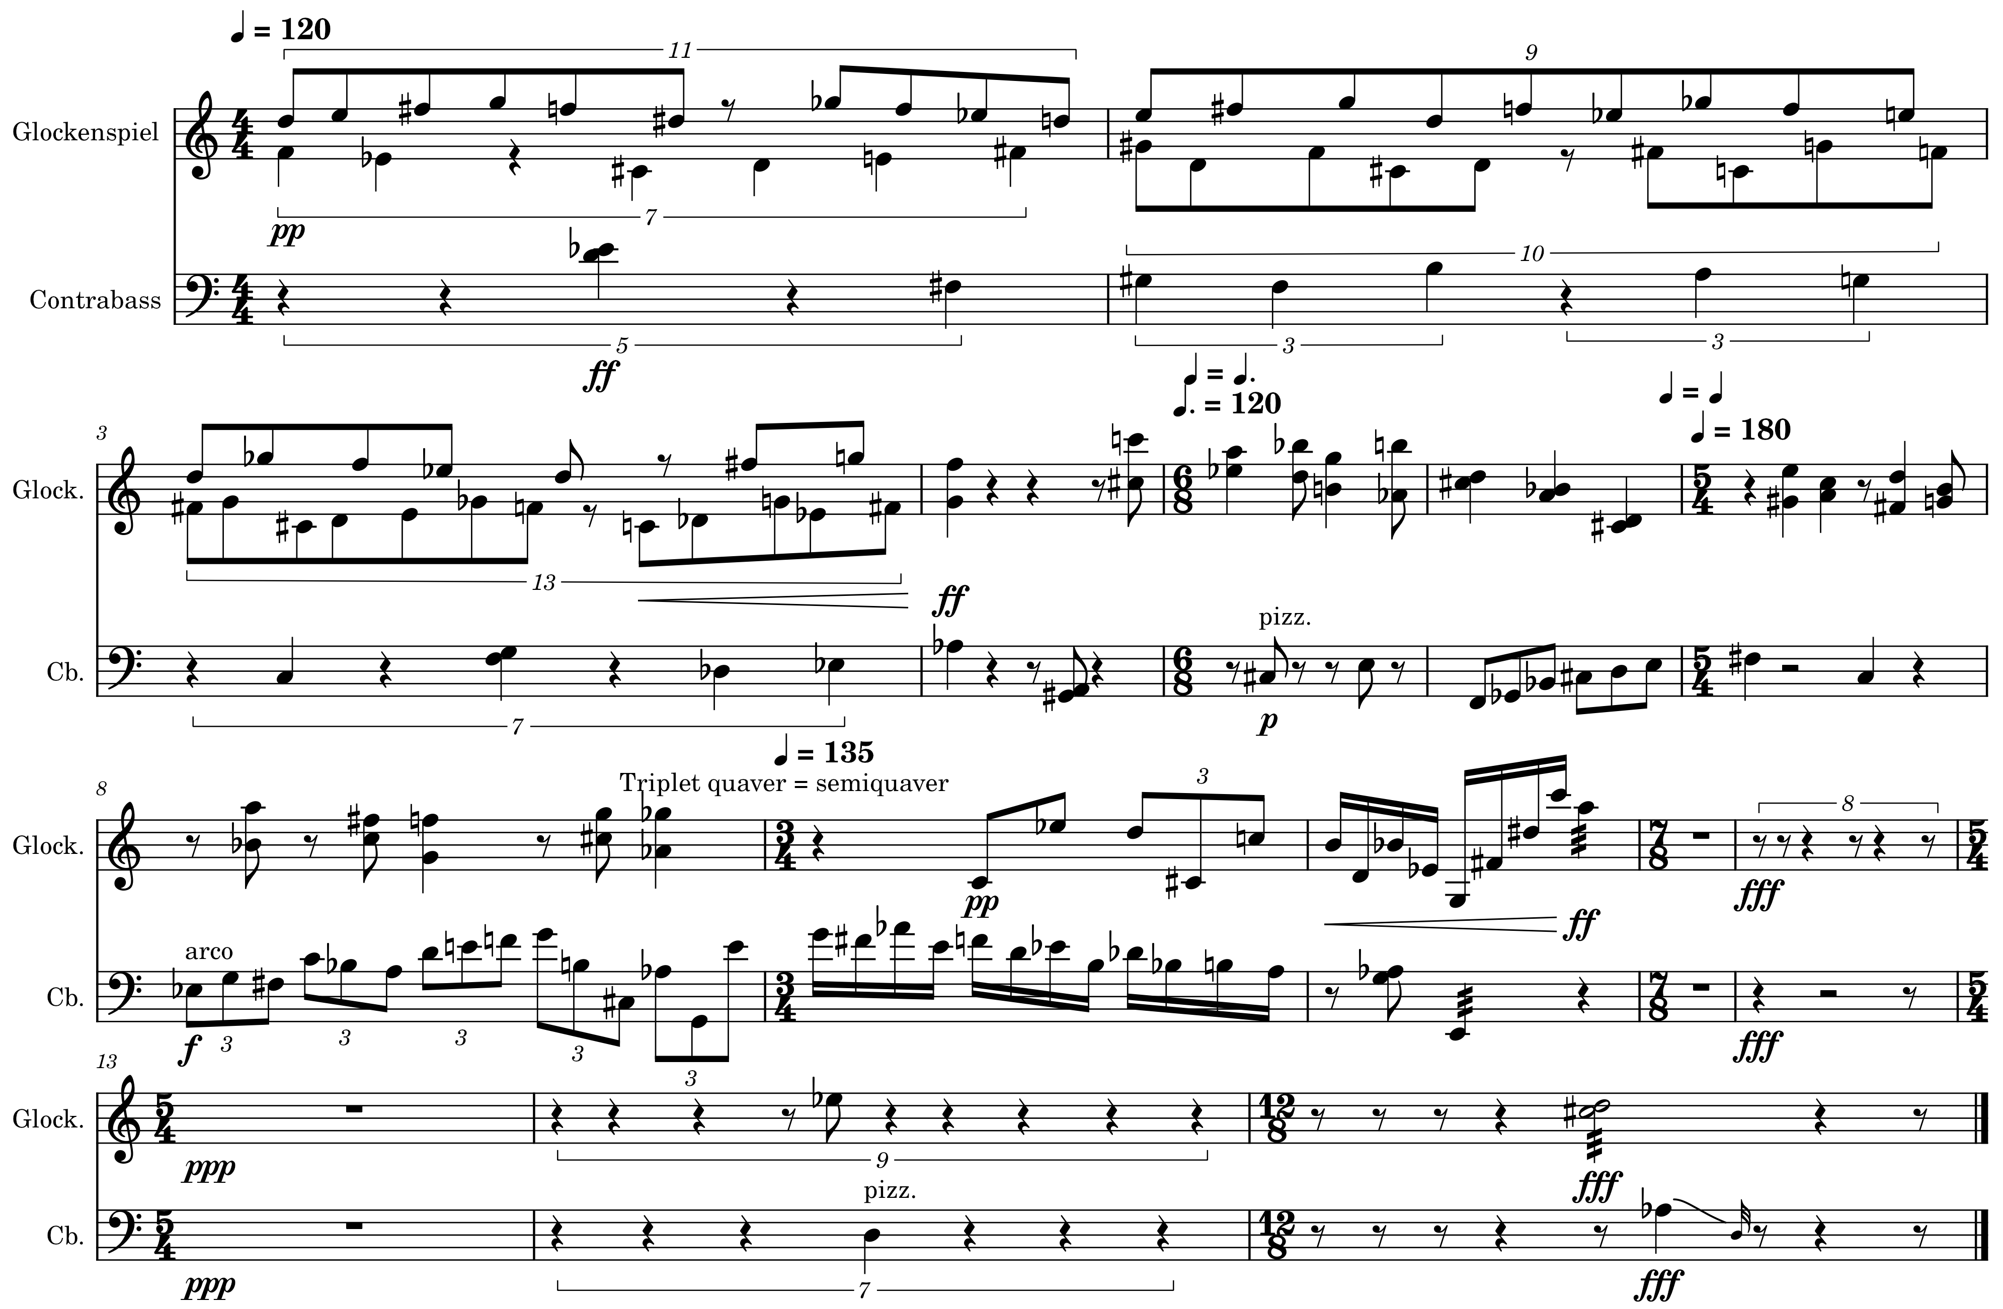
F3
Furtwängler’s Upbeat 3
Try to conduct the following passage, pretending that your fellow musicians are performing it. Your conducting skills are secondary, but you should give it your best shot.

