Slide 1
Childcare practitioners’ perceptions of numeracy: a challenge to vocational training curricula? SERA Presentation 23rd November 2017 Elizabeth Black

Slide 2
What new challenges in work spaces and practices are impacting on professional and vocational learning?
Increasing focus of Scottish policy on the early years
Challenges to traditional skillset and professional identity of early learning and childcare (ELCC) practitioners (Adams, 2008)
Higher qualification requirements and requirement for greater engagement with curriculum and pedagogy
Numeracy epitomises these challenges
Notes:
What new challenges in work spaces and practices are impacting on professional and vocational learning?
Scottish policy focuses ever-increasing attention on the early years of children’s lives as a period when effective intervention by skilled practitioners has the potential to prevent later development of social problems (Scottish Government, 2008), a focus changing and challenging the traditional skillset and professional identity of early learning and childcare practitioners (Adams, 2008) and which has been accompanied by higher qualification requirements and greater engagement with curriculum and pedagogical issues codified in both the original and revised Standard for Childhood Practice (SSSC, 2016). Numeracy is a field of knowledge at the heart of Scottish Government priorities for a more skilled and adaptable workforce (Scottish Government, 2014) and has also been recognised as an essential component of high quality ELCC provision (Wall et al, 2015) yet it is simultaneously a subject area where practitioners profess to lack confidence and therefore epitomises these challenges.
Supporting data for this presentation is drawn from my practitioner enquiry where my intention was to investigate, through discussion with a pre-existing group of practitioners, one group of ELCC practitioners’ perceptions of numeracy in order to explore the ways in which these issues are affecting practitioners.
The entwined themes of low confidence and struggles with terminology permeated participants’ discussions of beliefs about numeracy, descriptions of numeracy in practice and personal experiences of numeracy, suggesting that, despite being a Scottish national priority for improvement, numeracy continues to be a collective area of weakness, challenging both effective practice with children and practitioners’ professional self-images. While acknowledging the small scale of this study, it is possible to conclude that changes to pre- and in-service training may be required to ensure that qualified early learning and childcare practitioners have adequate levels of mathematical subject knowledge alongside clearer understanding of the pedagogical principles and techniques underpinning their everyday practice.

Slide 3
Defining numeracy
A lack of research into early numeracy
Most is from a child development perspective (Munn, 2005)
Competing definitions of numeracy are evident
Number recognition and number processes (Fox and Diezmann, 2007)
Early or basic mathematics (Melhuish et al., 2008)
Used interchangeably with mathematics (Gervasoni, 1998)
Notes:
Fox and Diezmann (2007) found a notable lack of research into early numeracy, and further reading reveals that the little available has frequently been written from a child development perspective, presenting numeracy as one of many emerging skills, rather than being framed by broader numeracy and mathematics discourses within the context of mathematical development (Munn, 2005). On the other hand, there is evidence of increasing recognition of the general importance of both numeracy (Parsons and Bynner, 2005) and learning in the early years of life (SG, 2008b).
Competing definitions of numeracy are provided by researchers, theorists and policy makers, contrasting with assumptions made about numeracy by authors writing from an ELCC background. Numeracy may be defined as
Learning to recognise numbers and use them in number processes (Fox and Diezmann, 2007:305)
Early or basic mathematics (Melhuish et al., 2008). – leading to the interchangeable use of numeracy and mathematics (Gervasoni, 1999)
And a majority refer to all aspects of learning concerning numbers as mathematics (for example, Griffiths, 1994; Kleinberg and Menmuir, 1995; Fox and Diezmann, 2007; Klein, 2007; Gifford, 2008; Faust, 2010).

Slide 4
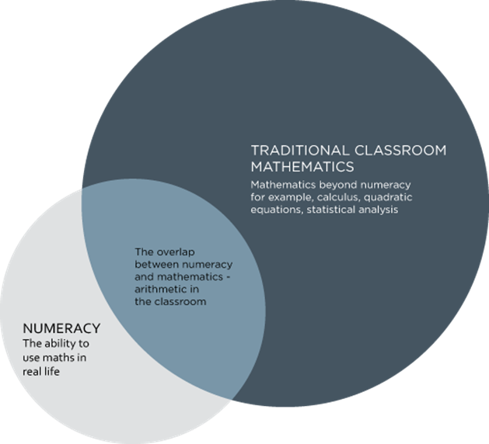
Figure 1: The relationship between numeracy and mathematics (National Numeracy, 2015: online)
Notes:
Based on the 1982 Cockroft Report and Munn and Schaffer’s (1993) research, Anning and Edwards (1999) define numeracy as distinct from mathematics.
Emphasising the importance of understanding, the use of numeracy in everyday life and the ability to ‘think mathematically’ (ibid:115), they describe numeracy as fluency with the language and concepts of number, a basic skill supporting the development of early mathematical concepts. This is the approach that has been adopted by the Scottish curriculum guidance, the document Numeracy across learning: Principles and practice (ES, online-f:1) beginning with the definition: ‘the confidence and competence in using number which will allow individuals to solve problems, analyse information and make informed decisions based on calculations’. This definition situates numeracy as distinct from yet interrelated with mathematics—represented by Figure 1—and was the definition adopted for the study.
These debates must also be placed in the context of an early years effectiveness research agenda seeking to justify financial investment in early years services through quality assurance (OECD, 2001; SG, 2008a). Several authors, including Maclellan (2012) stress the importance of mathematical subject knowledge for ensuring that practitioners are confident in their ability to recognise and support children’s learning, particularly through play.
Echoing Moyles et al. (2002b), Stephen (2010) finds that practitioners still lack a clear understanding of how best to support learning through play. This research indicates that once the pedagogical focus shifts from general instructional techniques to a tailored blend of care and education for individual children, the scope of essential knowledge becomes much broader, a complexity highlighted by the SPEEL project’s framework of 129 key statements of effective practice (Moyles et al., 2002b:60).
In addition to knowledge of numeracy and child development, confidence is an important factor in the ability of practitioners to support children’s development fully. Griffiths explores the ways in which this may be a particular problem for numeracy, a subject that many adults claim to have struggled with themselves at school (Griffiths, 1994).

Slide 5
Methodology
Practitioner enquiry using a discussion group with colleagues working with 3-5 year olds
Central importance of the voices and experiences of practitioners (Holloway and Wheeler, 2013)
Potential benefits for all participants through opportunity for collaborative reflection ((Moyles et al., 2002)
Data-driven thematic analysis
Limited by very small scale
Notes:
This backdrop of multiple definitions and competing priorities supported the situation of my practitioner enquiry within the interpretative paradigm (Lincoln et al., 2011) focusing on the understandings of numeracy held by childcare practitioners: how they articulated their understandings and viewed their role in introducing numeracy to children and their personal feelings about the subject. As Lincoln et al. (2011) describe interpretative enquiry, I was seeking to understand and reconstruct the specific reality of my workplace, taking a systematic and ethically rigorous approach to surpass everyday reflective practice as indicated by Groundwater-Smith and Mockler (2007).
Following Holloway and Wheeler (2013) the voices and experiences of individual practitioners were accorded central importance in the investigation: data was collected using a discussion group with all staff working in the 3-5 group invited to take part. To allow for free discussion, a small number of questions to prompt discussion were planned and my moderation of the ‘collective conversation’ (Kamberelis and Dimitriadis, 2013:4) was intended to allow the exploration of tangents and introduction of topics by the participants. The choice of a discussion group also had ethical implications framed by Groundwater-Smith and Mockler’s (2007) holistic approach to research ethics: ensuring benefits for all through the unusual opportunity to debate ideas and reflect on practice together (Moyles et al., 2002a); ensuring quality of purpose by allowing for immediate application of new ideas by participants regardless of my findings.
The constructivist approach was maintained through the data analysis process by using data-driven, inductive thematic analysis as described by Braun and Clarke (2006). By ascribing codes to individual segments of transcribed conversation then grouping these into themes—both expected and unanticipated—it was possible to create a thematic map representing, as faithfully as possible, the complexity of ideas presented by participants.
Although the scope of the enquiry was necessarily limited by having only one researcher, data source and method of collection, this was appropriate to the time and resources available and my competence as a researcher (BERA, 2011), however, it is clear that it may have been beneficial to use more than one discussion group with the same participants (Cochran-Smith and Donnell, 2006: 510). Allowing space for participants to reflect on their contributions might also have encouraged the introduction of additional topics to a second discussion and permitted the presentation of my initial analysis for their review, thus increasing the accuracy of my representation of their voices and potentially mitigating the dominance of certain participants.
While these limitations of the research must be acknowledged, I have nonetheless found certain themes in these practitioners’ understandings of numeracy which may have resonance further afield.

Slide 6
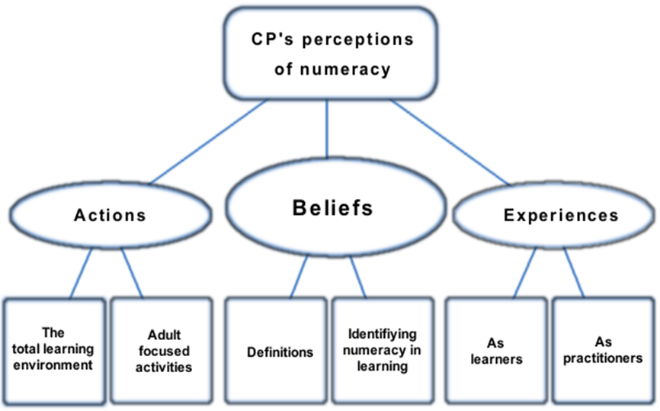
Figure 2 Thematic analysis of discussion group data
Notes:
Findings were organised within three themes representing different aspects of practitioners’ articulated understandings of numeracy: beliefs, actions and experiences. The main elements of this analysis will now be summarised.
My findings displayed some evidence that CPs understood numeracy as everyday, applied mathematics in line with curriculum guidance (ES, online-f). However an emphasis on learning numbers combined with the interchangeable use of the terms numeracy and early maths suggests that a traditional focus on counting (Fox and Diezmann, 2007) is still prevalent, raising the question of whether CPs have appreciated the full significance of new curriculum documents. Without the subject knowledge to perceive curriculum changes as relating to more than terminology, the effectiveness of such guidance is compromised.
Practitioners conveyed emerging awareness of potential opportunities for learning beyond adult-led activities however they showed limited understanding of ways to capitalise on children’s learning during these activities. This resonated with the findings of the SPEEL project where Moyles et al. (2002b) found that even the most effective practitioners struggled to articulate the nature of their effective teaching. Illustrating the overlap between beliefs and actions, CPs’ comments also indicated the influence of the holistic child-centred pedagogies described by various authors (Munn, 1994; Moyles et al., 2002b) requiring planning for all aspects of children’s development throughout the learning environment. However, certainly with regard to numeracy, practitioners in this study appeared to lack the self-awareness and subject knowledge to develop this approach effectively (Stephen, 2010). Opportunities for reflection, where reflection is understood as a critical process of reviewing and challenging one’s beliefs and is ideally undertaken collaboratively (Moyles et al., 2002b:57) could allow CPs to heighten their self-awareness and access the four elements of understanding for teaching numeracy described by Munn (2005).
The discussion showed that practitioners valued knowledge of the individual child and understood the importance of simplifying terminology for children but appeared to be missing the opportunities, highlighted by Munn’s (1994) findings, to use these approaches to demonstrate the relevance of numerical concepts to children’s everyday lives. Structuring planning too closely around curriculum outcomes seemed to be impinging on practitioners’ stated child-centred focus. This finding suggests again that subject knowledge needs to transcend curriculum content and also indicates that improved self-confidence will be required for practitioners to really make use of curriculum and pedagogical theory as tools (Stephen, 2010).
In terms of personal experiences, practitioners’ descriptions of negative encounters with school mathematics and lack of confidence in their own numerical abilities were reflected in the literature, for example the practice of teaching in ability groups featured heavily in comments. On the other hand, discussing their experiences of practice, practitioners articulated more positive feelings: although terminology and low confidence still presented barriers, the active, inter-domainal learning and teaching style prevalent in early years (Lambert, 2000) was understood as benefiting both children and adults. Somewhat contradicting this, evidence of the resources for planning being used, supported by findings from the SPEEL project (Moyles et al., 2002b) regarding the ineffectiveness of adult intervention to promote learning through play, indicate that, although willing, practitioners lack the subject knowledge and confidence to maximise children’s learning opportunities.
Throughout the presentation and analysis of these findings, the entwined aspects of practitioner confidence and understanding of terminology were found to be key both to effective practice and for professional engagement with practice. The experiences discussed suggested implications for change across the education system as well as the need for improved understanding of learning through play for practitioners (Stephen, 2010).

Slide 7
Potential implications for vocational training
Plans needed for practitioners to acquire deeper level subject knowledge
Accredited in-service training to support those already in practice
Breaking generational cycles of innumeracy?
Notes:
As Holloway and Wheeler state, ‘the ultimate goal for the [qualitative] researcher is to understand the reality of the participants, and not to make decisions about a specific issue or problem’ (2013:127) however the findings presented above indicate that the reality of these participants is that previous experiences of school mathematics and vocational qualifications (Scottish Social Services Council (SSSC), online) have created a situation where they have a limited awareness of the possibilities for teaching numeracy and lack the confidence and comprehensive subject knowledge required to capitalise on children’s learning. This would suggest that action is needed, certainly for these practitioners in this setting, and, unless their experiences are atypical, across the sector in general.
In addition to findings pertinent to the development of practice, several themes with broader implications could also be discerned:
Subject knowledge, including fluency with mathematical terminology, was a recurring motif within the discussion and analysis. The vocational qualifications currently required for work in the early years (SSSC, online) have been criticised for curricula that consist of ‘a list of competencies drawn up for a training programme’ (Smith, 1996, 2000: online), failing to introduce the detailed subject content that would enable practitioners to make links across the curriculum more readily (Moyles et al., 2002b). While the introduction of childhood practice degrees provides access to further study for early years practitioners, these qualifications are non-compulsory, part time and reflect the strong management/leadership focus of the Standard for Childhood Practice (QAA, 2007; Adams, 2008). Significant differences remain between early years practitioners and teachers in terms of entry requirements—there remains no minimum literacy or numeracy requirement to enter childcare training (Nutbrown, 2012)—and minimum practice qualifications: Higher National Certificate or SVQ Level 3 for ELCC (SSSC, online) and the newly-designed masters-level course for teaching (University of Glasgow, online-b). Given this disparity, it also seems unrealistic to expect childcare practitioners to be able to implement the same curriculum guidance as teachers and yet this is the expectation of CfE (ES, online-b): it would appear that CPs are being held accountable to standards that they have not been trained to meet. It is important that while early years qualifications continue to reflect the dual priorities of education and care (SG, 2014a) plans are made for practitioners to acquire the deeper subject knowledge needed to address these concerns (Siraj-Blatchford, 2002; Maclellan, 2012).
Findings also highlighted the need to consider not only pre-service training, but opportunities for in-service training for the professional development of the current early years workforce. Increasingly, however, policy documents are being supported by further online guidance including videos and examples from practice (ES, online-g). While I am wary of implying that early years practitioners require step-by-step instruction, I also believe that accessing and interpreting these materials independently can be challenging for some. Again, confidence and terminology can present significant barriers to accessing information through independent or further study, including the higher-level training required to improve subject knowledge and confidence. Accredited in-service training presents a potential route to building practitioner confidence while strengthening subject knowledge (ES, online-d:13).
If the ramifications of the current system of mathematics teaching are that CPs (and teachers) are reproducing limited and negative experiences of number across generations (Griffiths, 1994; Munn, 2005), there is an urgent need to address the way in which mathematics is being taught. This is particularly challenging when it could be perceived that society does not value numeracy (Paulos, 2001). If, as has been suggested, the early years are the most important time for learning in a child’s life (OECD, 2001), perhaps it is possible that confident, numerate early years professionals could help to provide positive early experiences that would lay the foundations for breaking the cycle of innumeracy, instilling a deep-rooted understanding of the usefulness of numbers and a belief that numeracy comes ‘from [our] own thought processes’ (Munn, 2006:106).

