Slide 1

From Paisley to Practice to Pedagogue
Dr. Paul Andrew Eynon BVMS MRCVS
University Lecturer – First Opinion (Small Animal)
Deputy Chief Adviser of Studies BVMS Programme

Slide 2

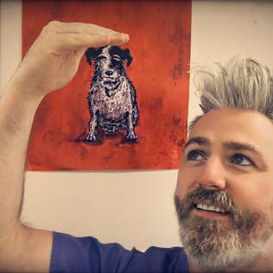
Overview:
  Me, me and me….
  Beginnings
  Middles
  Ends…?

Slide 3
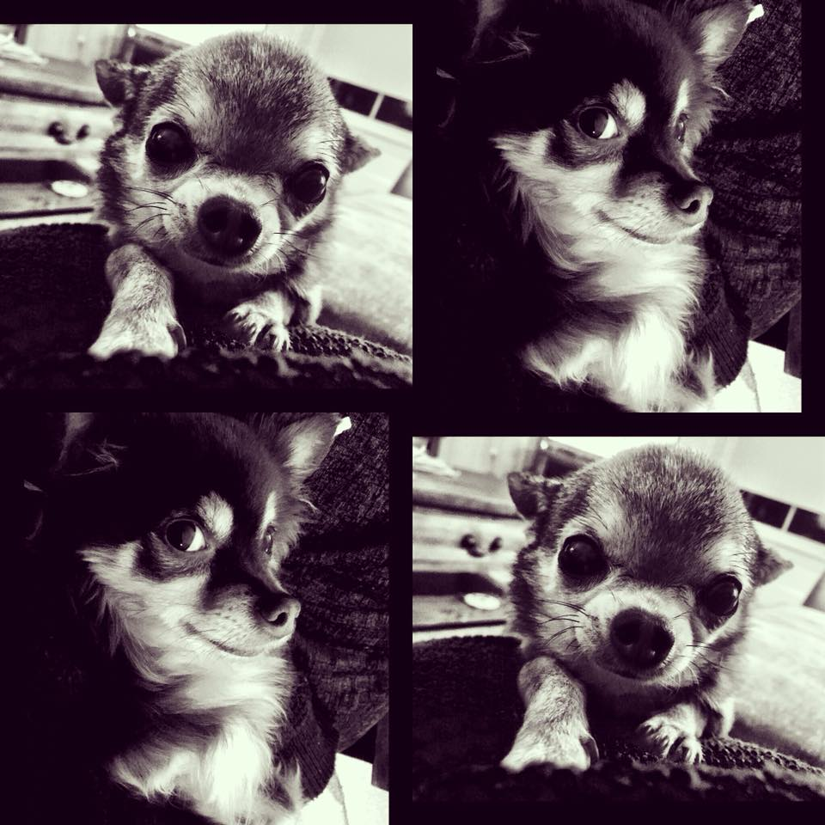
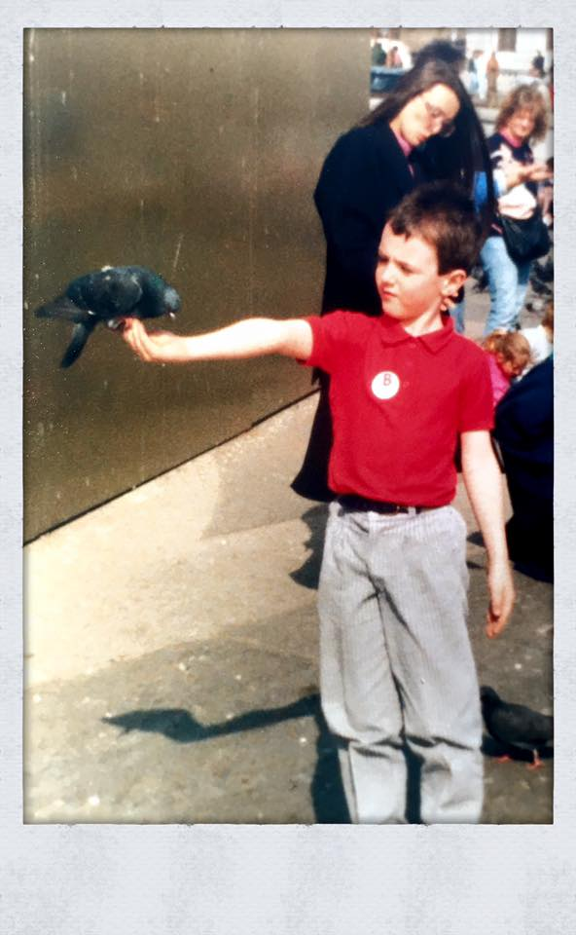
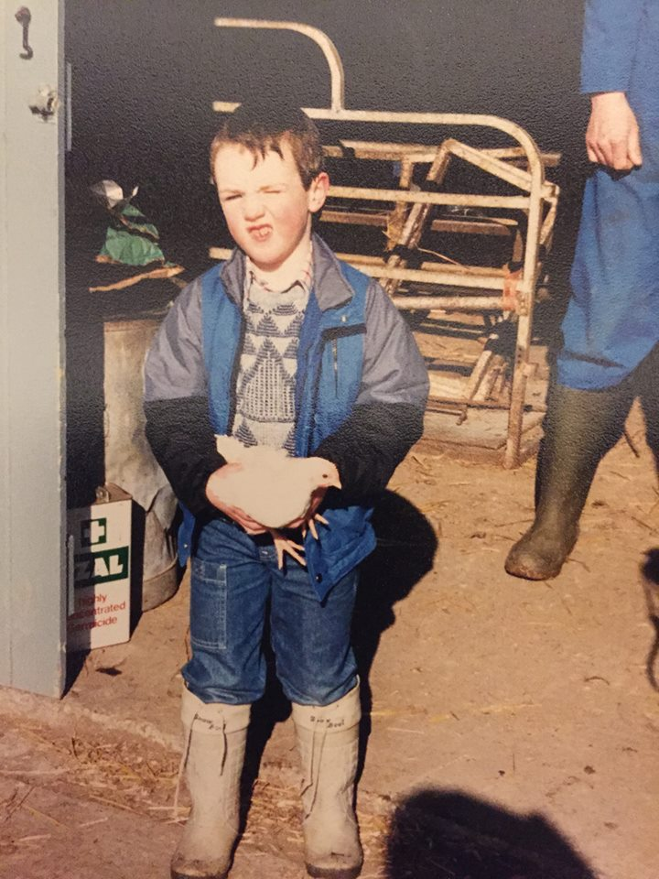
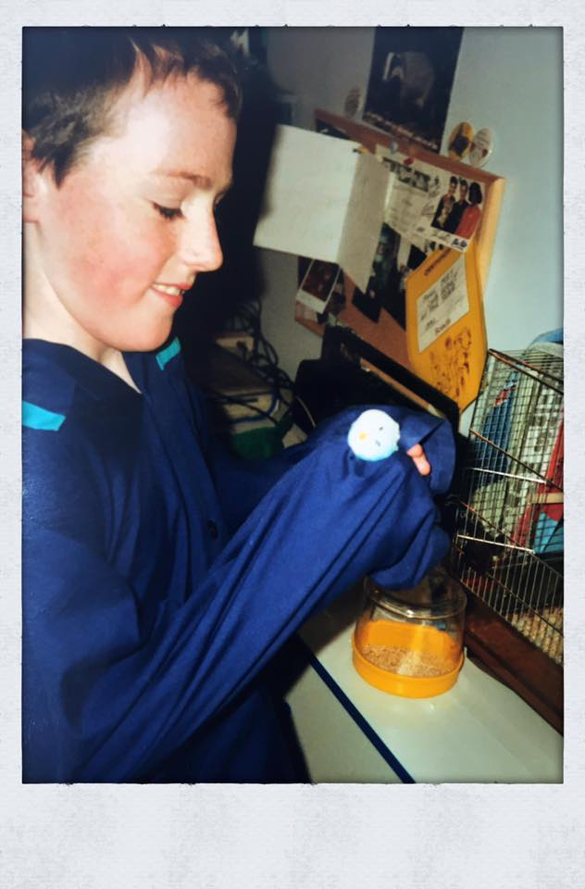
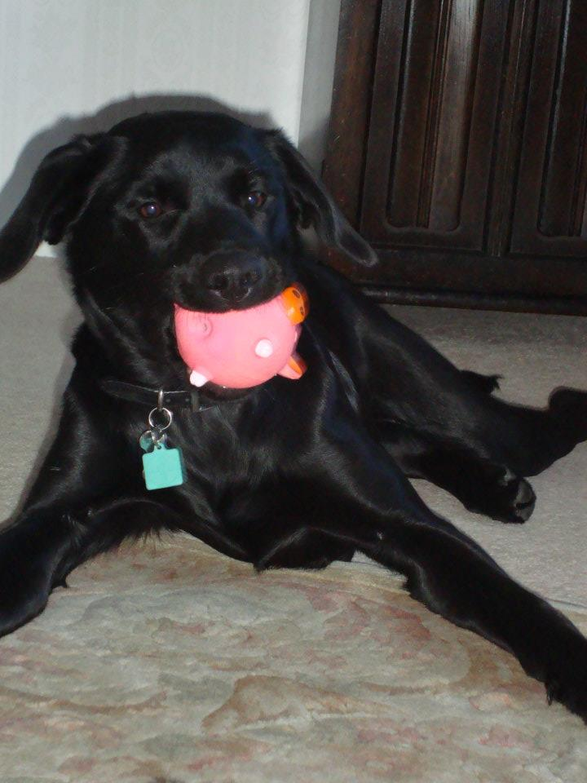
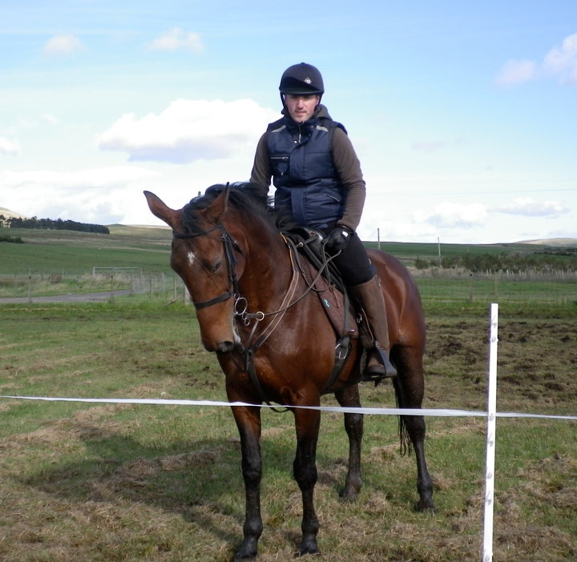
Beginnings:
- Animals
- Science
- Nature
- Animal Hospital
- Vets in Practice
- ‘Casper’ stung by a wasp!
- Saturday & Weekend Jobs

Slide 4
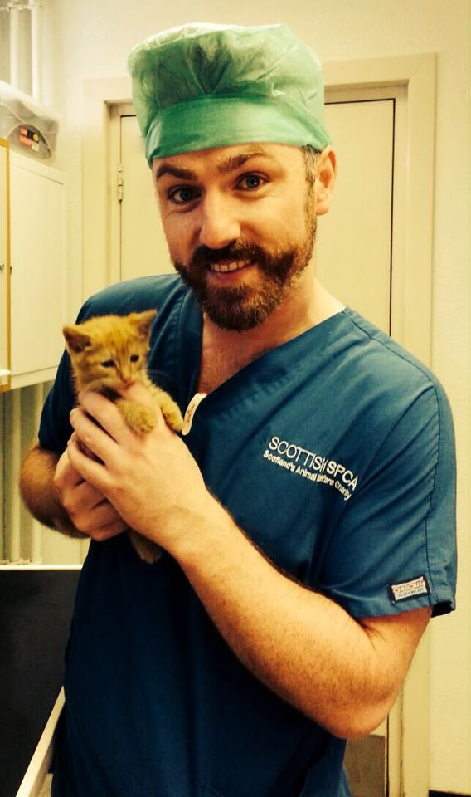
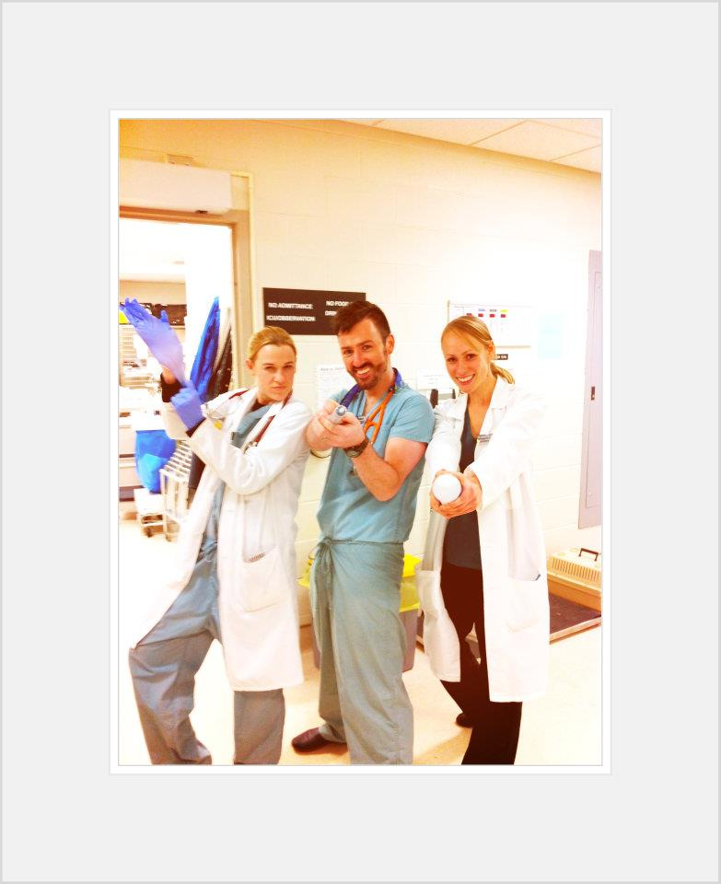
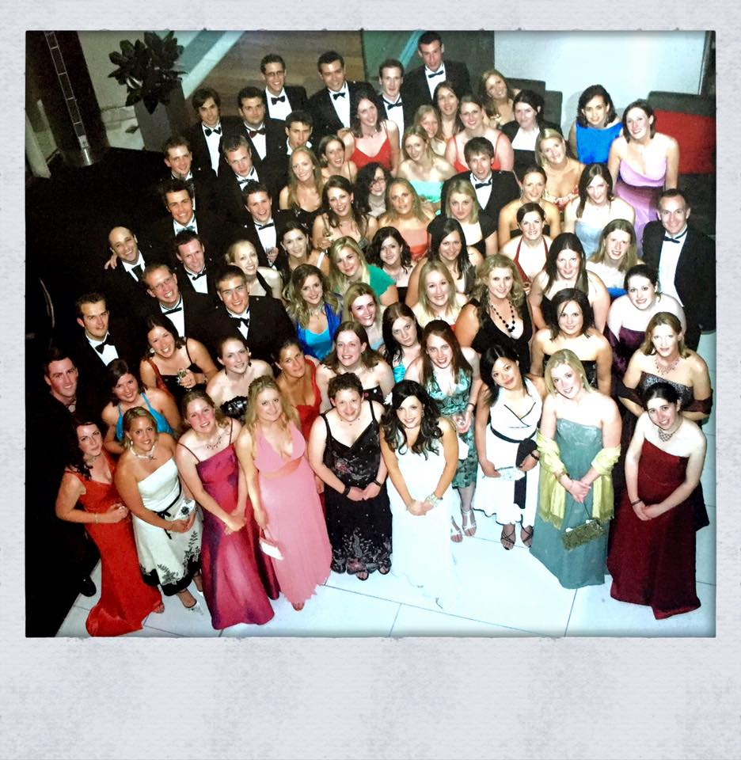
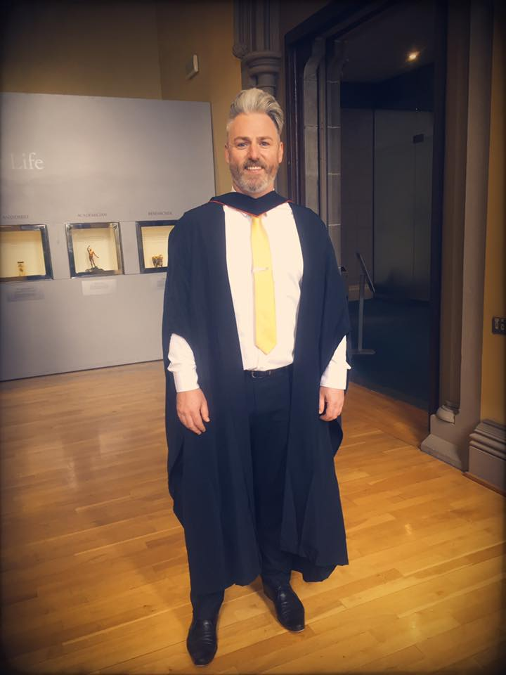
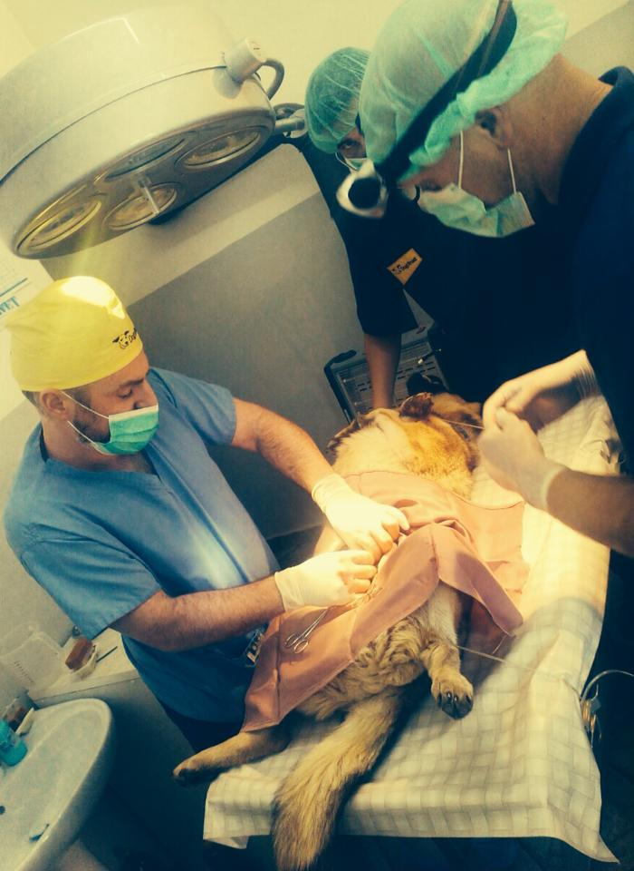

Middles:
GCSEs/Highers/CSYS
Interviews for Glasgow and Edinburgh Vet Schools
Chose Glasgow – AVMA Approved
Took 6 years to do the course – repeated 2nd year
Graduated July 2006
Years spent in practices all over the UK – 48 practices since graduating
Private, Charity, Voluntary, Locuming then Rotating 1 Year Internship
Identified a passion for teaching during Internship in 2012
Became Lecturer at Glasgow School of Veterinary Medicine in April 2016

Slide 5
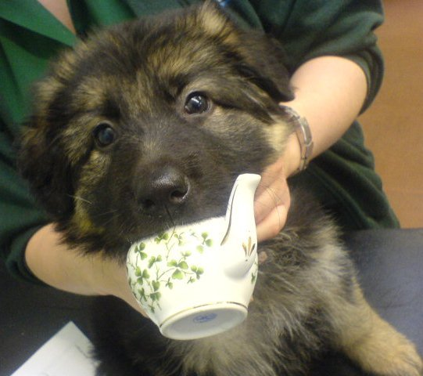
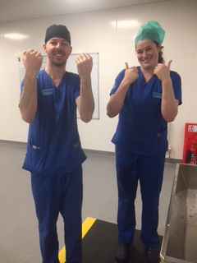
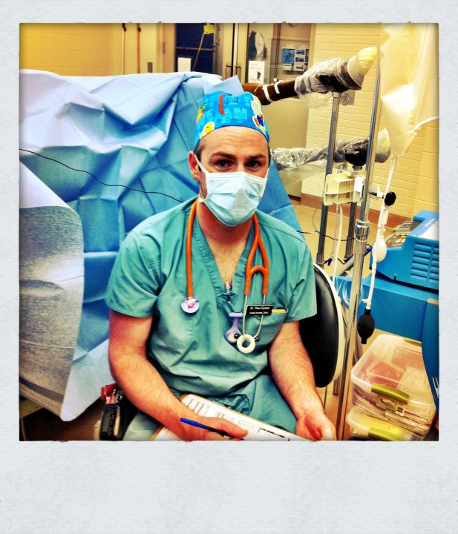
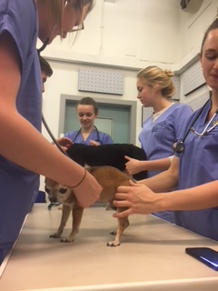
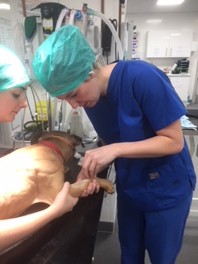
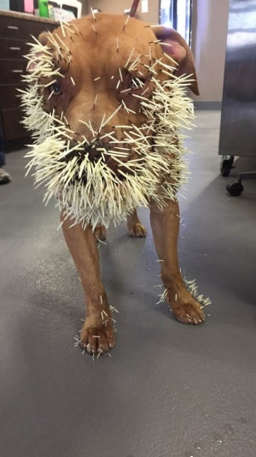
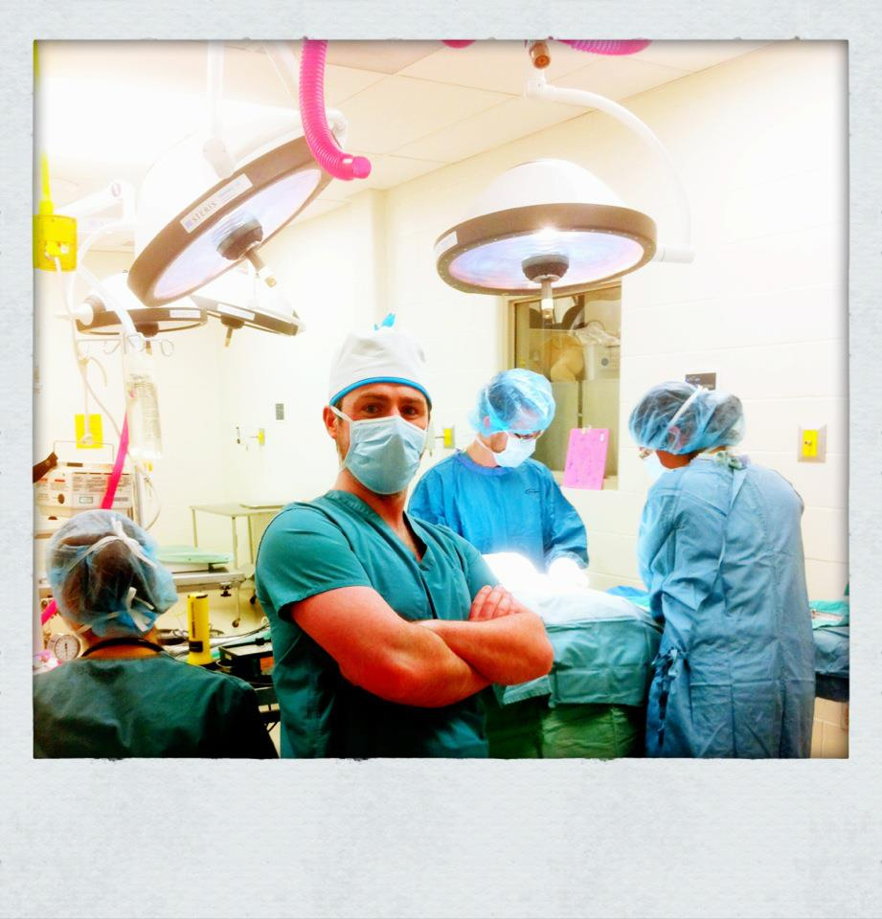
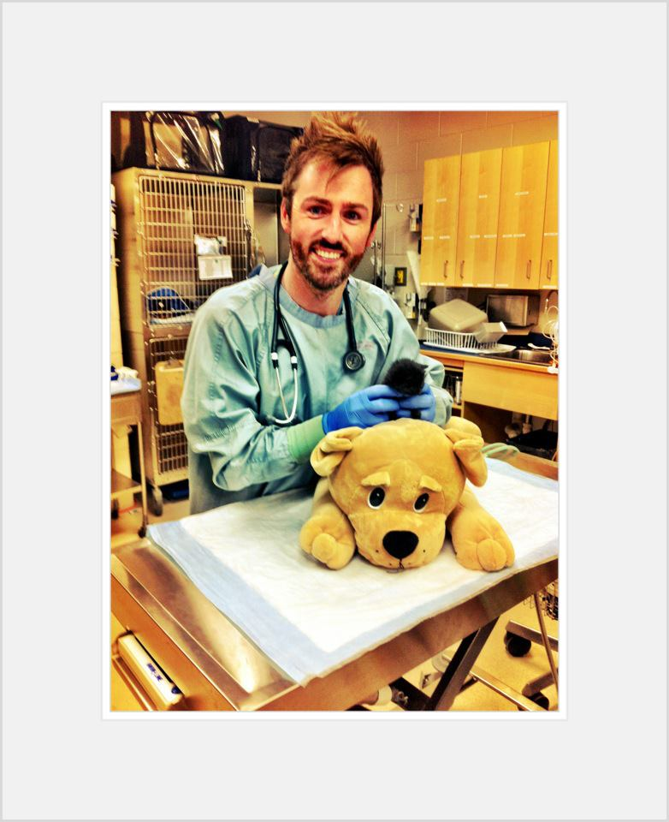
End(s):
Typical week:
  3 x mornings of surgery at SSPCA with BVMS 5
  Lectures
  Clinical & Practical Skills teaching to BVMS 1-4 – canine handling, placing an IV catheter, suturing and over 100+ other skills
  Pastoral and mentoring support – ALL students

Slide 6
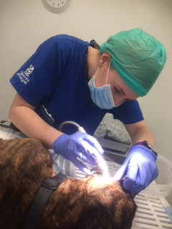
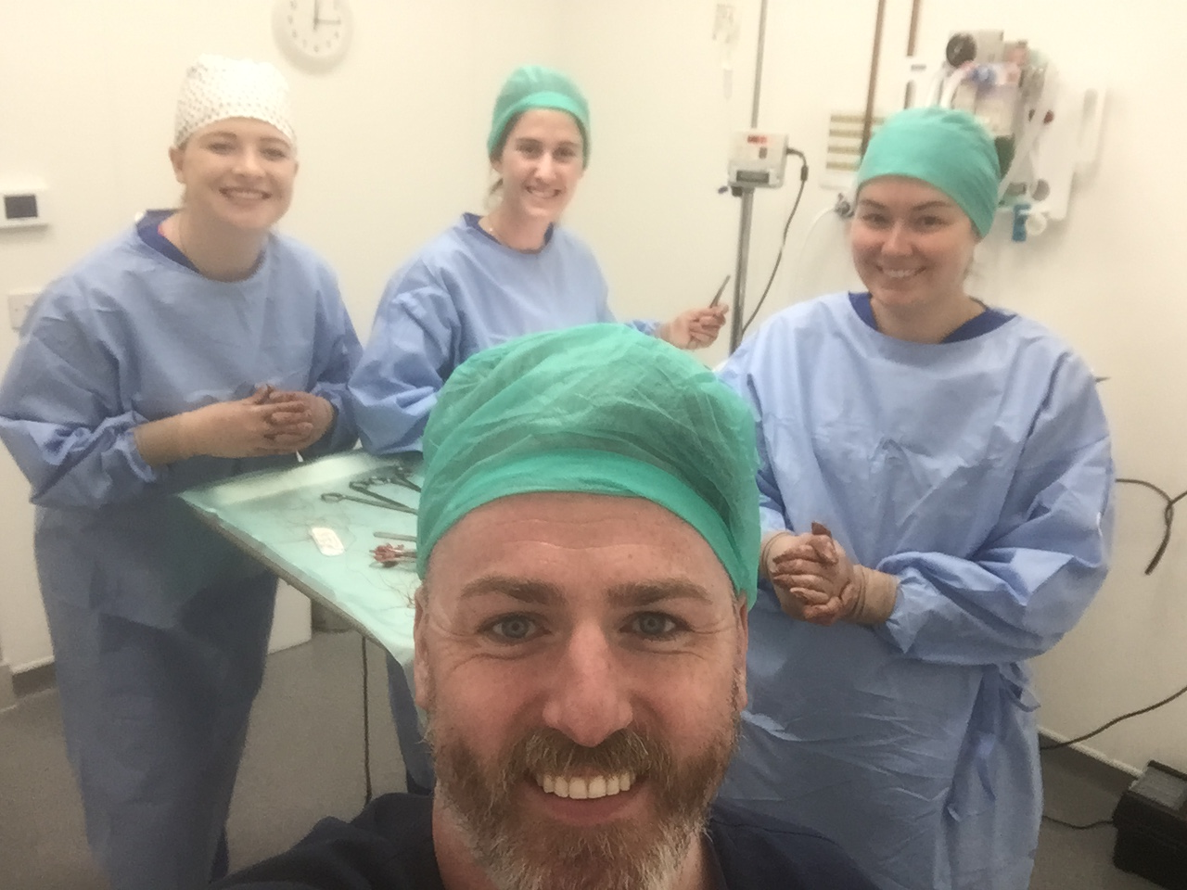
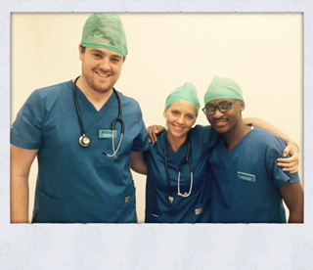
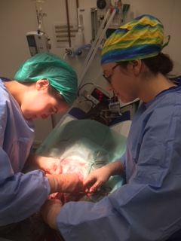
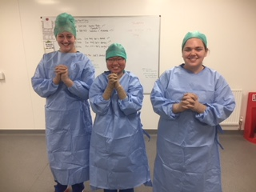
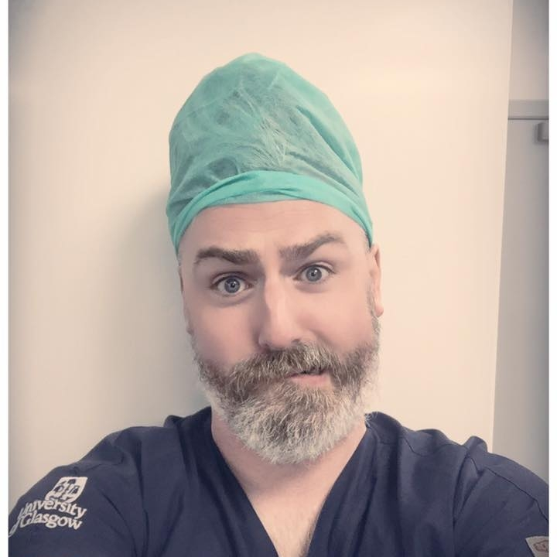
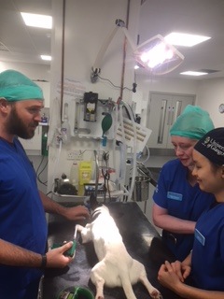

Slide 7
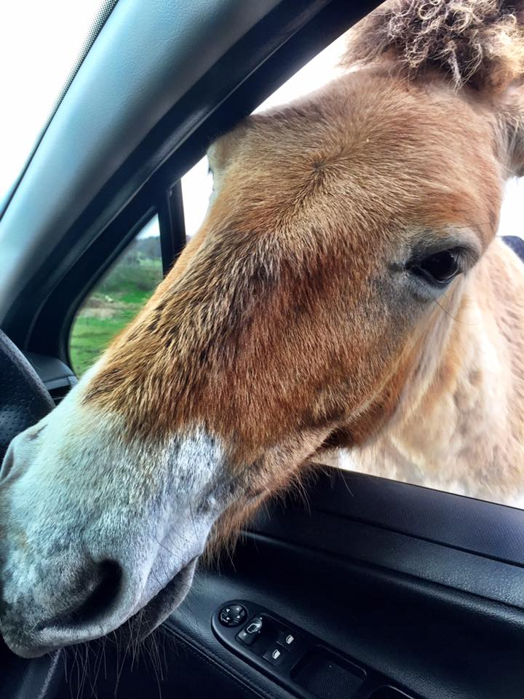
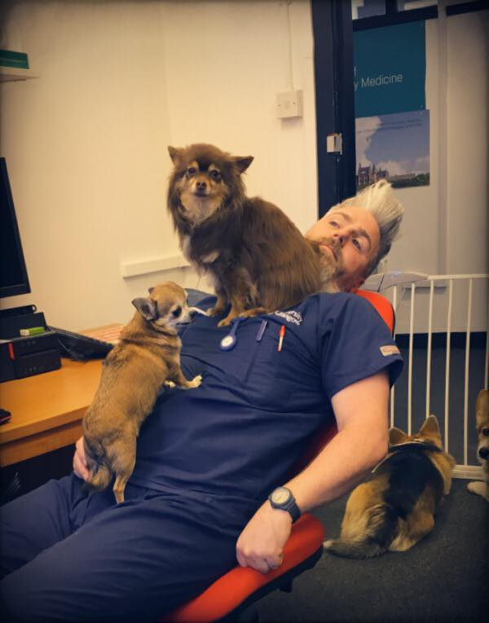
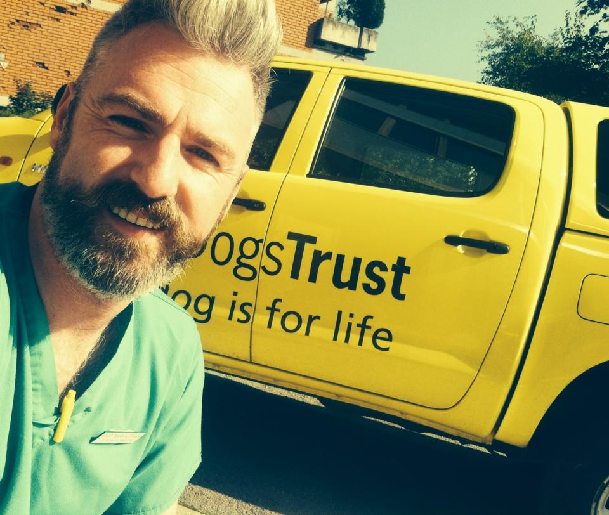
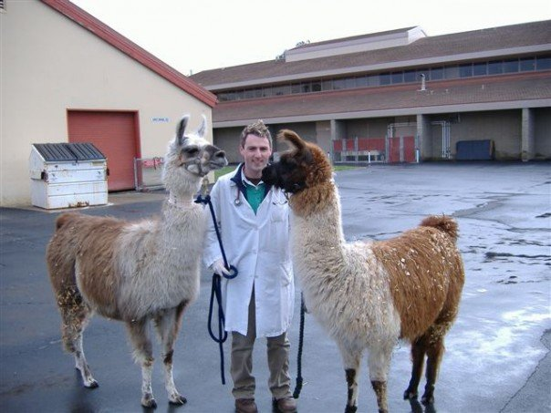
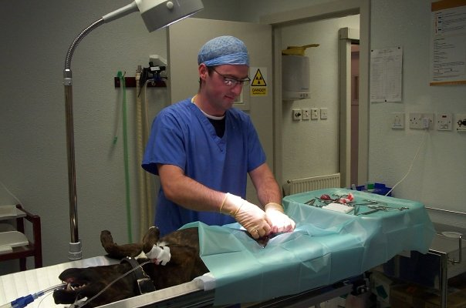
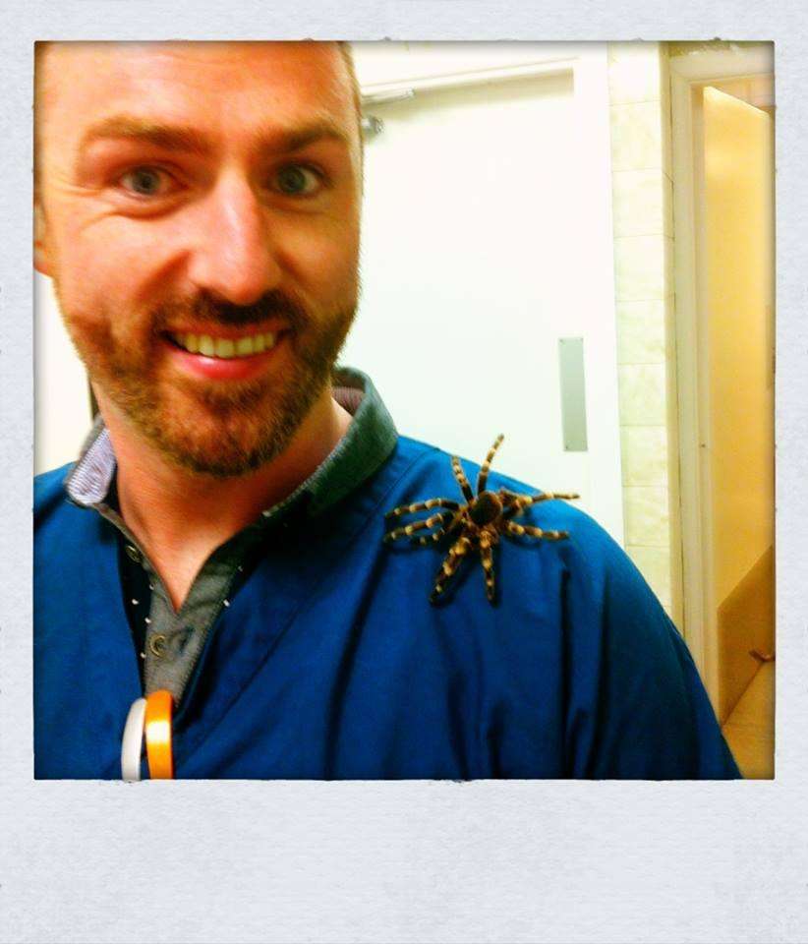
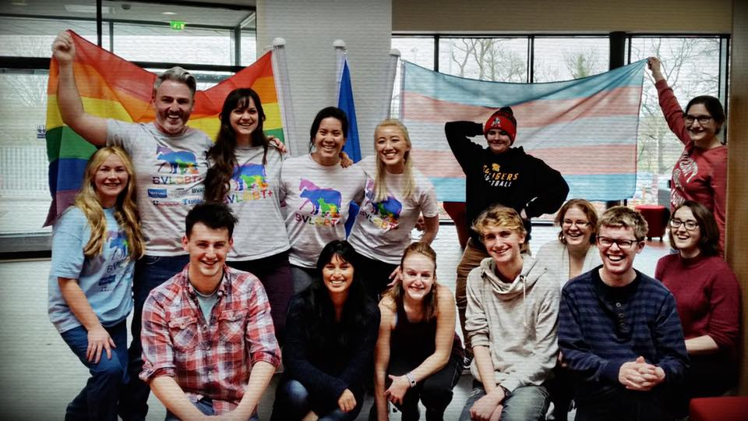
What Else To Do?
Sit on the admissions panel for the University - Interviews
Play an active part in Vet School LGBT+ Chapter
Deputy Chief Adviser on our Student Mentor Scheme
Plans to develop ‘in-practice’ Mentors for students throughout AND after Vet School
Volunteer in Bosnia at Vet School and in India teaching Surgery

Slide 8
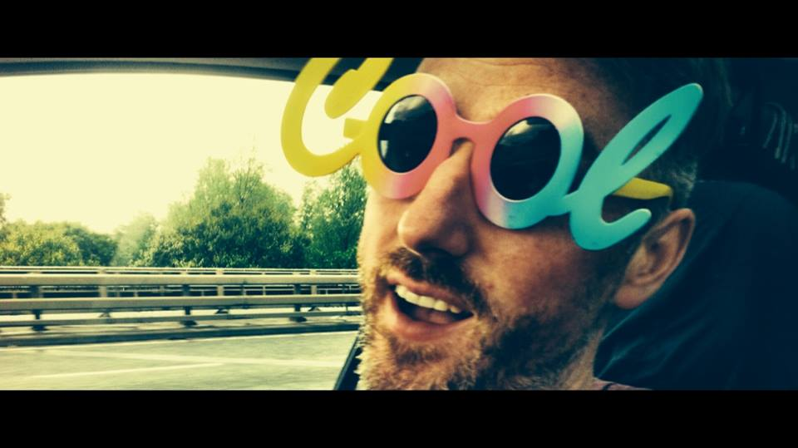
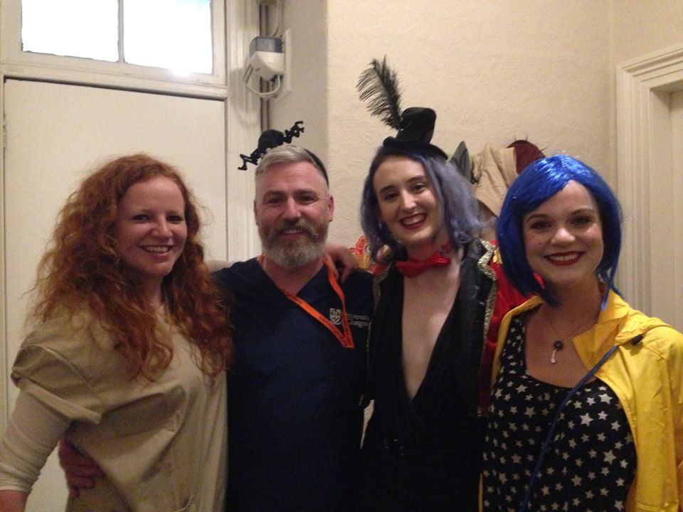
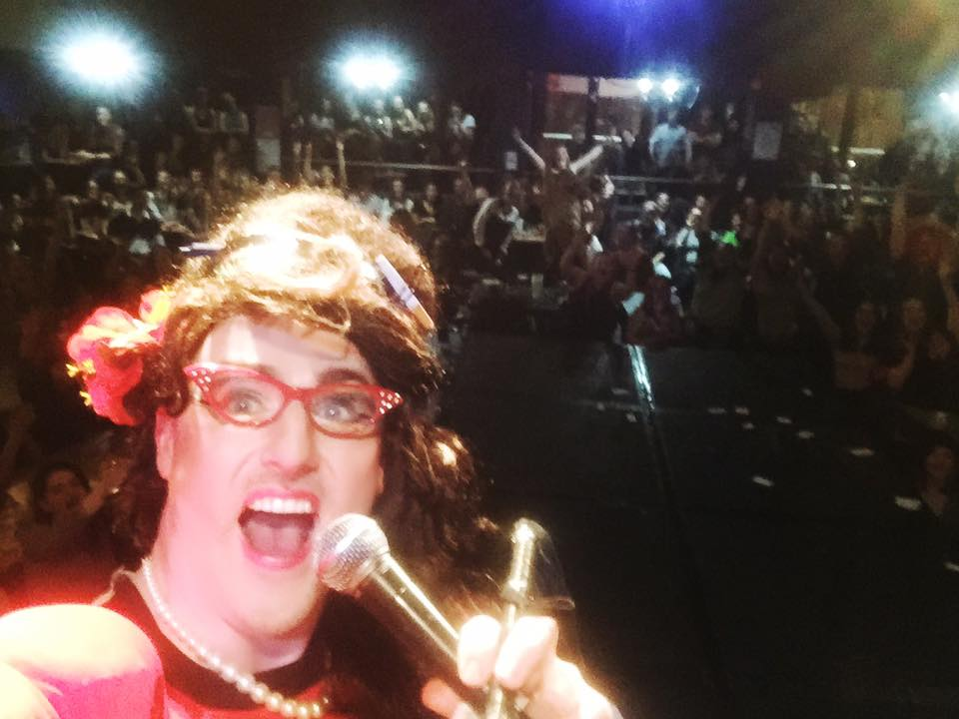
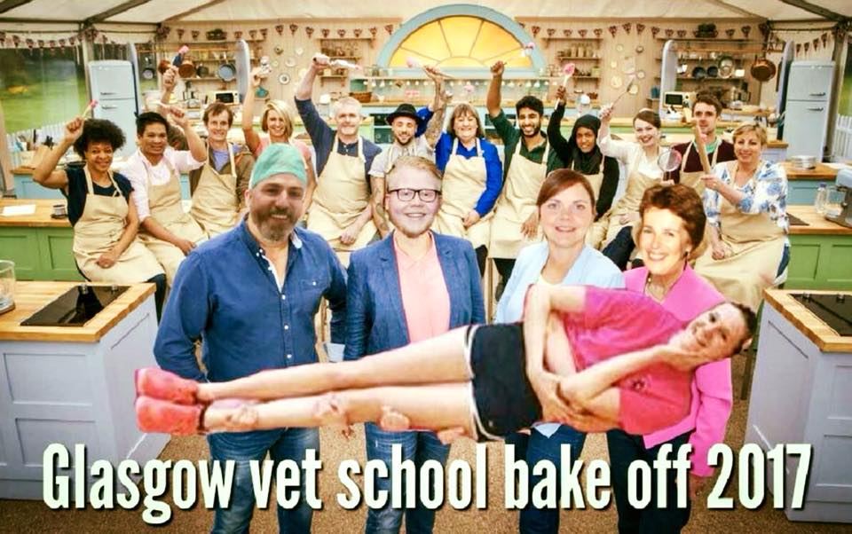
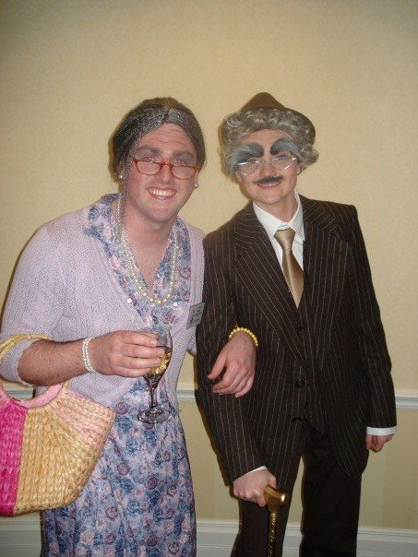
Why Teaching?
Non-traditional ‘Lectureship’
GP from practice into Academia – real life experience, older, still relevant…
Undertaking Postgraduate Certificate in Academic Practice – helps me to be a ‘better’ teacher
Why? What drives me? Where am I happiest?
Getting to know students
“Those that can’t ‘do’, teach…”

Slide 9
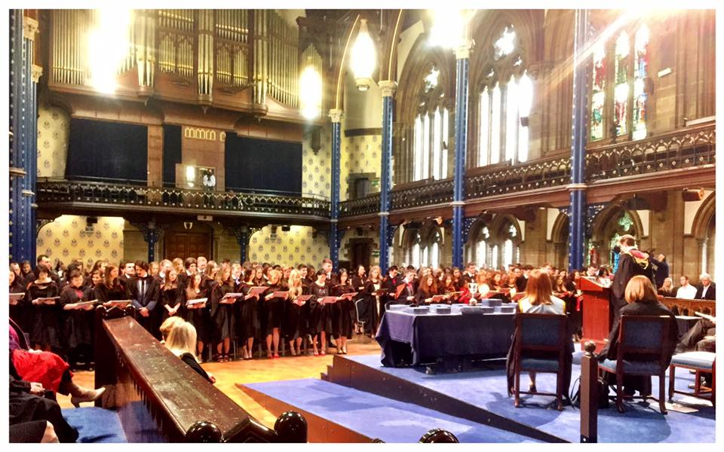
Do I Like My Job?
“After 10 years as a Vet out there, I get to share in the journey over and over again from getting into Vet School, working & playing hard throughout and graduating at the end as fully fledged baby Vets. From Paisley, into practice and full circle to becoming a Pedagogue (teacher). So when asked if I like my job, the answer is no… I don’t like it, I honestly LOVE it!”

Slide 10









Thanks for your time
If you have any questions, please email me: PaulAndrew.Eynon@glasgow.ac.uk
/glasgowuniversity
@UofGlasgow
Search: University of Glasgow
@UofGlasgow
UofGlasgow
#UofGWorldChangers

