Slide 1
Refugee Pupils in Scottish Schools: Integration in a Previously Monocultural School
Geri Smyth & Nathalie Sheridan
University of Strathclyde

Slide 2
Background
Schools and Social Capital network of AERS
Report on a secondary school in Glasgow
8 days in field
Observation
Interviewing teachers
Conversations with pupils
Extra curricular photography club

Slide 3
Main Issues
Actual Inclusivity of Inclusion Process
Change Impact
Who is Pro-active for Inclusion
Is there Reciprocity?
Who has Responsibility?
Notes:
Change Impact
How teacher have to teach
Creation of EAL unit
teacher not ready for structural change yet
no co-operation btw EAL & MSC
Who has responsibility
Headteacher disappearing influence on this?
Stress hiding behind narrow definition of role of teacher
Discipline as main issue???

Slide 4
The School
EAL Unit
Mainstream
School

Slide 5
The School
Secondary School in a socially deprived area
English as Additional Language Unit
Niche? For Refugee Children

Slide 6
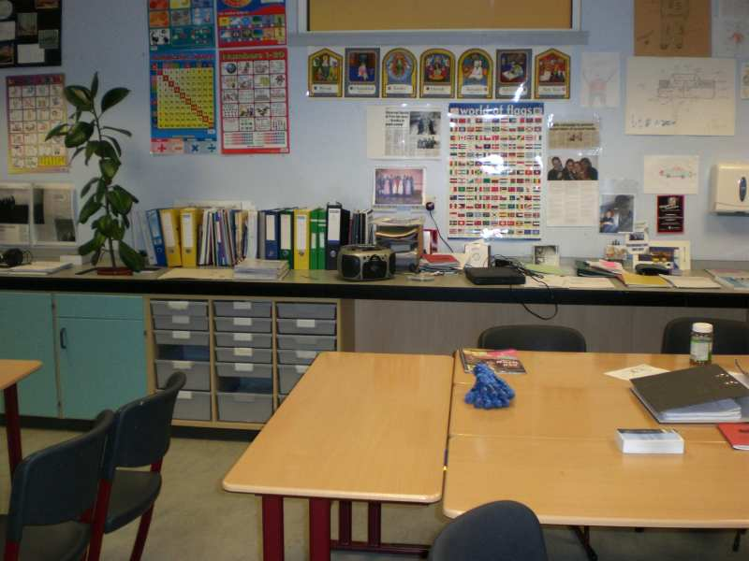

Slide 7
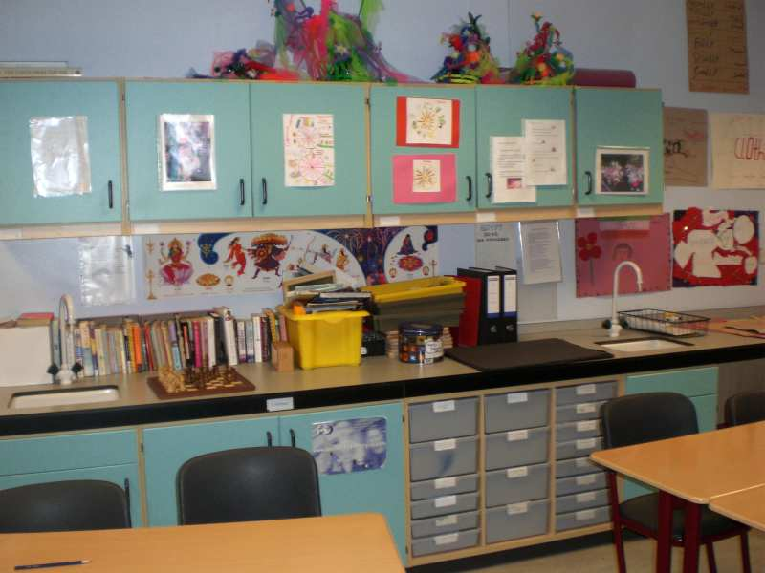

Slide 8
Classroom vs. School
Within EAL space
Within Mainstream space
In break area
Outreach only in one direction?
Integration as extra-curricular?

Slide 9
Change Impact
Awards
Awareness
Inclusion?
Notes:
Awards under old Headteacher
Raise awareness

Slide 10
Worlds Apart?
Time as Factor for Information
Selective Inclusion
Niches

