Slide 1
The Notion of Citizenship and Britishness
Henry Kum University of Strathclyde
Nathalie Sheridan University of Strathclyde

Slide 2
British citizenship
The forms of British nationality are:
British citizenship
British Overseas citizenship
British Overseas territories citizenship
British national (overseas)
British protected person
British subject

Slide 3
British citizenship: CONTEXT/LEGALITY
Jus Sanguinis: UK citizenship by Blood (race/language = Fatherland)
Jus Soli: UK citizenship by territory or related territory (soil factor). This will include a plane, birth in a plane, ship, train carrying the British flag.
De Jure: Citizenship determined by law. Persons who are not nationals of any state, either because at birth or subsequently they were not given any nationality, or because during their lifetime they lost their own nationality and did not acquire a new one.

Slide 4
De facto: citizenship enforced by contract (fact): Persons who, having left the country of which they were nationals, no longer enjoy the protection and assiatnace of their national authorities, either because these authorities refuse to grant them assistance and protection, or because they themselves renounce the assistance of the protection of which they are nationals.
Jus domicili: right of citizenship through continuous residence.

Slide 5
CHILDREN
Adopted child must be in a UK court (after 1983) and within UN conventional procedures: before 18 years of age and one of the adopting parent must be British.
Children born outside UK to British citizen on or after 1983 have automatic citizenship rights.
Only one parent needs to be British but not by descent.

Slide 6
CONTEXT OF CAMEROON
Jus Soli and de facto
Dual nationality (see attached sheet)
Sub national citizenship and supranational citizenship
Nationality, citizenship and effective citizenship

Slide 7
An unmarried father cannot pass British citizenship automatically to his child born before July 2006.
If parent of child is by descent child can gain citizenship if parent had lived in the UK for 3 years and child is not more than 12.

Slide 8
Britishness National Identity and Citizenship

Slide 9
Patchwork Identities
Britishness means different things to different people.
There are many ingredients to national identities
Notes:
Before talking about these ingredients I would like to introduce
A concept of Identities

Slide 10
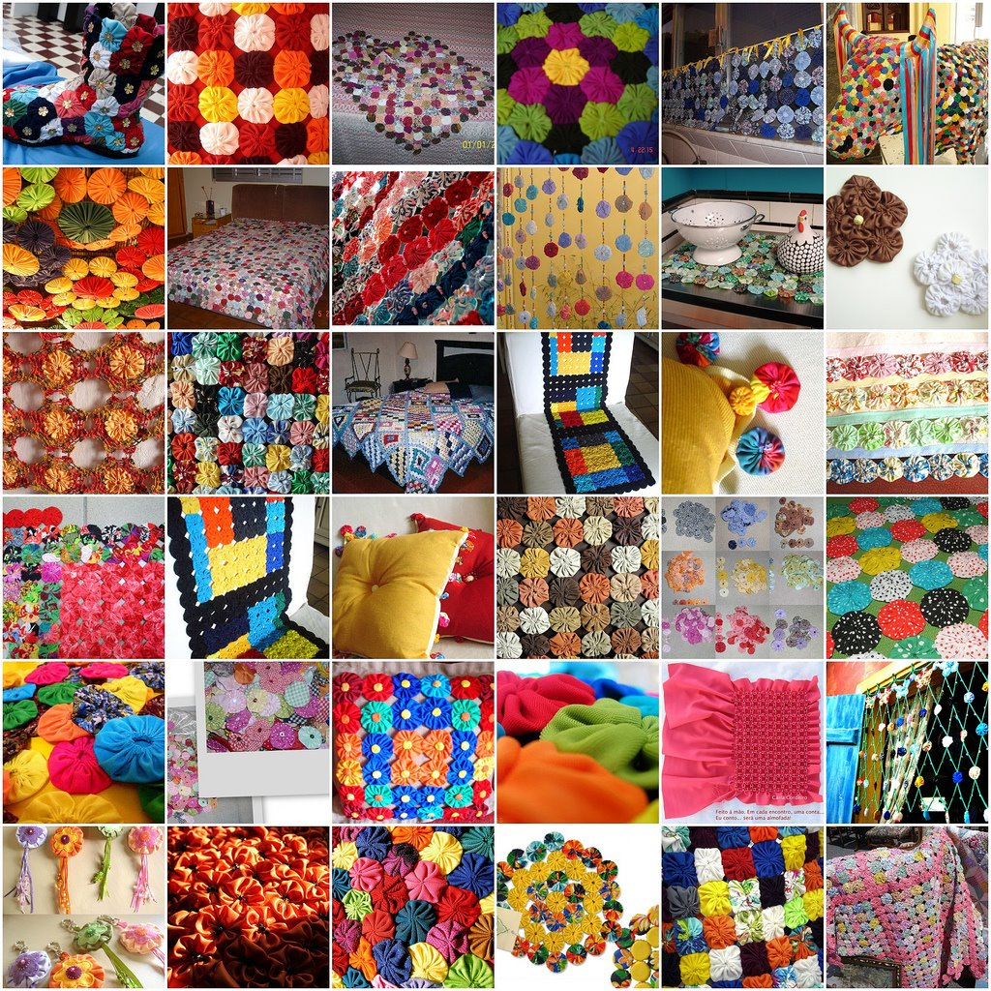
Notes:
Based on roles
Divers
Belonging to different social networks or groups

Slide 11
Brother in Law
Sister
Mother
Wife
Grandchild
Teacher
Brother
Student
Granny
Uncle
Daughter
Friend
Nephew
Son
Cousin
Niece
Aunt
Sister in Law
Father
Colleague
Notes:
Based on roles
Character – Roles can be contradicting
Divers
Belonging to different social networks or groups

Slide 12
History of Stories
Strive for life coherence
Combine Roles
Character
Personal History
With New National Identity
With Britishness

Slide 13
Languages: English, Scots, Welsh, Gaelic
Holl amrantau'r sêr ddywedant,
Ar hyd y nos,
'Dyma'r ffordd i fro gogoniant,
Ar hyd y nos.
John Ceiriog Hughes
An i Seo a' bhliadhna
a leaghas na bodaich-shneachda
ann am pòg mhilis an
t-samhraidh,
Iain Moireach
All women become like their mothers.
That is their tragedy. No man does. That's his.
Oscar Wilde
Britishness - National Consciousness
Swelter'd venom sleeping got, Boil thou first i' the charmed pot! Double, double toil and trouble; Fire burn, and caldron bubble.
W. Shakespeare
Wee, sleekit, cow'rin, tim'rous beastie,
O, what a panic's in thy breastie!
Thou need na start awa sae hasty,
Wi' bickering brattle!
Robert Burns
Notes:
Ingredients to National Identities:
National Heroes – imagined Past
or the image its citizens have of their country
History of Stories

Slide 14
110 languages spoken in Glasgow (2008)
Identities = Reciprocal
Impact on Britishness
Britishness - shared cultural matrix

Slide 15
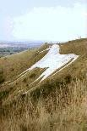
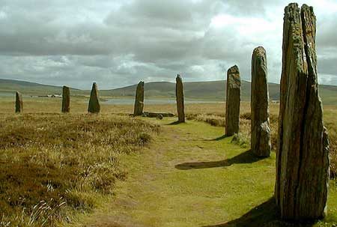
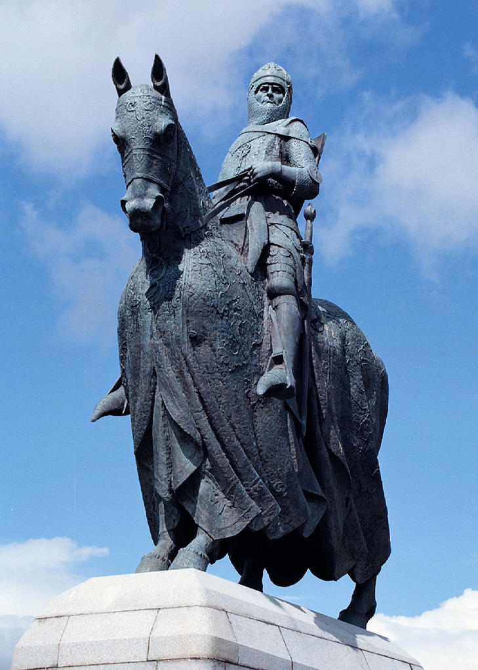
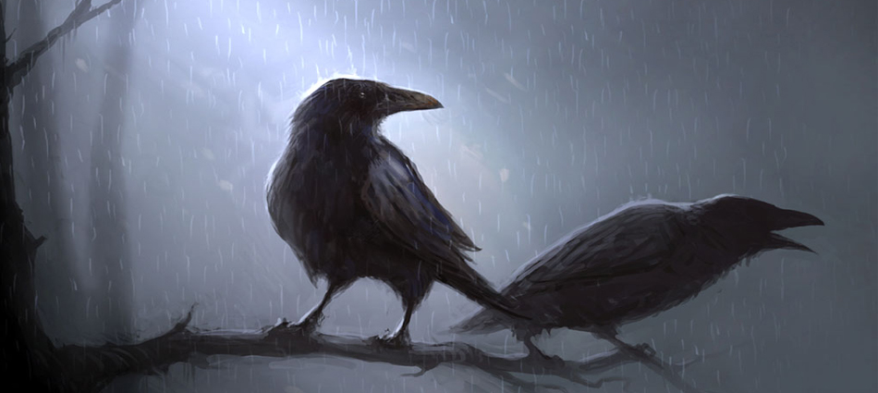
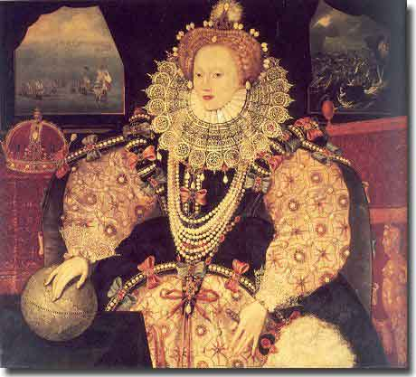
Memory, History
National Myth, Symbols, National Heroes
Notes:
Robert the Bruce
http://ghosts-hauntings.com/wp-content/themes/modularity-lite/images/slideshow/image5.jpg ghost stories

Slide 16
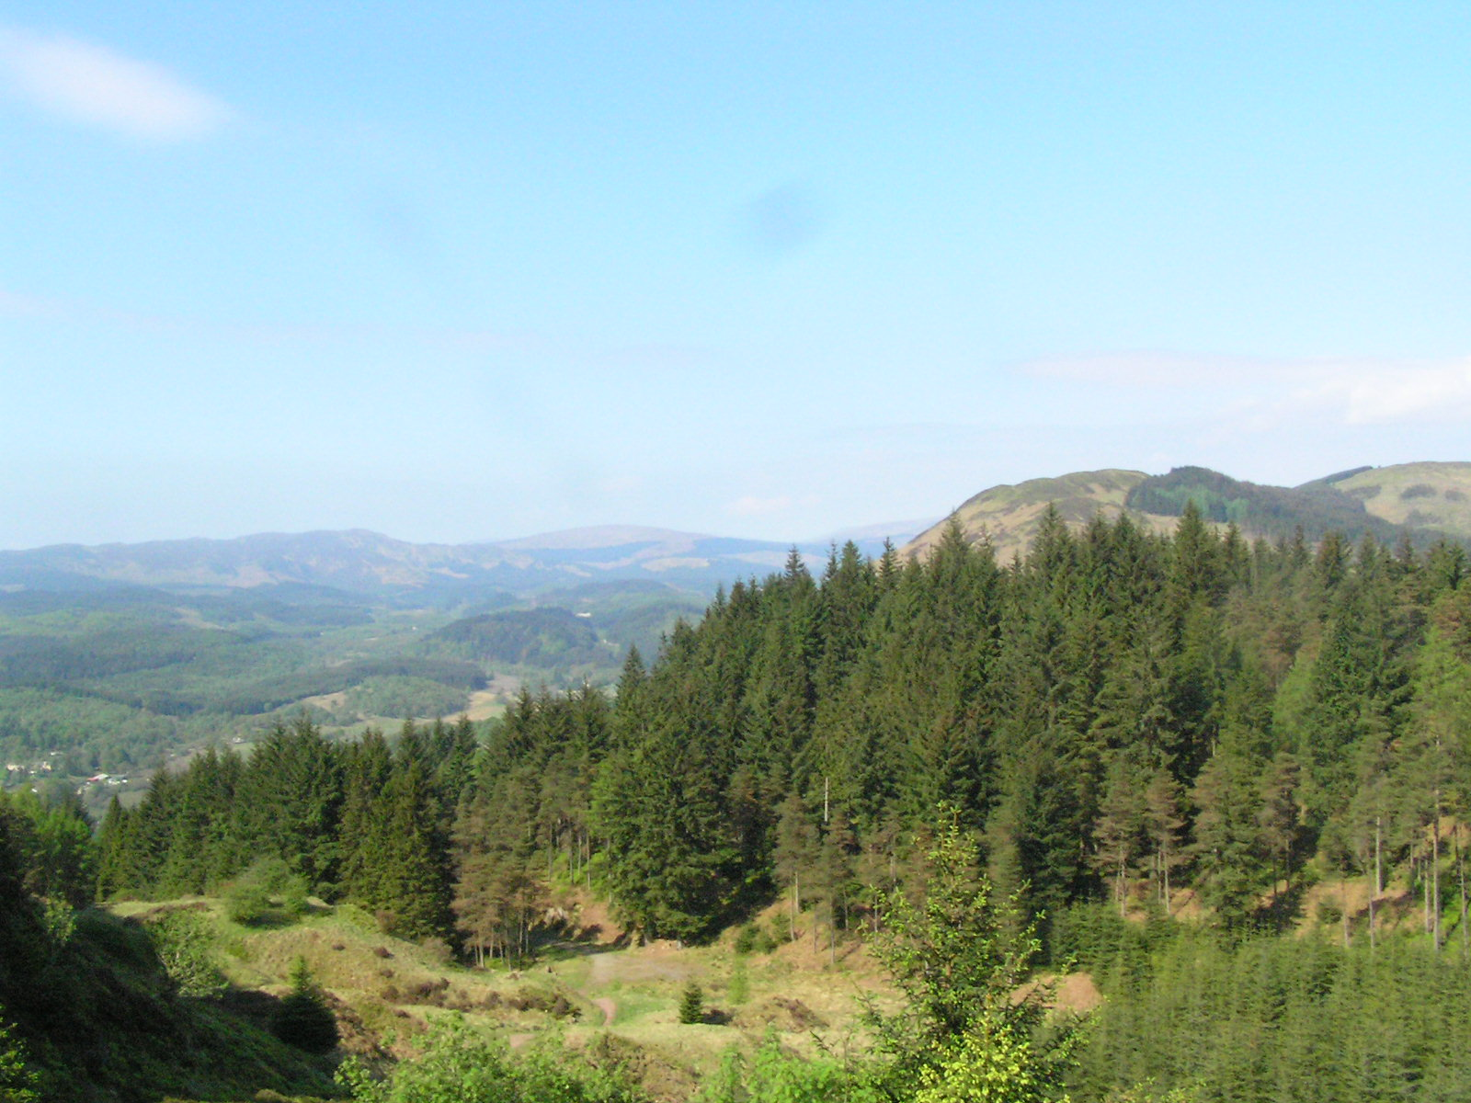
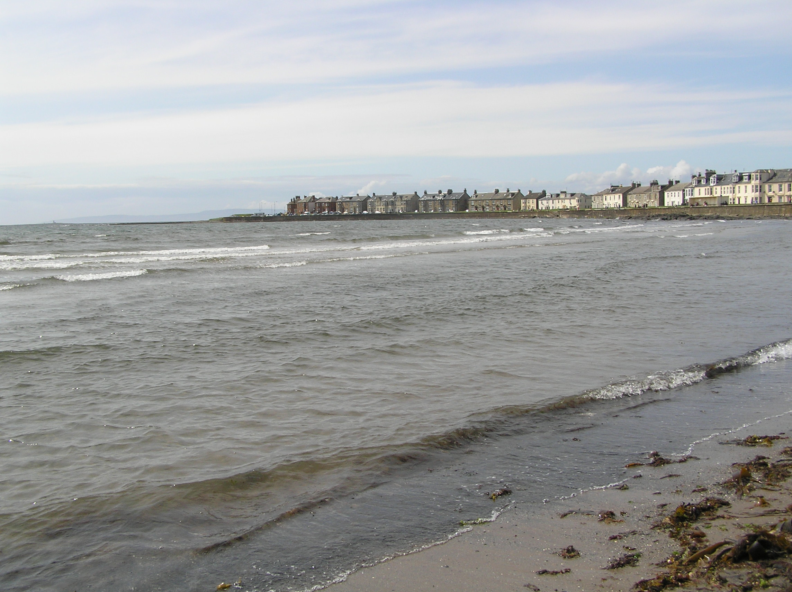
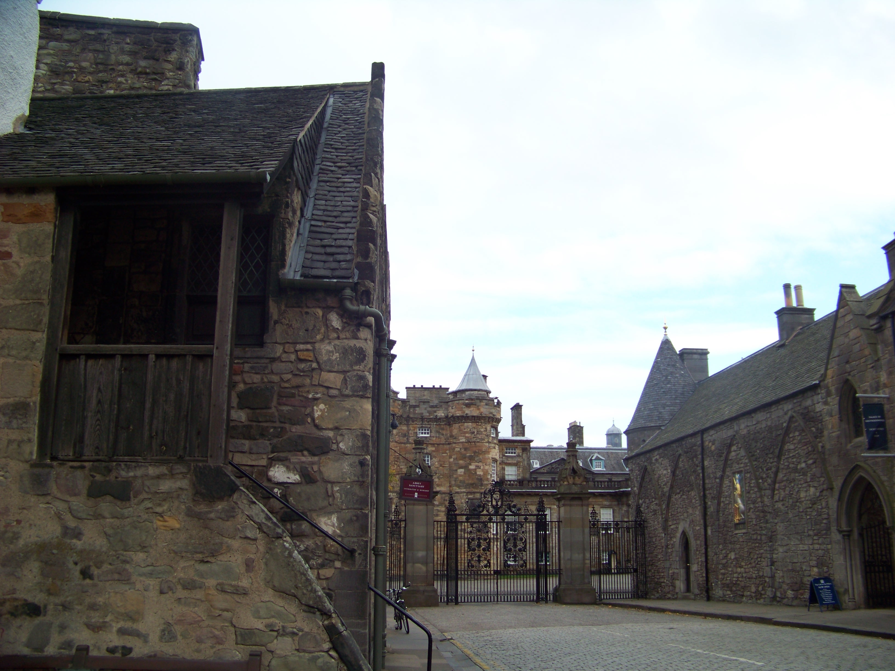
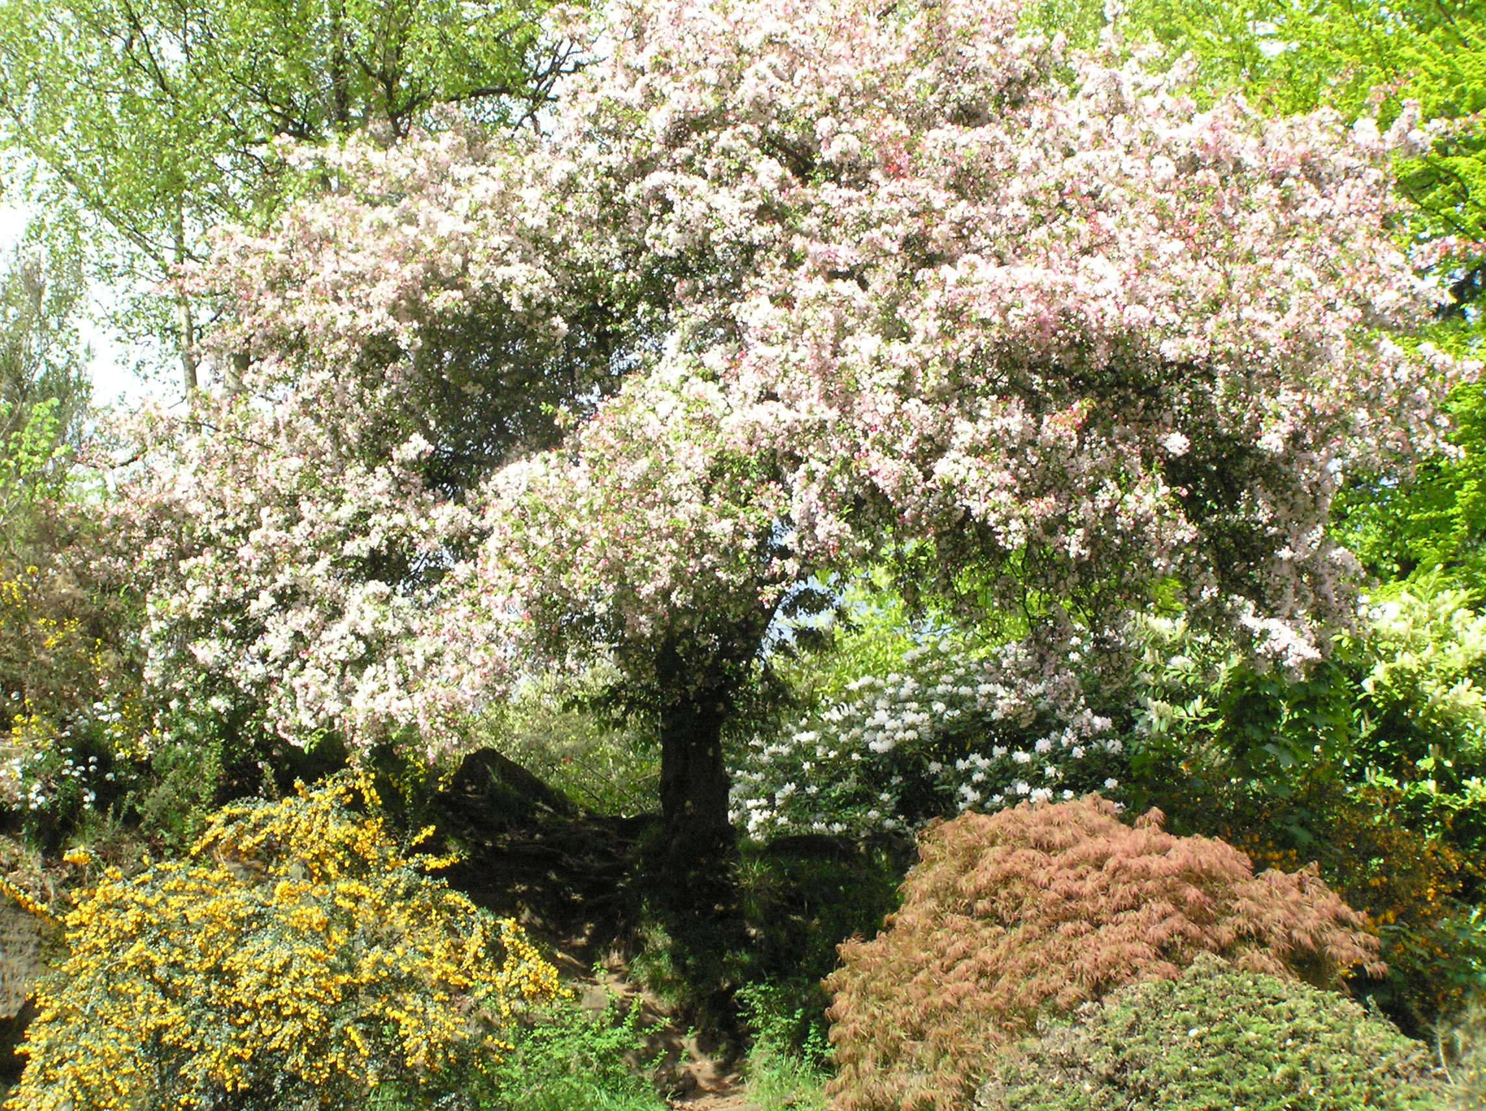
Land, Territory, Hills Valleys, Streams and Mountains

Slide 17
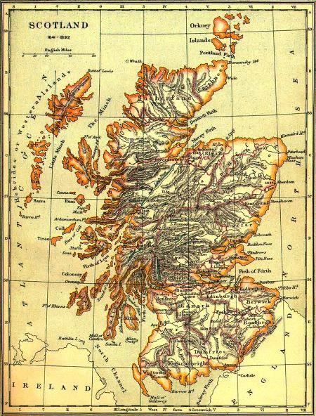
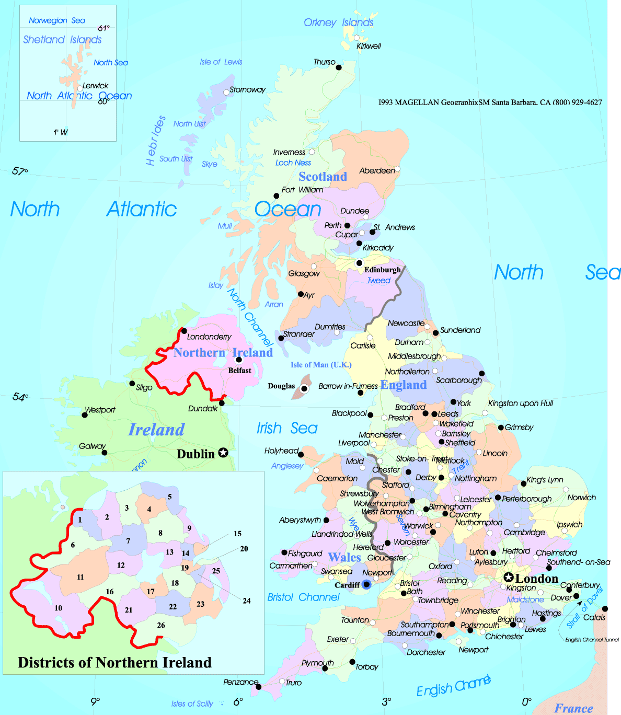
BORDERS – Drawing Maps is Political
Notes:
Borders may change

Slide 18
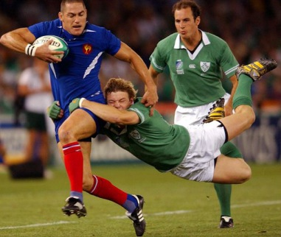
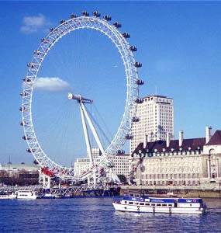
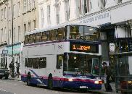
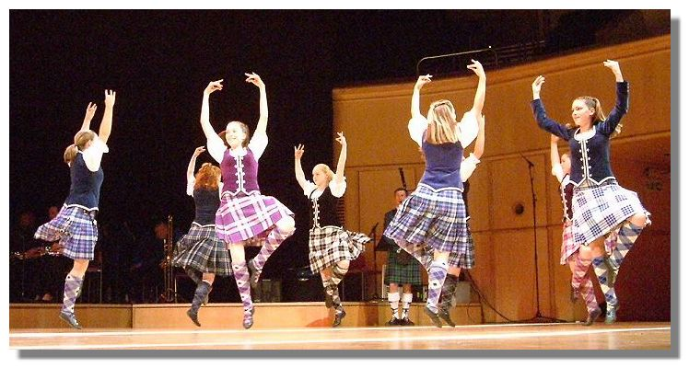
Everyday Practices
Performance of National Identity
Dance, Flags, Sport, Media, Money, Monarchy, Songs, Phrases etc
Notes:
Reliance on Victorian Age influence speech patterns, housing, behaviour …

Slide 19
Summary
Citizenship a Political Construct by Power Holders
National Identity a Subjective Experience
Discussion
Notes:
Britain is a society grappling with the complex social, cultural and political realities of becoming multicultural community. Ethnic and racial diversities living in the UK have reproduced and reconstructed themselves, constructing not a single ethnic identity but hybrid ethno-national, ethno-local and ethno-national, ethno-local and ethno- transnational boundaries of social identity, as a result of migrants’ community experience and other established boundaries of social identity such as social class position, gender, and ageˆ
Multiculturalism is not one doctrine, but a range of strategies, politics, and ideas of incorporation and governing ethnic differences and cultural diversities within one nation state .

