Slide 1
There is more to it than Disadvantage
Dr Nathalie Sheridan (Tasler)
University of Strathclyde

Slide 2
Research Background
Secondary School Glasgow
Socio-economic disadvantaged
Bilingual and Monolingual participants
Research Period Nov 2007-May 2009
Participant Photography
Observation
Fieldnotes
Conversations
Research Spaces
EAL Unit
English Mainstream Classroom
Maths Mainstream Classroom

Slide 3
Research Questions
Which creative learning strategies, can refugee children access, and how are these strategies helping to support their scholarly development and inclusion?
What role is social capital playing in school context, particularly with the emphasis on support and inclusion?
In context of learning and teaching does social capital influence identity constructions and understanding of the refugee learners?

Slide 4
Pre-conception before Fieldwork
Refugee children are more disadvantaged than monolingual children
Turned Into:
Unless the the monolingual children come from socially deprived areas
It is not THAT straight forward

Slide 5
The School & Area
EAL Unit
Mainstream
School

Slide 6
Teacher Voices
‘nothing but soggy grassland’ (Teacher Interview, 19th May 2009)
majority of the pupils coming from families who in: ‘second or third generation never held their own decent paid job’ (Teacher Interview, 19th May 2009)
There are people in this community who have aspirations and good parental involvement, but the rest is left to slowly rot.’ (Teacher Interview, 19th May 2009)

Slide 7
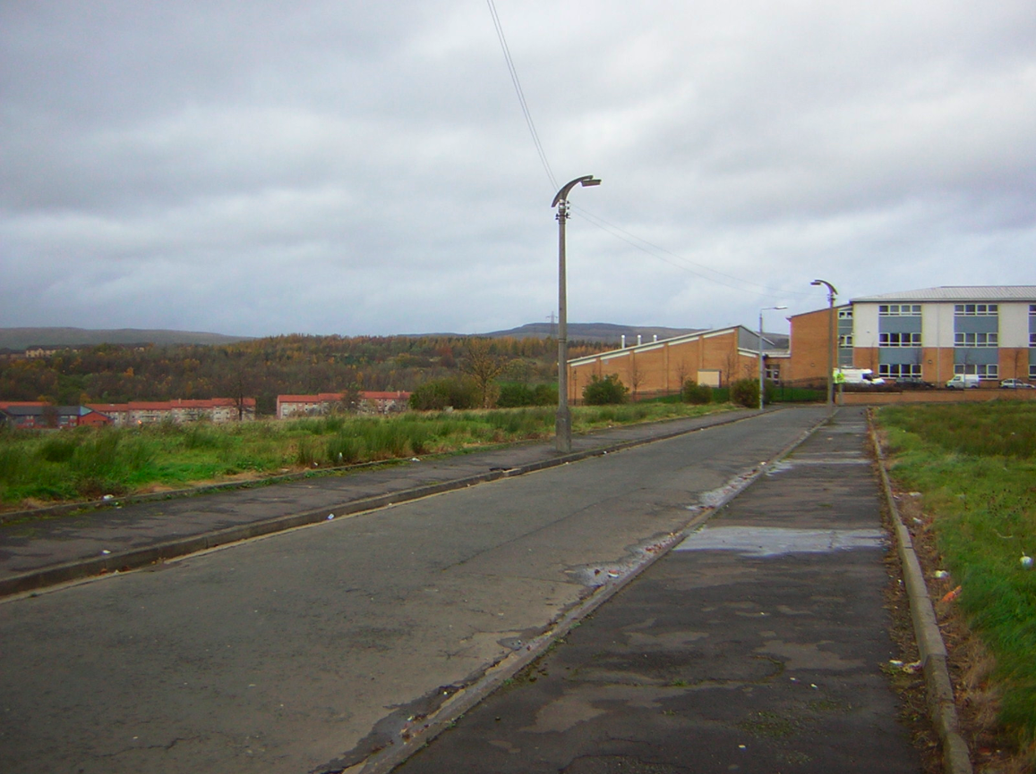

Slide 8
The Mainstream Classrooms
Researcher: ‘What are you doing in school?’
Pupils: … ‘sleeping’ … ‘copying’ …
Researcher: ‘Do you have a clue why you are not learning?’
Pupils: … ‘cos the teachers don’t know anything’ …
Gulliver …’ the teacher don’t know if you learn or do something or not they don’t know’ … [other pupil] ‘well some teacher do’ … ‘They don’t actually care if you learn or not.’ … ‘They don’t teach you man!’ [Grant?] … ‘They just want to get paid …’ (Group Discussion Maths Class, 16th May 2008)

Slide 9
Teacher Voice
Red Flash: ‘What is strange with a lot of the children here you are teaching reading, writing and arithmetic they are sometimes distrustful in a weird way … they accept it is important you need to learn reading, if you receive a bill or something through the post you need to know clearly understand what you are reading … even if you try to give instances … they are mistrustful.’

Slide 10
Teacher Voice
Mr Gee: ‘Education—education is middle class and is completely distrusted by working class … because the value system is not shared—so education has become an enemy rather then an aid to freedom.’ (Teacher Interview, 19th May 2009)

Slide 11
EAL Unit
‘They don’t moan at you a lot’ … ‘Yeah and some teachers communicate with the pupils’ … ‘Yeah’ … ‘Yeah they are friends they don’t treat different people’ … ‘and some of them listen to you’ … (Group Discussion EAL Unit, 3rd March 2009)
‘They teach you differently.’ ‘Yeah, they have different teaching [hesitates] sils.’ ‘Styles! It’s Scottish man!‘

Slide 12
Worlds Apart?
Teachers as friends
Some bully but you can do something about it
School is good
Teachers don’t care
They just want to get money
School is for meeting friends

Slide 13
Worlds Apart?
You need an education
To get a good job
BUT
Relationship between School & Good Job unclear
Victim Role Versus Pro-active Approach

Slide 14
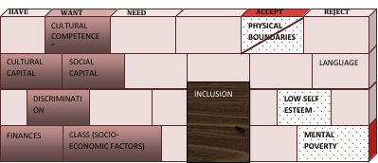
Obstacles—The Same Difference?
It’s all about the strategies and attitudes

