Slide 1
Glasgow Caledonian University
Providing inclusive learning development: one learning development centre’s use of demographic data to support specific groups of learners

Slide 2
Outcome agreements
‘Outcomes based approach to funding’ 2012-2015 (SFC, 2012)
‘Access for people from the widest possible range of backgrounds’
Individual institutions have specific targets
Notes:
based on demographics, retention etc. Many mention increasing SIMD20/40 students.
‘Access for people from the widest possible range of backgrounds’
Although SIMD 20/40 was the measure the Funding Council elected to use, HEIs were encouraged to include any other measure, or set of measures, for deprivation that they felt would demonstrate their success in improving access.
Outcome agreements set out what Universities/colleges plan to do in return for funding.
8 Main areas including widening participation, high quality learning, the right learning in the right place, research etc. Each institution must outline how it will meet those outcomes. The
How this is done is extremely varied.
Post 16 reform?

Slide 3
Background
MD20/40
Scottish Index Of Multiple Deprivation
38 indicators under the groupings
income,
employment,
health,
education,
skills and training, housing,
geographic access and
crime.
Notes:
Information used to target policy and funding
The SIMD is a system by which the Scottish Government splits the country into ‘datazones’ and ranks the level on deprivation in the area based on a comparison of 38 indicators with 7 main domains income, employment, health, education, skills and training, housing, geographic access and crime. Educaton, skills and training is 1 grouping on its own and consists of indicators such as ‘school pupil absences’ to ‘17-21 year olds enrolling into full time higher education’
This information is used to target policy and funding in specific areas.
The datazones are ranked 1 to 6505 (with 1 being the most deprived and 6505 the least deprived) and consist of approximately 800 people. These datazones sometimes only consist of a few streets but depending on the population can be up to many miles.
Scotland has SIMD, although there similar groupings across the UK. The office for national statistics provides stats for all UK countries.
Mention the fact there’s a section on the Scottish government website – how deprived is your area (sounds like an incredibly depressing game)
Glasgow City has a national share of 26% of the lowest 20% of ranked postcodes (45% of the lowest 5%)
Government states that these are deprived areas NOT individuals as this varies, not all income deprived people live in the lowest quintiles.

Slide 4
SIMD20/40 School of Health and Life Sciences
From the full time UG entrants
18.6% of students were in the lowest 20%
30.2% of students were in the lowest 40%

Slide 5
Glasgow Caledonian University
Formed in 1993 with merger of Glasgow Polytechnic and Queen’s College, Glasgow
5th largest in Scotland in terms of student recruitment.
Student population of over 17,000
3 Academic Schools

Slide 6
Learning Development Centre
LDC Director
Admin
ICT Skills Tutor
First point of student contact
Booking
Tracking
Evaluating
ICT Skills Learning and Teaching
Website and VLE
Academic Development Tutors (ADTs)
Allied Health Professions
Social Work
Psychology
Nursing
Midwifery
Podiatry
Radiotherapy
Physiotherapy
Psychology
Biological Sciences
Vision Sciences
Occupational Therapy
Notes:
LDC currently follows the opt out model
Partially funded by SFC money
GCU outcome agreement (2013/2014) – focus on being ‘inclusive’ rather than specifically targeting specific groups:
‘Our new Strategy for Learning enshrines our aim to continue to improve on progression retention and completion for all our students’
Research about MD20/40 students
Explore who they are

Slide 7
Learning Development Centre
Generic Workshops
Embedded Sessions
One-to-one appointments
Drop-in Sessions

Slide 8
Learning Development Centre
Partially funded by SFC money
LDC for all students
But tasked to support MD20/40 students
Research about MD20/40 students
Explore who they are

Slide 9
Two Approaches
What works? (Thomas, 2012)
Opt out approach
Collaborative/Proactive
Mainstream supplemented by targeted approaches
Buttle UK
Targeted interventions
Embedding support before crisis occurs
Care Leavers as distinct from other vulnerable groups (David Beards, Scottish Funding Council)
Notes:
What works:
Opt out approach - sense of belonging is key to retention and success and so should have ‘mainstream’ activities
Collaborative/Proactive – working with staff and students, embedding support before crisis occurs
Mainstream approaches can be supplemented by targeted approaches
Buttle UK
Suggests targeted interventions through the lifecycles of students
‘It has enabled institutions to consider the needs of Care Leavers as distinct from other vulnerable groups’ (David Beards, Scottish Funding Council)
The only body that centrally collates information on Care Leavers in higher education.
If they didn’t do this – what would happen to this group?
Bamber and tett great quote on what works summary
Survey and data found that academic issues feeling isolated onot fitting in concern about achieving – main reasons students think about leaving
Pre-entry relationships with students should be nurtured
Well timed appropriate media
Monitored – extent and quality of students’ engagement should be monitored and where there is evidence of low engagement follow up action should be taken. (Me – HOW do we monitor quality of engagement?)

Slide 10
Discussion 01
Should MD20 students be targeted?
What are the challenges/potential benefits of targeting?

Slide 11
Discussion 02
Are your students targeted?
What do you do for these students?
Do you measure the success of the support?
How can support be measured?

Slide 12
Our Project
Understanding who the MD20 students are
Needs and barriers
Phase 1:
Numbers
Student Interviews
Phase 2: Interviews
Staff
Prospective students
Notes:
The LDC provides enhancement-led, learning support to all students in the School through a blend of timetabled, in-programme teaching, workshops and one to one appointments. Support for, and monitoring of, those identified as belonging to the ‘multiple deprivations’ category (MD20s), however, is becoming an increasing priority. Whilst clearly a desirable aim in terms of social justice and widening participation, it is less obvious how best to target and measure support. The risks of stigmatising, alienating or even creating dependency amongst what is surely a heterogeneous group are manifold. In addition, the voices and views of one of the most significant stakeholders, namely the students themselves, can often appear largely absent from the debate. This project aims to provide an evidence-base on which further learning development support can be based.

Slide 13
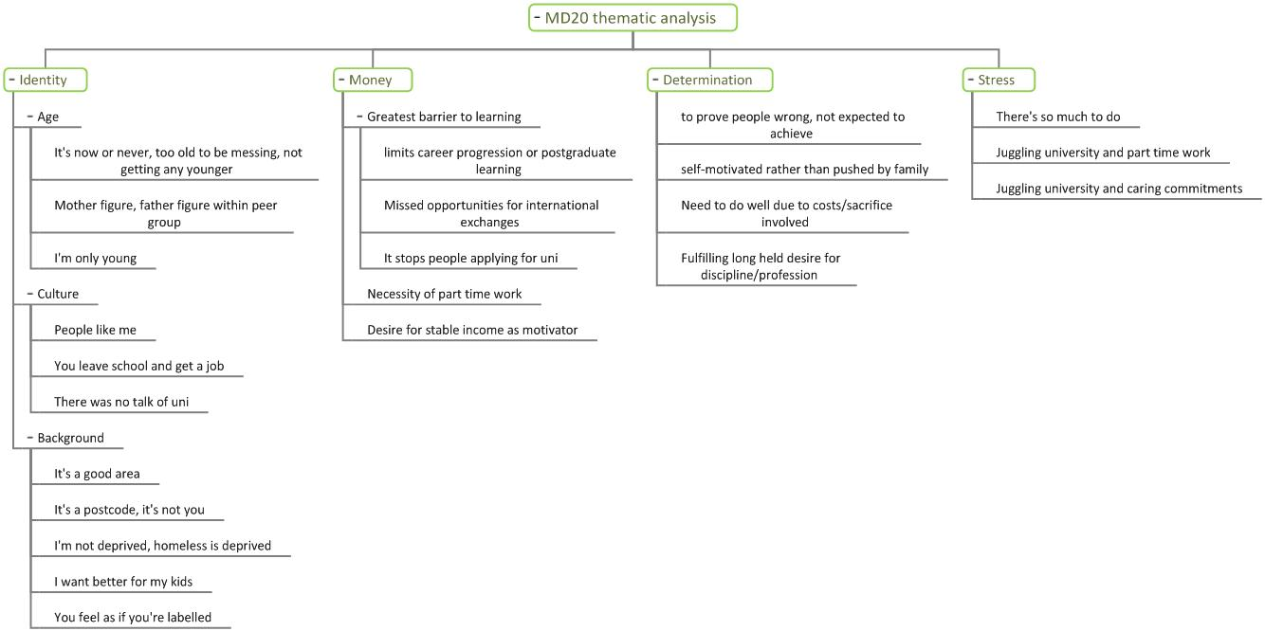
Initial thematic analysis

Slide 14
LDC Numbers
MD20 to School comparison
*full time undergraduate students

Slide 15
LDC Numbers
MD20 students: age comparison
age | students
17-20 | 134
21-25 | 320
26-30 | 234
31-35 | 91
36-56 | 133

Slide 16
LDC Numbers
MD20 students: age comparison
85% are ‘mature aged’ (21 or over)
50% of MD20 students are over 25
24% are over 30

Slide 17
LDC Numbers
Opt out model
289 sessions with 7000 attendances
Opt in model
Workshops
1:1s
Drop-ins

Slide 18
LDC Numbers
Workshops: MD20 to School comparison
* full time undergraduate students

Slide 19
LDC Numbers
Workshops: MD20 to School comparison
MD20 students are choosing workshops in greater numbers than expected.
Note: MD40 students are not representative.

Slide 20
LDC Numbers
1:1s: MD20 to School comparison
*full time undergraduate students

Slide 21
LDC Numbers
1:1s: MD20 to School comparison
MD20 students are choosing individual tutorials in greater numbers than expected.
Note: MD40 students are not representative.

Slide 22
Your institution
Do these findings fit with your understanding of these groups?

Slide 23
Thank You!

