Slide 1
FEMSTEM
‘Just another old man.’
Dr Nathalie Sheridan
Shazia Ahmed
LEADS
Learning Enhancement and Academic Development Service

Slide 2
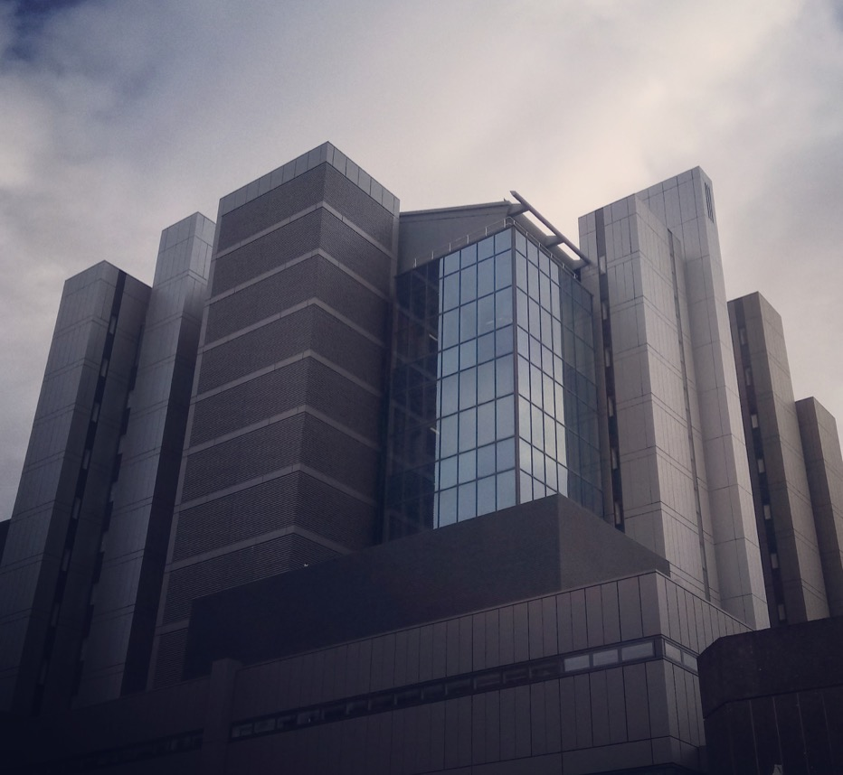
Today’s Session
A theoretical framework suggestion
Background Researcher
Background Research
Data
Questions

Slide 3
Patchwork Identities
Any one social identity does not necessarily function in isolation from other identities within the overall identity-structure -it exists in a specific position relative to other aspects of identity, as well as the overall identity-structure.
(Timotijevic & Breakwell, 2000, p. 359)
Keupp, H. (2005). Pachtworkidentität -Riskante Chancen by Prekären Resourcen. [Electronic Version], Retrieved May 20, 2007 from http://www.ipp-muenchen.de/texte/keupp_dortmund.pdf

Slide 4
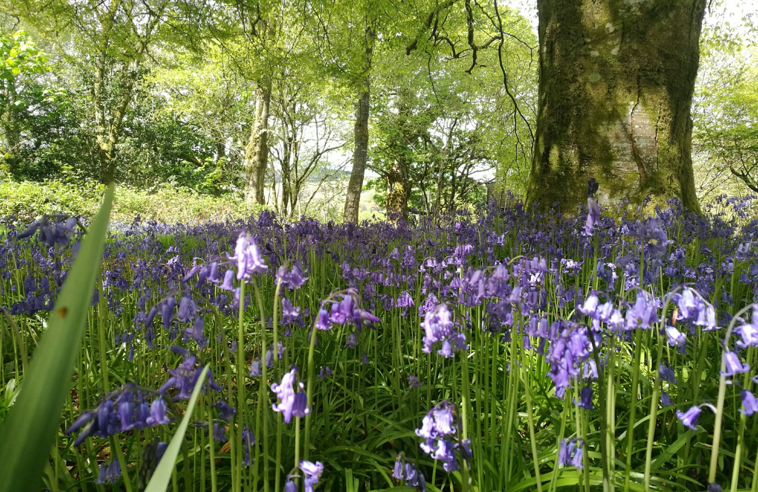
’Who am I and if yes how many?’
Background Researcher
Richard David Precht
‘Wer bin ich und wenn ja wie viele?’

Slide 5
Background Research
The College of Science and Engineering
Numbers $Σ$ = 5108
M= 60% F=39% (2014/15)
538
1486
625
396
779
649
633
School of Computing Science
School of Engineering
School of Physics & Astronomy
School of Chemistry
School of Psychology
School of Maths and Stats
School of Geography and Earth Sciences

Slide 6
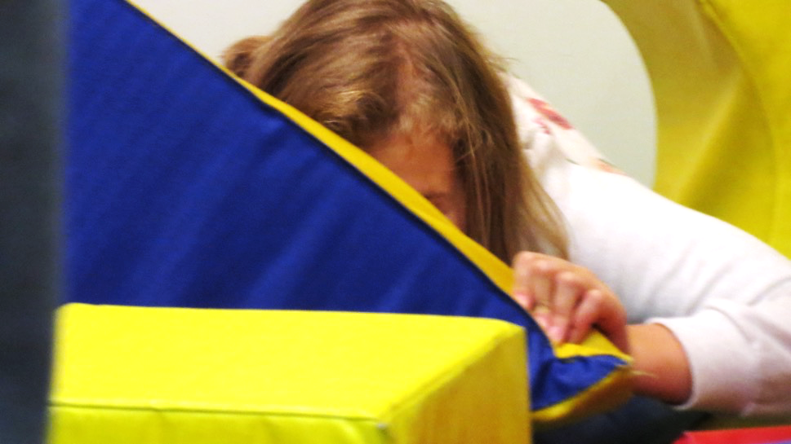
Research Design
‘nobody should make me feel bad for trying to understand the course material ‘
Questionnaires
L1 N = 156 (CS=14)
L2 N = 149 (CS=14)
Interviews & Group Discussion (20)
Staff = 10 (CS=4)
Students = 11 (CS=2)*
Reflective Diaries
Students (CS=2)
*more student participants had CS as subject but only as a additional credits course
Notes:
Majority of students names issues around the actual subject and interest or academic reasons for dropping a subject.
Questionnaire Design
Which Subjects did you study in Year 1 & Year 2?
Which Subjects did you drop?
Reasons for Dropping
Offering a choice of 7
Asking for elaboration, any other things we might have missed,
And if they wanted to participate in further research.

Slide 7
Level | Lack of Support | Course Content | Social Aspects | Personal Reasons | Attitudes of Classmates | Attitudes of Lecturing Staff | Attitudes of Staff
Level 1 All | 10 | 66 | 6 | 32 | 1 | 7 | 5
Level 2 All | 16 | 83 | 5 | 30 | 4 | 14 | 4
Year | Unsure | Drop CS | Reasons
1 | 1 | 1 | Attitudes of Classmates & Staff
2 | 1 | 6 | Additional Credit & Interest (4) Attitudes of Classmates (2)
Notes:
Lack of support (across college) Course content (on dropping CS) Social aspects Personal reasons Attitudes of classmates Lecturing staff Attitudes of staff

Slide 8
The Students’ Voice
On dropping CS in L1
On dropping CS in L2
“For computing I feel as though having never done computing before everyone is better than me this concerns me and intimidates me to be honest and like anyone I don't like feeling like that also I don't understand it to be honest and I'm not enjoying it as much as I thought it would I think I expected something different to what it is really.”
“I'm planning on doing a computing science degree but the sexism in computing science is awful. The ratio of men to woman in classes is so extreme and can make you feel really outnumbered. Also some men seem to think you can't program if you're a woman. [Decided to do something different.]”

Slide 9
Reflective Diaries: Over-helping
I find that I understand more when I figure out something for myself than being led through a task blindly so I felt great when I worked it out myself or asked for help but became annoyed at the overzealous additions from the lab helper. I was partly frustrated because I didn’t want to write answers down blindly without thought but then also frustrated because I didn’t wan t to tell the lab helper to stop as I knew they were trying to help but in the wrong way. I was annoyed when he leant over and took control of my keyboard typing code for me as I felt it really defeated the point of the exercise.

Slide 10
Reflective Diaries: Competition & Confidence
ABOUT PREPARING FOR HACKATHON
‘It was clear he was trying to build himself a winning team and that I didn't make the cut. I had already doubted if I was good enough to go to CDX, so this confirmed that in my mind.’ * […]
‘On the day, the teams split almost like X has planned, with the 'talented' boys all sticking together, with the exception of Y, who was in my team alongside [two girls].’ …
The team of tech wizards X had assembled failed to even get their system up and running, with most of them leaving part of the way through Sunday in a huff.
Much to our surprise, Y and I** managed to come in third place, something none of us had ever expected.’

Slide 11
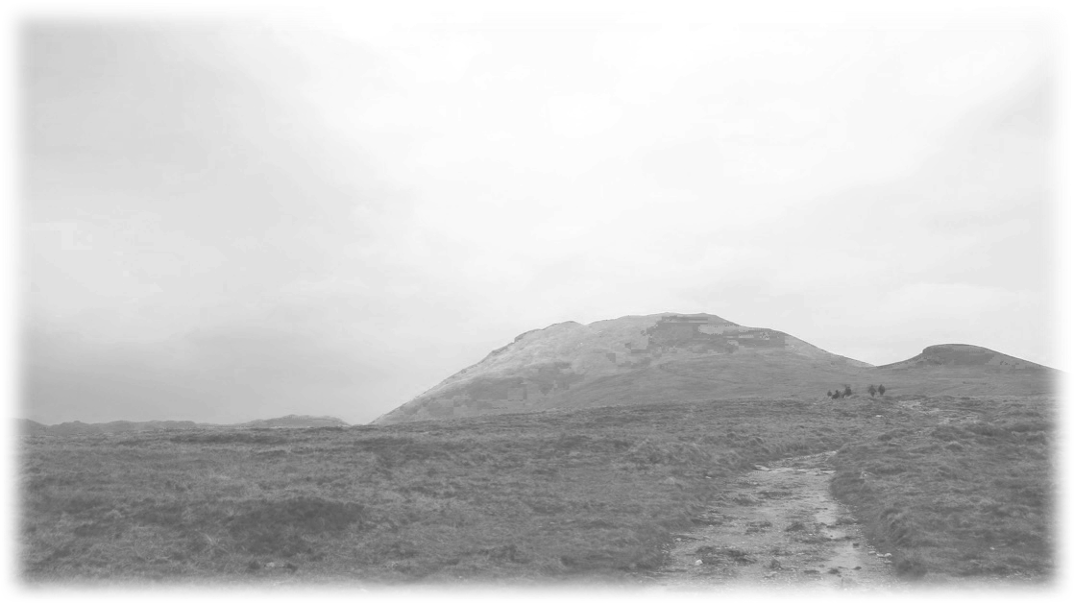
Themes (CS)
Sexism (language, expectations)
Sartorial Communication
Confidence
Managing Expectation
Attitudes of Staff
Professional Identities
Attitudes of Classmates

Slide 12
Staff Voices
CS Focus

Slide 13
Staff Interviews: Professional Identities
‘Remember that thing every girls picked biology…
If you are a hacker a cool programmer then you don't wash, you work over night, you drink beer, and shabby clothes …
Well I don't work like that, and I don't look like that so I cannot be like that.
You know if you don’t walk like a duck, and you don't quack like a duck, you are not a duck.’

Slide 14
Remember Identities?

Slide 15
Staff Interviews: Othering Low Expectations Reluctance
Man are usually they like to show off although they are not being that good compared to a woman … they [sic] are more humble … just being aware this is a reality just making students aware off that this is how they are … that is the nature of people.
That's just how they are. That doesn't mean you are not good. … You can’t make people equal … it's genetics, it's hormones, it's socially … this is how men are .. We are so good and this is why I deserve a raise because I am so good … but for a woman it is maybe I can do more than that … and yeah there are different cases and extremes …
and of course there is sexism … well I wouldn't say sexism … it's attitudes towards things that men have and woman have less … have different perspectives … from my husband … yeah men work less than woman … for the same amount of work they will be more proud and more demanding and think they have done a better job than a woman would say
but this is how it works its ingrained into society this is not something you can change over night
Notes:
The problem here is: does the ‘that’s just how they are come from a ‘low power’ there is nothing I can do and so this is how I cope point of view or does it come from a high power {men are just a bit silly) point of view?

Slide 16
Staff Interviews: Having a Voice Confidence
Very common to sit in a meeting make a suggestion and people would ignore it and ten minutes later a male member of staff would make that same suggestion, slightly reworded, and everybody would say what a great idea. This happened to me more than once, and I know this happens to my colleagues as well. That you would say something and it is naught, and someone else would say […] in school committees. That happens more often than in university wide committees.

Slide 17
Staff Interviews: Acknowledgement Confidence Opportunities
The other thing I have noticed … if you are not working on something that is considered important (and this happens to my male colleagues as well) then you are not working very hard, but when you are working on something important […]
I started on working on something that mattered to the college because of money etc all of a sudden people would saying: ‘ah isn't she doing a great job.’ Whereas I have been doing a great job over the last three years caring for xyz* … I don't know if this would be the same for my male colleagues
If you are not given a role—a named specific role that matters— than you are not considered doing something, and the main specific roles go to the male colleagues.

Slide 18
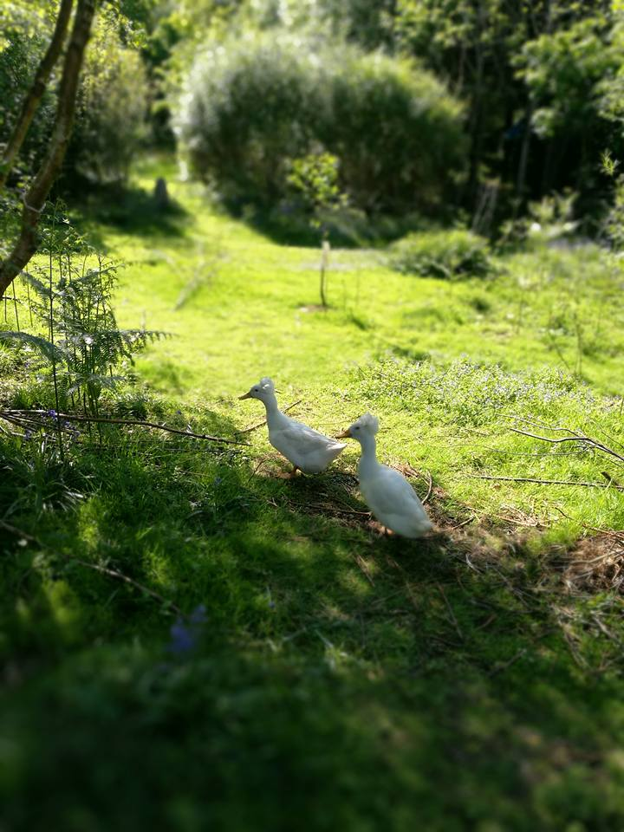
Themes (CS) Staff
Sexism
Sartorial Communication
Confidence
Managing Expectation
Attitudes of Staff
Professional Identities
Having a Voice & Communication
Being Included into Opportunities

Slide 19
What’s Next?
Ask the boys
Language gender bias in L&T Material
Culture
Subtexts
[...] among the many symbolic resources available for the cultural production of identity, language is the most flexible and pervasive. (Bucholtz & Hall, 2004, p. 368

