Slide 1


TransFORMing Feedback to TransFORM Learning: Focusing on the process
13th Annual UofG Learning & Teaching Conference, 2020
Aneta Marren and Carole MacDiarmid, English for Academic Study, SMLC
Jiayang Chen, Xihui Ling, Iain Newman, Anny Yi-Hsuan Tsai, Xue Xue, MSc & MEd TESOL students, 2019-20

Slide 2
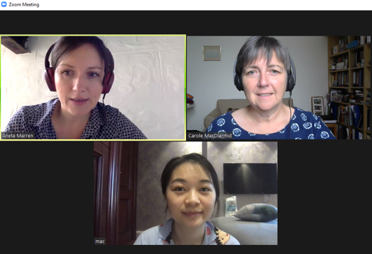
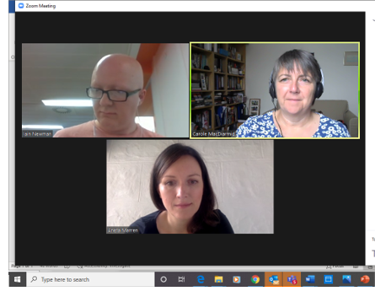
The Project
Small-scale evaluation of feedback practices on the MSc & MEd TESOL
A Staff-student collaboration

Slide 3
Overview of Talk
Background Context
Examples of FB practices
Project aims
Methodology
  Study design process; participants; data-gathering procedures(s); adaptations
Findings & discussion
Staff-student reflections

Slide 4




Context
MSc TESOL | MEd TESOL
Small-medium PGT 40 + students New to TESOL | Small PGT 15 - 20 students Experienced in TESOL
Some shared courses; some specific 1-year intensive for most, all new to PGT

Slide 5
On Feedback
‘Feedback is an essential component in the learning cycle, providing for reflection and development’ (Weaver, 2006, p.379)
Feedback on learning and for learning (see, for example, Black & Wiliam, 2018)

Slide 6
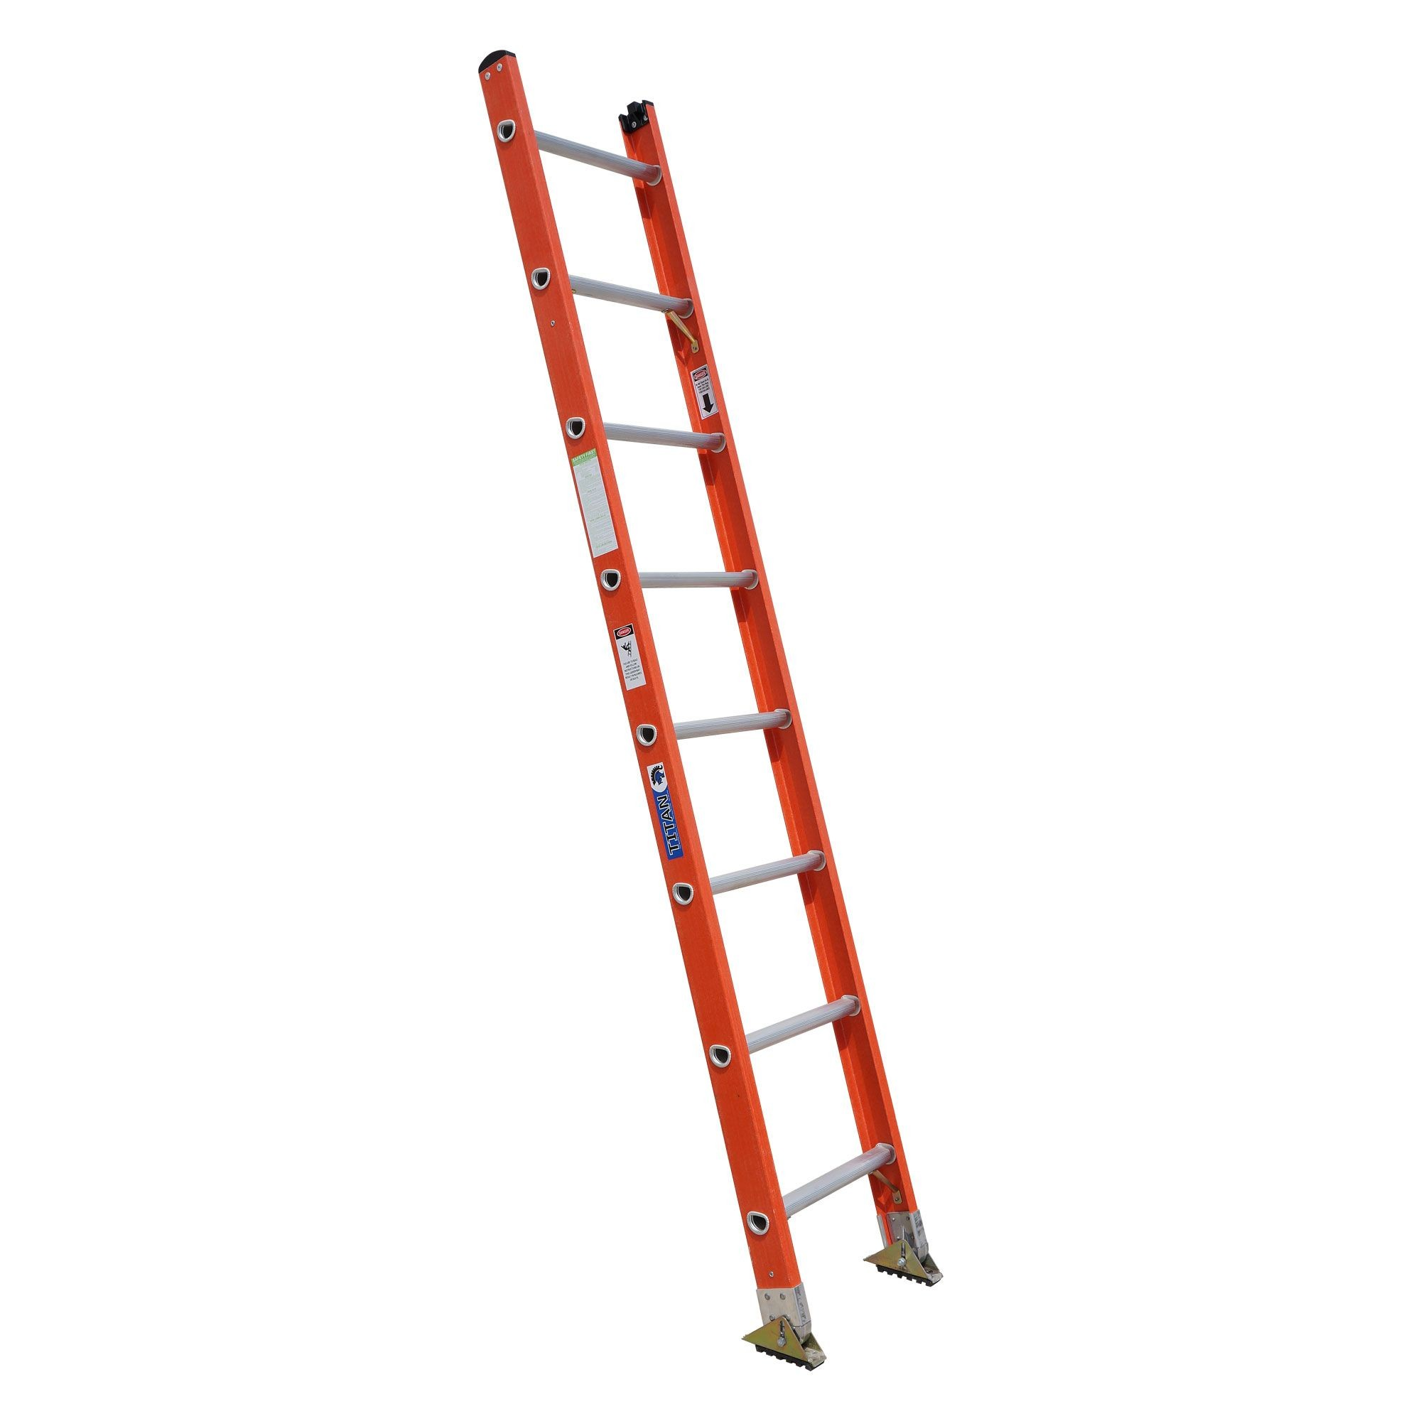
Our Feedback Practices
Making assessment and feedback transparent
Making constructive alignment visible (Biggs & Tang, 2011)
Scaffolding through assessment familiarisation tasks (workshops, exemplars, online resources)
Promoting engagement with tasks & learning (Gibbs & Simpson, 2004)

Slide 7

Feedback Practices
Typical familiarisation process
Workshop or ‘Moodle book’
ILOs & Criteria & Task(s)
View Extracts/
examples
St ‘Mark’
Compare to FB
Notes:
The series of tasks to familiarise students will involve looking at the assignment task, the ILOs and criteria, and then reading and marking previous assignments, or parts of assignments, and finally comparing with lecturer FB and grades
This might be in a face to face workshop (or zoom) or via Moodle book activities

Slide 8
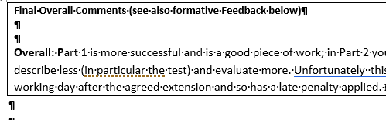
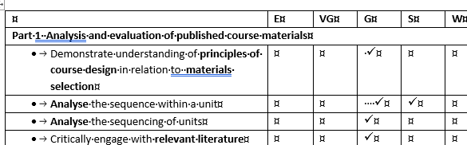
Feedback Practices
Summative overall, in-text & ‘tick-box’

Slide 9
Front-loading Formative FB
Front-loading: the move to more formative FB
  ‘to provide feedback for the purpose of development’ (Weaver, 2006, p.382).
  ‘if students are to learn from feedback, they must have opportunities to construct their own meaning from the received message: they must do something with it, analyse it, ask questions about it, discuss it with others and connect it with prior knowledge’ (Nicol et al., 2013, p.102).
  (Our italics)

Slide 10
Front-loading Formative FB
Front-loading: the move to more formative FB
  ‘Peer review is an important alternative to teacher feedback, as research indicates that both the production and the receipt of feedback reviews can enhance students’ learning without necessarily increasing teacher workload.’ (Nicol, 2013, p. 103).
(Our italics)

Slide 11
Constructive alignment flow
Example 1: Descriptions course; MSc & MEd assignment 1- text analysis
https://aropa.gla.ac.uk/aropa/aropa.php
Class input & ‘parallel’ group class tasks
Group write up
Lecturer group FFB
Individual final assignment
Lecturer FB (individual and generic; transferable & specific)
‘Model’ annotated e.g.; FAQs

Slide 12
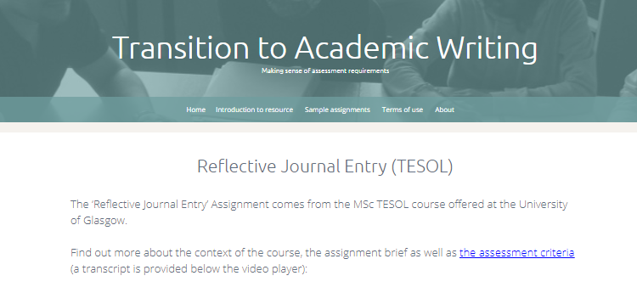
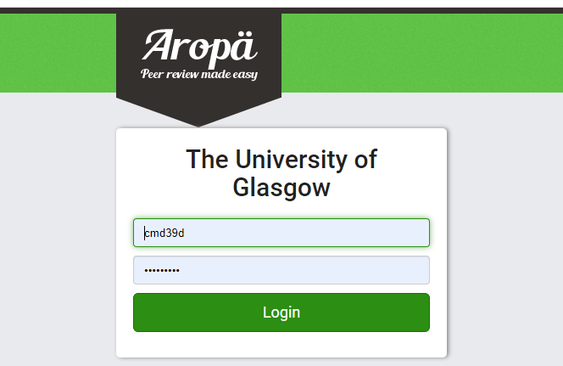
Constructive alignment flow
Example 2: Classroom Processes MSc core; assignment 1 Journal entries
Assignment workshop
& FAQs
& TAW resource
Select individual entry from wk1-3
Aropa
Peer FFB
Generic Lecturer FFB
Final submissions
Lecturer FB (individual and generic)

Slide 13
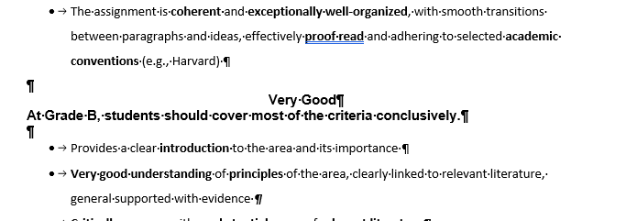
Constructive alignment flow
Example 3: Language Learning & Applications; core MEd; assignments 1 & 2
Write a section for Individual FFB
Aropa
Peer FFB
Guide for grades
Lecturer FFB
Final submissions
Lecturer FB (individual and generic)
Parallel class tasks Lecturer FFB
Assignment
Workshop
& FAQs
Notes:
Example 3 is similar
The Students have parallel class tasks- one assignment focuses on an observation; they do a draft of a recorded lesson first and get lecturer FB,; the 2nd involves lesson planning- they have mentored practice teaching and LFFB on plans
Again we have a familiarisation workshop with sample assignments and marking and FB, FAQs
In this course, though, partly as we were involved in a pilot of this system and partly as the numbers are smaller, Students submit a section of their assignment for peer review followed by lecturer FB
We use Aropa, provide also exemplar guides of what specifically to look for in each grade, and student need to do the peer formative FB before lecturer formative FB is provided
This lecturer FB tends to be confirming peer FB, sometimes highlight or adding a point that has been missed, and very very occasional re-directing FB from peers (e.g. if something is incorrect)

Slide 14
Constructive alignment flow
Example 4: Teaching EAP, Optional course; short assignments 2 & 3
Moodle Book tasks
& FAQs
& Q & A workshop
Individual drafts
Aropa
Peer FFB
Final submissions
Lecturer FB (individual and generic)

Slide 15
Good feedback but… what do students think?
Feedback for Transforming Learning
  What is/are the most favoured approaches?
  What approaches are seen as effective?
  What contributes to future learning?
  I.e., does what we do support ‘worthwhile learning’ (Gibbs & Simpson, 2004, p. 4).

Slide 16
Our questions:
What are students’ perceptions of feedback
What the impact the feedback has on their learning process
Widening our lens:
A staff-student collaboration
Call for participant researchers
Notes:
These were our overarching questions:
What are..
What impact …
Explore Students perceptions of the range of approaches used
Keen to explore how clear the criteria and resulting feedback were,, to what extent students understand, and interact with feedback and take this forward to future learning
Inspired by other staff-student collaborations we’d heard about and the possibilities such partnerships can offer, we also wanted to involve students as researchers
We put out a call for participant researcher's from the two programmes via Moodle and got (#6 Volunteers initially although one in the end didn’t join as they were interested in main stream education assessment)
3 Med 2 MSc
Aneta will now talk you through the study design and findings

Slide 17
How did we do it?
The process
Step 1
Initial meeting, reflection on feedback
Step 5
Data analysis
Step 2
Background reading
Step 3
Design of Survey
Step 4
Data Collection
Step 6
Conclusion Reflection

Slide 18
How did we ensure that the partnership worked?
Power- working cooperatively with students, being open to criticism (Brookfield, 2017)
Ongoing dialogue between staff and students (Barnes et al., 2011)
Parallel discussions (staff/students e.g. 1st focus group & results)
Student researchers' input before teacher's input

Slide 19
Methodology
Initial Plan
(adapted) Questionnaire (Weaver, 2006)
Student researcher led focus group- generate more and richer data (Carless, 2006)

Slide 20
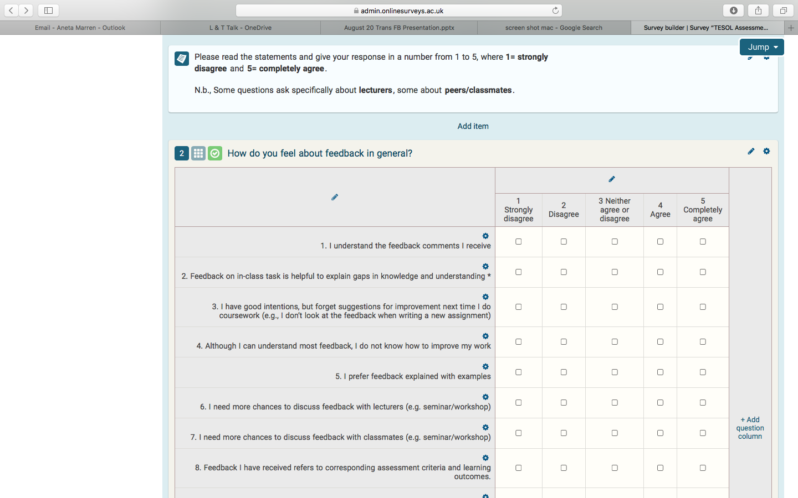
Methodology
Revised Plan ​
Questionnaire (please contact us if you would like a copy) ​(Weaver, 2006)
Staff and student self-reflection on the project-

Slide 21
Participants
12 MSc TESOL
4 MEd TESOL
Online Questionnaire (Online surveys)

Slide 22
What have we found out?
Positives:
Most understand feedback they receive
The assessment criteria are useful
Ss believe positive comments have boosted their confidence
Negative comments (mixed)

Slide 23
Results
However,
Disconnect between comprehension and action -important
Students willing to take part in peer feedback tasks but
Value teacher feedback more than peer feedback
Students would like an opportunity to discuss feedback with lecturers and peers

Slide 24
Results-Suggestions for improvement
Training on giving peer feedback
Organising a workshop after the assignments have been marked
Written and spoken feedback
Spoken vs written feedback

Slide 25
Discussion
Students' perception of feedback –important-understandable, timely, acted upon (Gibbs and Simpson, 2004)
Feedback conversations, feedback requests forms to increase feedback effectiveness (Agricola, Prins, Sluijsmans, 2020)
Peer feedback- increasing value

Slide 26
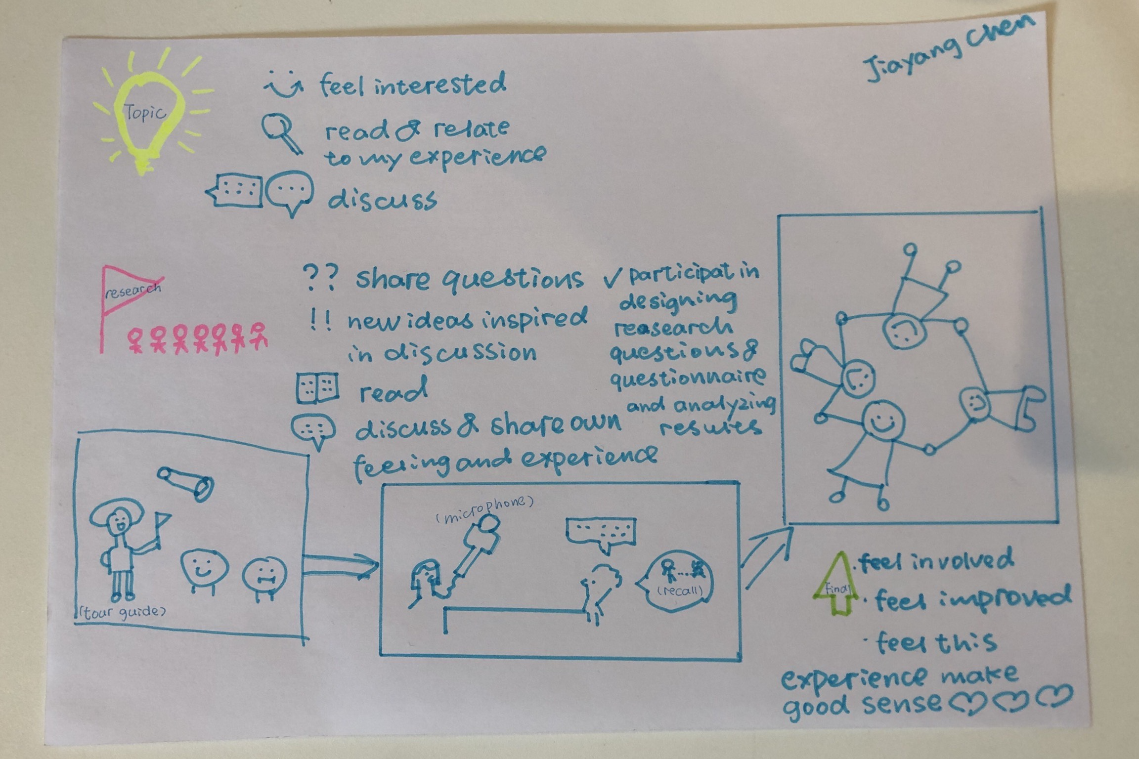
Reflections

Slide 27
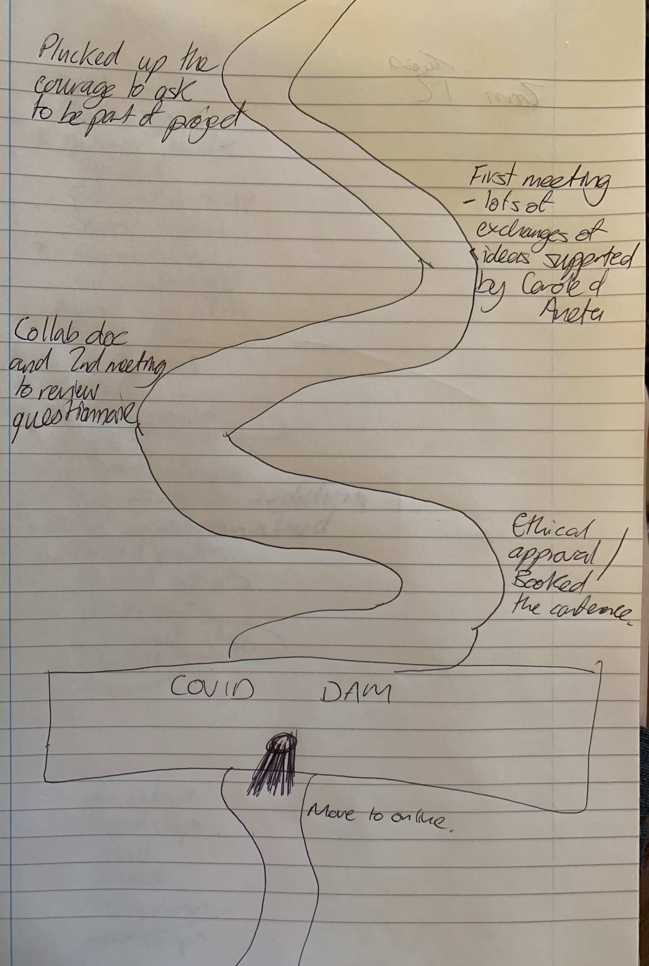
Reflections

Slide 28
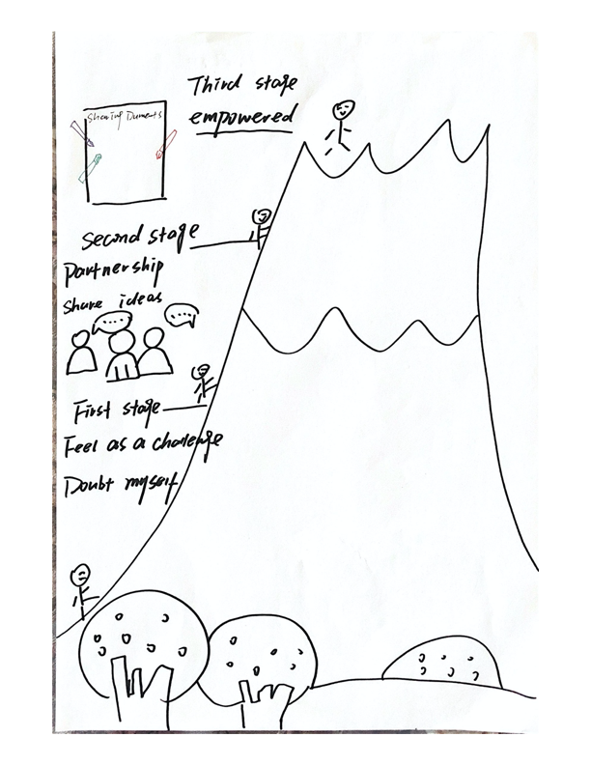
Reflections

Slide 29
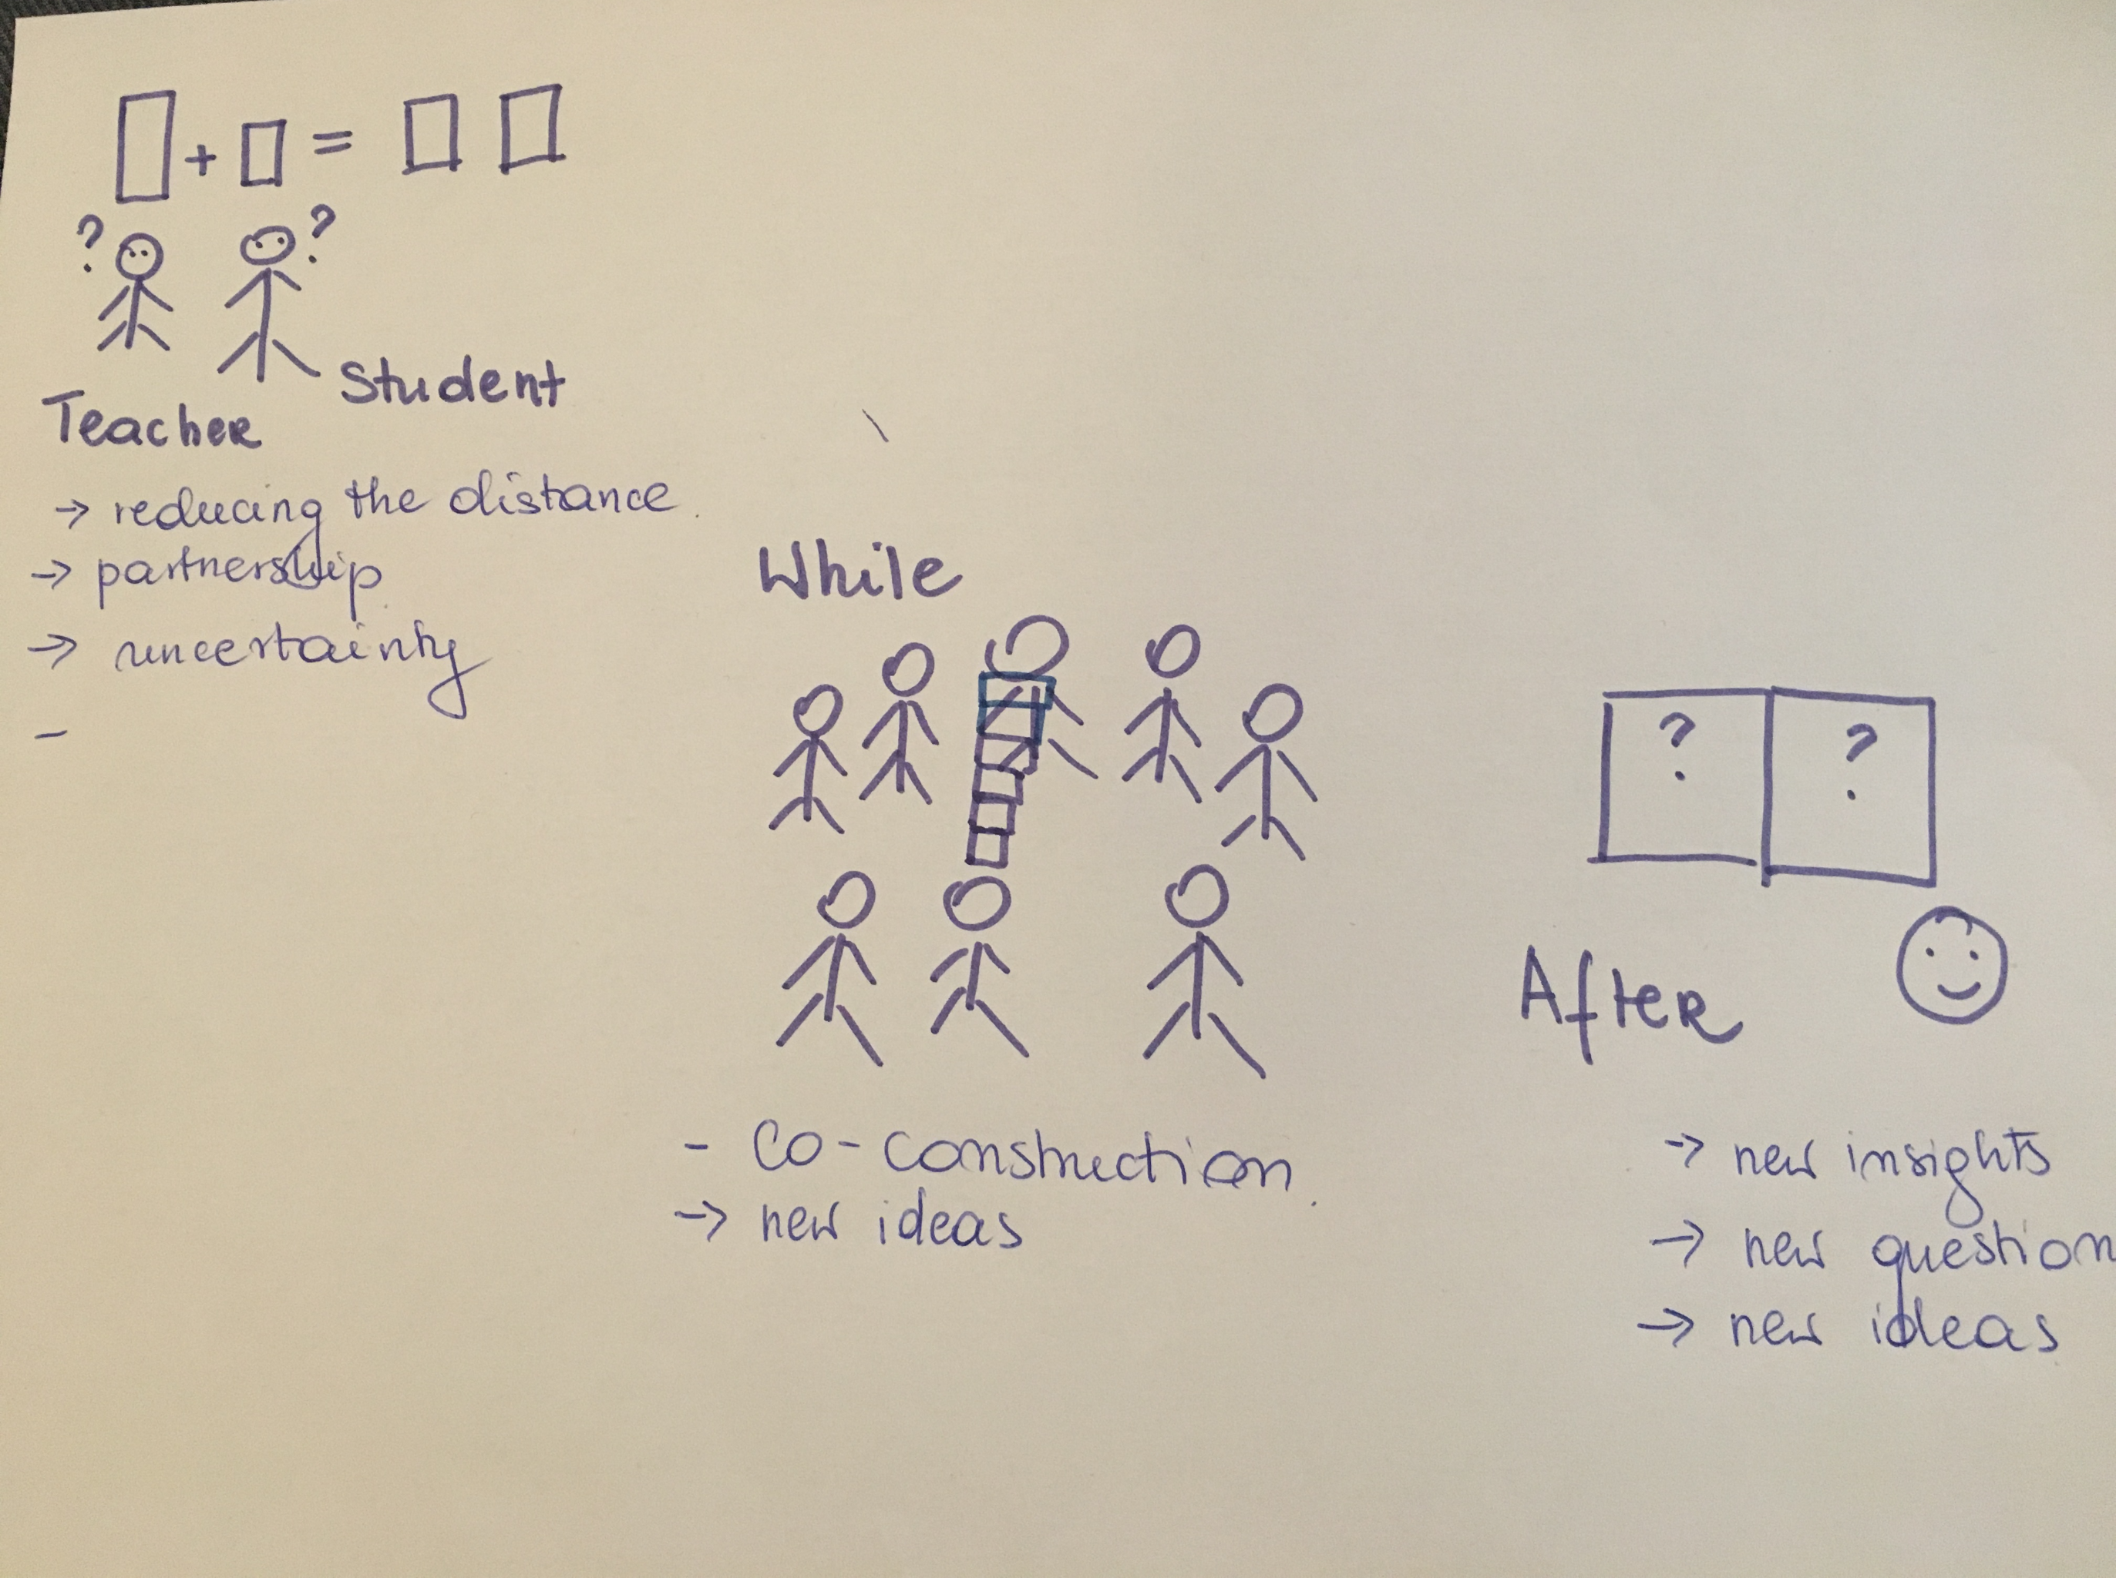
Reflections

Slide 30
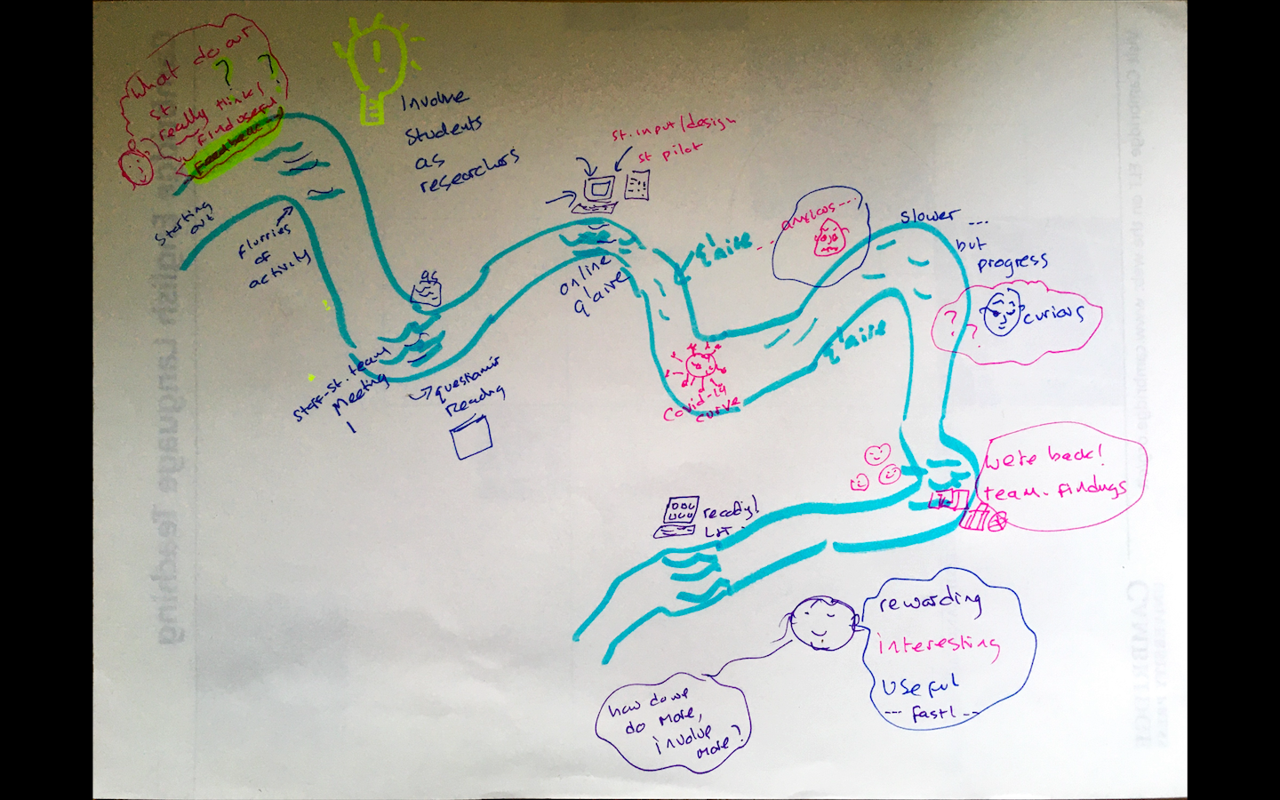
Reflections

Slide 31
curiosity, doubt, challenge, feeling unsure and nervous
Pride, empowerment, feeling involved, curiosity, new ideas and questions, sense of achievement, learning experience
challenge, partnership, cooperation, curiosity, lockdown- losing momentum, co-construction

Slide 32
Conclusion
Insight into students' perceptions of feedback
Better understanding of which aspects of feedback work and which do not
Identified areas for further investigation to further improve feedback
Learning experience: staff-student partnership
Challenge our (teachers') assumptions of what effective feedback is

Slide 33
If you have questions and/or would like further information on any of the points we have discussed, please contact us at:
Carole.MacDiarmid@Glasgow.ac.uk
Aneta.Marren@Glasgow.ac.uk
English for Academic Study, SMLC.

Slide 34
References
Agricola, B.T., Prins, F.J. and Sluijsmans, D.M. (2020). Impact of feedback request forms and verbal feedback on higher education students’ feedback perception, self-efficacy, and motivation. Assessment in Education: Principles, Policy & Practice, 27(1), 6-25.
Biggs, J. B., & Tang, C. S (2011). Teaching for quality learning at university: What the student does (Fourth ed.). Maidenhead: McGraw-Hill/Society for Research into Higher Education/Open University Press.
Black, P., & Wiliam, D. (2018). Classroom assessment and pedagogy. Assessment in Education : Principles, Policy & Practice, 25(6), 551-575.
Brookfield, S.D. (2017). Becoming a critically reflective teacher. John Wiley & Sons.
Carless, D. (2006). Differing perceptions in the feedback process. Studies in Higher Education, 31(2), 219-233.
Gibbs, G and Simpson, C. (2004). Conditions under which assessment supports students' learning. Learning and Teaching in Higher Education, 1, 3-31.
Iantaffi, A. (2012). Travelling along ‘rivers of experience’: Personal construct psychology and visual metaphors in research. In Reavey, P (ed.) Visual Methods in Psychology, pp. 271-283. Sussex: Psychology Press.
Nicol, D., Thomson, A., & Breslin, C. (2013;2014;). Rethinking feedback practices in higher education: A peer review perspective. Assessment and Evaluation in Higher Education, 39(1), 102-122
Weaver, M. (2006). Do students value feedback? Students’ perception of tutors’ written response. Assessment & Evaluation in Higher Education, 31(3), 379-94.

