Slide 1


Exploring approaches to teacher observation on a pre-sessional…
Carole.MacDiarmid@Glasgow.ac.uk

Slide 2
True for you?
Observations are…
a delight
a hoop to jump through
a performance
stressful
developmental (QE)
a hassle
judgemental (QA)
Notes:
(all commented on;

Slide 3
Context & Investigation
Observation cycle
Types of observations
Observation of lesson or lecture
Observation of Consultation (1-to-1)
Observation at a distance- recorded
Peer Observation
‘Blind’ Observation
[‘Flash Obs’ (implementation of course)]
Briefing (LP/Purpose/guidelines)
Pre-Obs discussion (with LP..)
‘Lesson’ Observation
Reflection (write up?)
Follow-up meeting & report

Slide 4
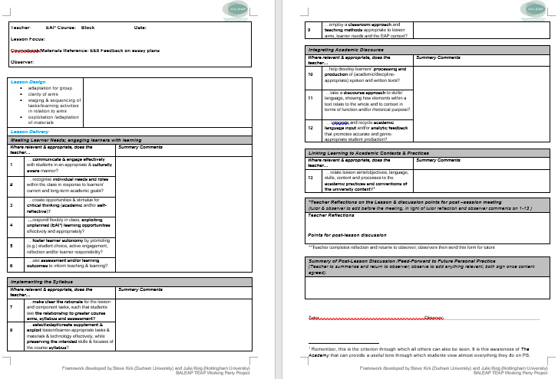
Turning a problem into an investigation
What do our team really think about:
the different types offered
the observation cycle
the TEAP CF framework (FB form)
Notes:
Mainly QE (with a bit of QA)
the TEAP CF framework (FB form) as an aid to development

Slide 5
Methodology
‘Photo’ elicitation (Margolis & Pauwels, 2011).
Focus groups:
  Observers (#2); Observees (#2)
  F2F (#2); & online (#2; Zoom)
Recorded and transcribed (Otter voice notes)
Thematic analysis (e.g., Clarke & Braun, 2013).

Slide 6
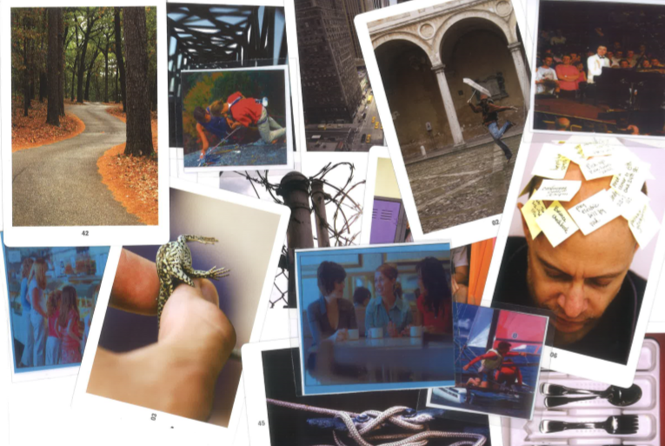
Visuals: Pick 3

Slide 7
Codes & Themes
Emerging Themes | Related Codes
Pressure/constraints | 1.Constraints/restrictions (timeframe/paperwork) 7. B) lesson planning as constraint (9. TEAP CF FB) constraint )
Emotion | 2. Vulnerability 11. Judgement/assessment 4. Positive emotions
Expectations | 10. Expectations of observations (clarity of process; preparedness; criteria ) 8. Observation as performance/artificiality
Developmental opportunities | 3. Focus of attention/FB in observation 5. Observations as CPD (developmental/reflection) 7. A) lesson plans as guide 9. TEAP CF a) as guide
Communication | 6. Value of communication/dialogue/sharing
Notes:
Emerging Themes:
Pressure/constraints: limiting factors e.g., affect on engagement with process; with what one can do
1.Constraints/restrictions- (timeframe to complete cycle/paperwork)
7. b) lesson planning as constraint-
(9. TEAP CF b) constraint )
Emotion : expressly talking about feelings (vulnerability…; feelings of judgement; QA/control ) ?)/ QA (is QA always negative?)
2. Vulnerability
11. Judgement/assessment
4 positive emotions
Expectations: understanding of process/expectations/cycle/criteria (Guidance on Process clarity of process; preparedness /feelings; understanding of criteria may include based on previous experiences- how different from 11?
10. Expectations of observations (clarity of process; preparedness )
8. Observation as performance/artificiality
Developmental opportunities (comments on how it supports reflection/development) /guidance
3. Focus of attention in observation
5. Observations as CPD (developmental/reflection)
7. a) Lesson plans as guide
9. TEAP CF a) as guide
Communication-related to development but expressly about opportunities to share ideas/knowledge/learning/with observers/-includes relationship rapport with Observer-ee)
6. Value of communication /dialogue

Slide 8
Pressures/Constraints
Visual Man with postits on head (Soularium card 06)
Timeframe
Paperwork
Lesson plans/ing
(TEAP FB form)
Notes:
This was a major theme from both the observers’ and observees’ point of views.
The timeframe to complete the cycle (getting familiar with a class, head round the work/course etc and then organising pre and post and lesson obs was a challenge; following up paper work also)- for most (not all though)
(TEAP Fb form included here for some, feeling they need to squeeze everything in or it limits what you can discuss (observer) /related to expectations also though)
Constraints/ to development to engagement: limit the engaging with process; barriers
Fitting the cycle (seen as positive) into the time frame a real challenge (implication- change paper work/esp LP format – what do we need?)
For most this was – (3 though less so, one- not for me but for Ts)
But what do we need and why?

Slide 9
Pressures/Constraints
but as it is it's very squeezed for me for the tutors and yeah that compromises perhaps the value of the experience.
you are kind of duplicating that for the meeting and the discussion anyway so it seems even just typing it up seems like a lot of work
I think I don't think all of it is realistic. I think that some of the things we ask teachers to do for the observation, they're not doing for their every every other lesson, especially not in a the pre-sessional when things are planned for them. So that would be my answer. I thought it was a little excessive
Notes:
Fitting the cycle (seen as positive) into the time frame a real challenge (implication- change paper work/esp LP format – what do we need?)
For most this was – (3 though less so, one- not for me but for Ts)
But what do we need and why?
On LP & Cycle
but as it is it's very squeezed for me for the tutors and yeah that compromises perhaps the value of the experience.
it's something i quite resent doing to be honest it's just like i kind of think it's a valuable; exercise to be observed and to articulate

Slide 10
Pressures/Constraints
Yeah, I don't find the paperwork, a problem (either). But I think that lots of the teachers do, and then that causes a problem for me.
Notes:
Fitting the cycle (seen as positive) into the time frame a real challenge (implication- change paper work/esp LP format – what do we need?)
For most this was – (3 though less so, one- not for me but for Ts)
But what do we need and why?
On LP & Cycle
but as it is it's very squeezed for me for the tutors and yeah that compromises perhaps the value of the experience.
it's something i quite resent doing to be honest it's just like i kind of think it's a valuable; exercise to be observed and to articulate

Slide 11
Emotion
Vulnerability
QA, judgement & power
A delight; a positive experience
Visual: half face/eye (Soularium card 10)
Notes:
Emotion-For both Observers and observees; talking expressly about their feelings
Vulnerability ; judgment; anxiety; - this appears related a lot to Previous experiences (links to expectations)
and hence the QA/control and checking aspect
Also though awareness of new teachers and responsibility to students (calibrate; new courses for Ts; ss compare) ;
or to expectations ; also to possibly need to ‘normalise’ more for teachers ;
how to deal with issues for observers
How others will see them
Judgment- QA or QE? (links to expectations)
Power.. also observers may be materials writers (or vice versa)
Not all negative though- along with usefulness comments, some actively Positive

Slide 12
Emotion
I mean, ultimately, you're always in a position of being judged and no matter how confident you are, no matter how experienced you are, as a teacher
(LP) it's something i quite resent doing to be honest it's just like i kind of think it's a valuable exercise to be observed …
it was quite an insight for me to see how people that have been there for for several years still worry about being observed (O)
Notes:
Emotion-For both Observers and observees
Vulnerability ; judgment; anxiety; how to deal with issues - a lot related to QA
Previous experiences (links to expectations) – quite a lot on feeling of QA-even though we say developmental and to observes assume good tehaicng
Also related to this were about responsibility and control
How others will see them
Judgment- QA or QE? (links to expectations)
Power..
Postive
a responsibility to the student for the students to make the students – related to a discussion about development

Slide 13
Emotion
So I felt that I had a good experience
And I felt a sense of freedom, you know, to perform and experiment and enjoy the whole thing. And I thought it was a positive experience .
I got observed so many times I don't care anymore
Notes:
Emotion-For both Observers and observees
Vulnerability ; judgment; anxiety; how to deal with issues - a lot related to QA
Previous experiences (links to expectations) – quite a lot on feeling of QA-even though we say developmental and to observes assume good tehaicng
Also related to this were about responsibility and control
How others will see them
Judgment- QA or QE? (links to expectations)
Power..
Postive

Slide 14
Expectations
Clarity & Support
Scaffolding
Familiarity
LP and TEAP CF as a guide
Visual: 1 person helping another rock climbing
Notes:
Expectations of the cycle and observations: how well prepared teachers and observers feel- leading to more positive engagement and familiarity (includes familiarity and understanding of TEAP FB form and what is expected in lessons)
For both Observers and observees
Particularly on the cycle but also related to lesson and understanding expectations of lesson &, criteria
Teachers and observers appreciated support- in setting out expectations- eg. Videos of lesson; familiarising with TEAP FB; for observers shadowing
This familiarity with expectations and ‘system’ and forms was connected to positive comments (but not all –missed in some block? Some observers?)
e.g. what do expect in planning; what we can offer; what can realistically be observed ; familiarity with process and criteria
+ shadowing for familiarity
+ sample recorded lessons a plus to familiarity (wish for peer obs)
TEAP CF as guide
But also- even if clear, feel possibly a performance

Slide 15
Expectations
It was very clear what I had to do and that was nice. But you know, because your observations are colored by previous observations. You never know if there's a bear trap that you haven't seen, you know, but no, it was just like, that's what was clear. ….That's what they expected to achieve. So that was nice. And they've shown us that video of someone on a previous summer school teaching. And so I was like, Oh, yeah, they really just want you to teach a regular lesson. And that was so reassuring. So I was a lot less anxious and stressed than I would have been.

Slide 16
Expectations
…showed like a clear framework, you know, where you're going
…that the person who observed me recently supported me making clear what I was supposed to do
…Yeah, I chose the man performing at piano I because, because for me, while I think it's a positive thing to be observed, and for me, the biggest thing has always been the observer paradox

Slide 17
Developmental
Useful
Encourages reflection
Peer & dialogue
Dancing in the rain (Soularium card 02)
Notes:
Observations as Developmental opportunities – encouraging reflection; ideally a positive experience!
A delight…
Recorded- at a distance- removes observer paradox; Ts did view selves after;
Easier for observer (flexibility felt less pressure)
TEA

Slide 18
Developmental
I think having observations helps us to become more aware of what we're doing [?the exercise of] of talking about what we're doing and accounting for what we're doing.. I think is very useful…. Otherwise, I think, you know, sometimes I find that, you know, get it does get of a treadmill
When you're being observed, you do actually have to go through that process prepare, present, reflect that, that happens in observation. And it's very, very useful, but an everyday teaching, I don't go through that process
I find the, the feedback here is very relevant for the entire 80 hours.
Notes:
Observations as Developmental
A delight…
Recorded- at a distance- removes observer paradox; Ts did view selves after;
Easier for observer (flexibility felt less pressure)
Peers dicuss…

Slide 19
Developmental
and they were much more relaxed than if the observer was there. And I found the same thing ….. that was an advantage of the Swivl, actually, yeah, you know, I did watch it. And fortunately
when I did the peer one it didn't feel that way, because my colleague was not checking the... we were actually discussing, you know how
Notes:
Observations as Developmental
A delight…
Recorded- at a distance- removes observer paradox; Ts did view selves after;
Easier for observer (flexibility felt less pressure)
Peers discuss…
Extra
But, you know, you have a responsibility to the student for the students to make the students are being prepared in those classes for study at the end of the block.

Slide 20
Communication
Visual: 3 people having coffee
Observers
Teachers
Sharing ideas/knowledge
Notes:
Communication- relates to dialogue between observers and observees, and sharing of knowledge and expertise and ideas
Observations as Developmental & opp to share ideas and learn from each other
From observers- learn a lot- interesting it was observers who commented most about learning from observations- of ‘typical ‘ lesson; otherwise more dialogue relates to peer obs (occasional at UofG and in other contexts)
Want to build more t-t communication
Observees- want to learn- comment on values of sharing ideas ; want more peer obs; less ‘formal’ (what are we doing that make sit so formal? )
Although a discussion (often) with observer, actually only 2 people- would like more/wider; reflected also in oser comments – a wish to enable wider /more discussion and collaboration and sharing

Slide 21
Communication
you can learn a lot so it's I find observing different people it's it's good for me because I can learn a lot from it
Yes, I felt so drawn to go and talk to my observers several times and initiate conversation. But then I realized I was not supposed to be this way.
that's the thing you can actually share idea and you know challenges yourself to think in different ways. that kind of discussion rather than have i fulfilled this objectives that objective I think (on peer & co-teaching)
Notes:
Observations as Developmental
From observers- learn a lot- first quote from observer
Want to build more t-t communication
Observees- want to learn- comment on values of sharing ideas ; want more peer obs; less ‘formal’ (what are we doing that make sit so formal?

Slide 22
Summary points: Observations types
Visual 1:
Piano concert performance
Visual 2
3 people having coffee
Same dynamic/content different
Developmental esp. peer
Recorded .. more relaxed
> recording?
> Peer..(?)
Notes:
Also- note on focus-
Same conversation ‘: I think the dynamic is the same isn't it you know you're …
O1: But that's interesting, because maybe the content of the conversation is slightly different. But the conversation in a way is similar in that you're asking the teacher to reflect on potential changes, or what can they shift?
Learn from watching others
Recoded- more relaxed, flexible
than have i fulfilled this objectives that objective I think
Recording less tress, more natural
Want more peer/dialogue – how to build in? co-planning?

Slide 23
Findings: Observation Cycle
Visual 1: traffic/ street scene
(Soularium card 38)
Visual 2: small insect between fingers (Soularium card 03)
Useful/good
Time constraints
Reduce paperwork; earlier planning & more collaboration
Notes:
Key task is to reduce planning- paper work demands; keep pre discussion but Ts can bring notes/postits/PPT
Building in planning for obs in induction in see if team leaders can build in to weekly meeting
Pre-plan obs (some TLs come for PS)

Slide 24
Summary: TEAP CF
Visual 1: iron frame bridge
(Soularium card 21)
Visual 2: fence with barbed wire (Soularium card 01)
Visual 1: traffic/ street scene
(Soularium card 38)
Visual 3: cutlery tray (Soularium card 28)
‘a clear framework, you know, where you're going’
‘Ugly but effective’
Review Layout
Select & focus
Notes:
Vast majority very positive in content
a helpful guide overall; not bable!!
Suggestion on layout /format
Some on wording
Carry on familiarization tasks (for observers shadowing and teachers)
Limit focus – e.g. select for lessons

Slide 25
Questions to explore
How to increase peer-obs & group planning on PS
  co-plan and teach?
  peer review recordings?
QA at some point…?
No Obs..? Ever…?
Notes:
How to increase peer-obs & group planning on PS
e.g. co-plan, teach, observer- part of each lesson (and /or with observer?)- 3 way.. Group plan, all teach/1 observer (over 2 hours)

Slide 26

Questions, comments….

Slide 27
Selected References
BALEAP. (2008). Competency Framework for Teachers of English for Academic Purposes. Available at https://www.baleap.org/wp-content/uploads/2016/04/teap-competency-framework.pdf (09/04/2019).
Clarke, V., & Braun, V. (2013). Teaching thematic analysis: Overcoming challenges and developing strategies for effective learning. The Psychologist, 26 (2). pp. 120-123. ISSN 0952-8229 Available from: http://eprints.uwe.ac.uk/21155
Margolis, E., & Pauwels, L. (2011). The SAGE handbook of visual research methods. London: SAGE.
Vaismoradi, M., Turunen, H., & Bondas, T. (2013). Content analysis and thematic analysis: Implications for conducting a qualitative descriptive study. Nursing & Health Sciences, 15(3), 398-405.
Otter voice notes: https://otter.ai
Souralarium cards
Zoom: https://zoom.us/

Slide 28




Thank you!
Carole.MacDiarmid@Glagow.ac.uk
TEAP Online: https://www.gla.ac.uk/schools/mlc/eas/teap/
#UofGWorldChangers
@UofGlasgow

