Slide 1
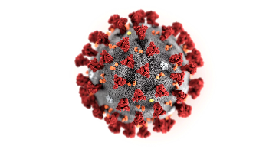
Before symptoms onset
After symptoms onset
SARS-CoV-2 exposure
Symptoms
Viral load
IgM
IgG
Serology threshold
RT-PCR threshold
Days -5 0 5 10 15 20 25
RT-PCR
Serological tests
Windows of false negatives

