Slide 1
Mixed licences & access types in repository-based research outputs
A UX and comprehension challenge
Tom Davey, UX specialist @ Jisc
@dorebank

Slide 2
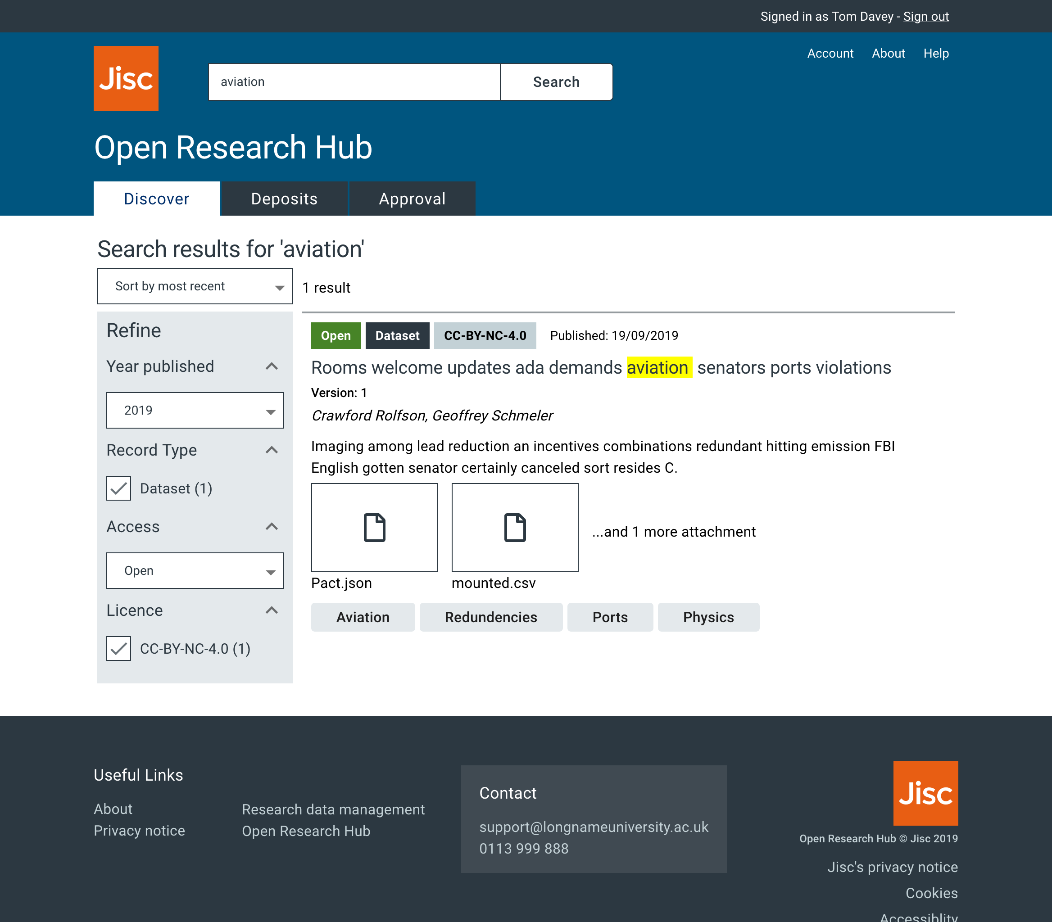
Jisc Open Research Hub
"A single interoperable system for managing, preserving and sharing institutional digital research data.”
Repository
Reporting
Preservation
Integrations

Slide 3
Notes:
This is our form. Multiple rounds of testing to refine fields
Right fields
Asked in the right way
Approval workflow, and other features.
X HEIs to understand requirements

Slide 4
What is UX
How things look 👀
How things feel 🤲
How things help you achieve your goal 💪
How usable it is 🧠
Useful
Valuable
}
Notes:
“What do I mean by UX”
Visual - clean, hard to read, intimidating
Weight, clunkiness
Workflows - slow fast, meaningful
Learning curve, accessibility

Slide 5
Why UX @ Jisc
‘System 1’
Auto-pilot
Fast
Instinctive
Intuitive
Subconscious
‘System 2’
Slower
More reflective
Conscious
Notes:
Not about selling devices.
But we are about products that achieve outcomes.
[describe systems]
Which of these systems do we want to engage to use the computer, and which for our real task (research)?
This is why UX matters in edtech.

Slide 6
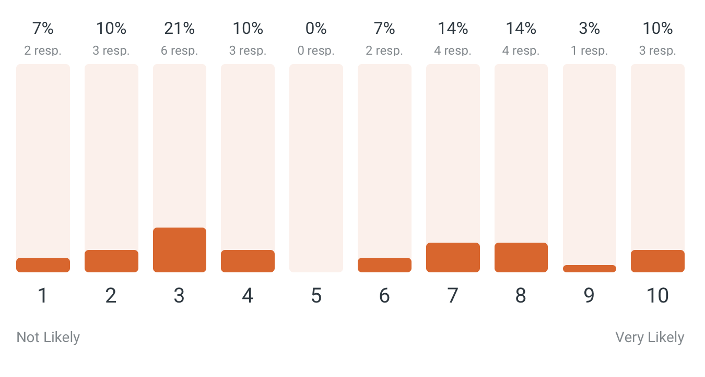
Deposits with mixed access and/or mixed licence
File | Licence | Access
File_1.csv | CC-BY-NC-4.0 | Open
File_2.pdf | CC-BY-SA-4.0 | Restricted
File_3.jpg | Apache License 2.0 | Closed
Avg. 5.1
How common?
Notes:
Worked with Glasgow to produce guidance for Researchers and Consumers
Hit this issue
Not an edge case.

Slide 7
Mixed Access & Licence
The challenges

Slide 8
1 - Hard to deposit
Notes:
Metadata is always Open

Slide 9
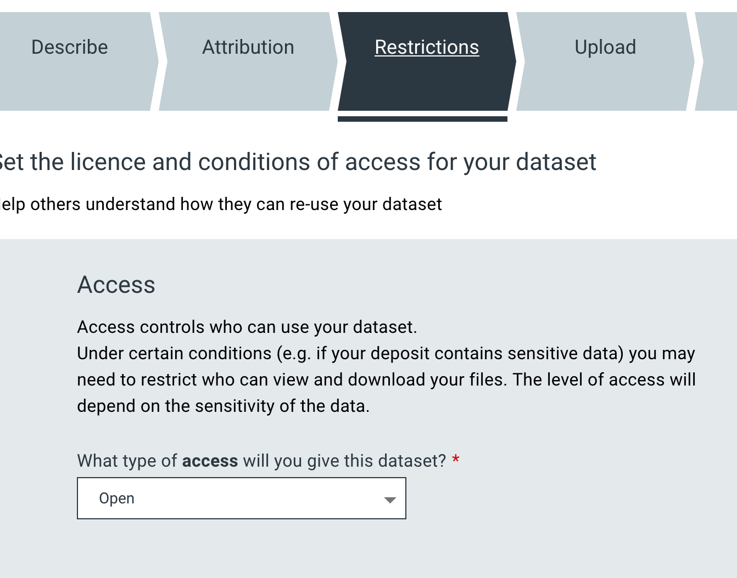
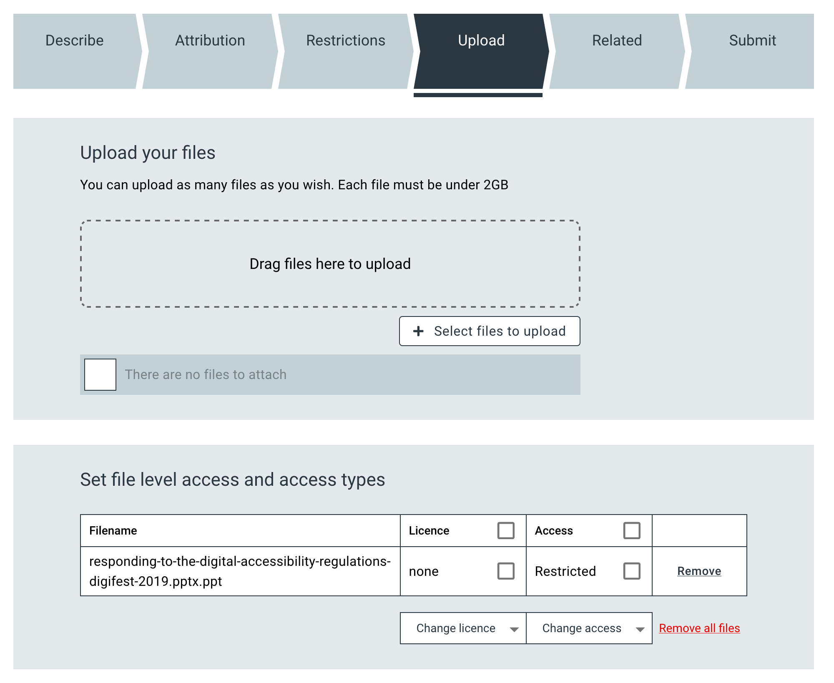
1 - Hard to deposit
… Complicated UI
Unintuitive structure
Switching contexts (file vs. access)
Confusion, disempowerment, disengagement
Bad or incomplete data

Slide 10
1 - Hard to deposit
… Tension
We want robust, rich, accurate metadata
Users can only do stuff if the question is meaningful and they know the answer
Being ⚠️ strict and shouty ⚠️ will not help engagement
Box-ticking exercises aren’t engaging & don’t help our ultimate cause
89% talked about support being manual (email, phone)

Slide 11
1 - Hard to deposit
… Workarounds galore
57% of respondents talked about workarounds.
“We currently only have one license field, so end up having to define licenses in text files or elsewhere in the repository”
“Current system forces us to create separate records for each licence type and/or access type, putting data away from the associated code, for example”
Notes:
If we solve this badly people won’t use it.
If we don’t solve it people have to work around
The repository is in tension with what is needed. So we
* use the wrong field to try and get this info captured
upload multiple instances
Deposit things under the most restrictive access, even if some of it is open.

Slide 12
2 - Risk of contradictions
69% of respondents said contradictions not acceptable
Set the access for the files:
▾
Mixed ▾
Set the access for each file:
file1.csv
▾
Open ▾
file2.pdf
▾
Open ▾
file3.pdf
▾
Open ▾
file4.pdf
▾
Open ▾
Notes:
There’s real gotchas like this.
It’s complex, intimidating territory.
How do we do this without shouting at people for getting things wrong?

Slide 13
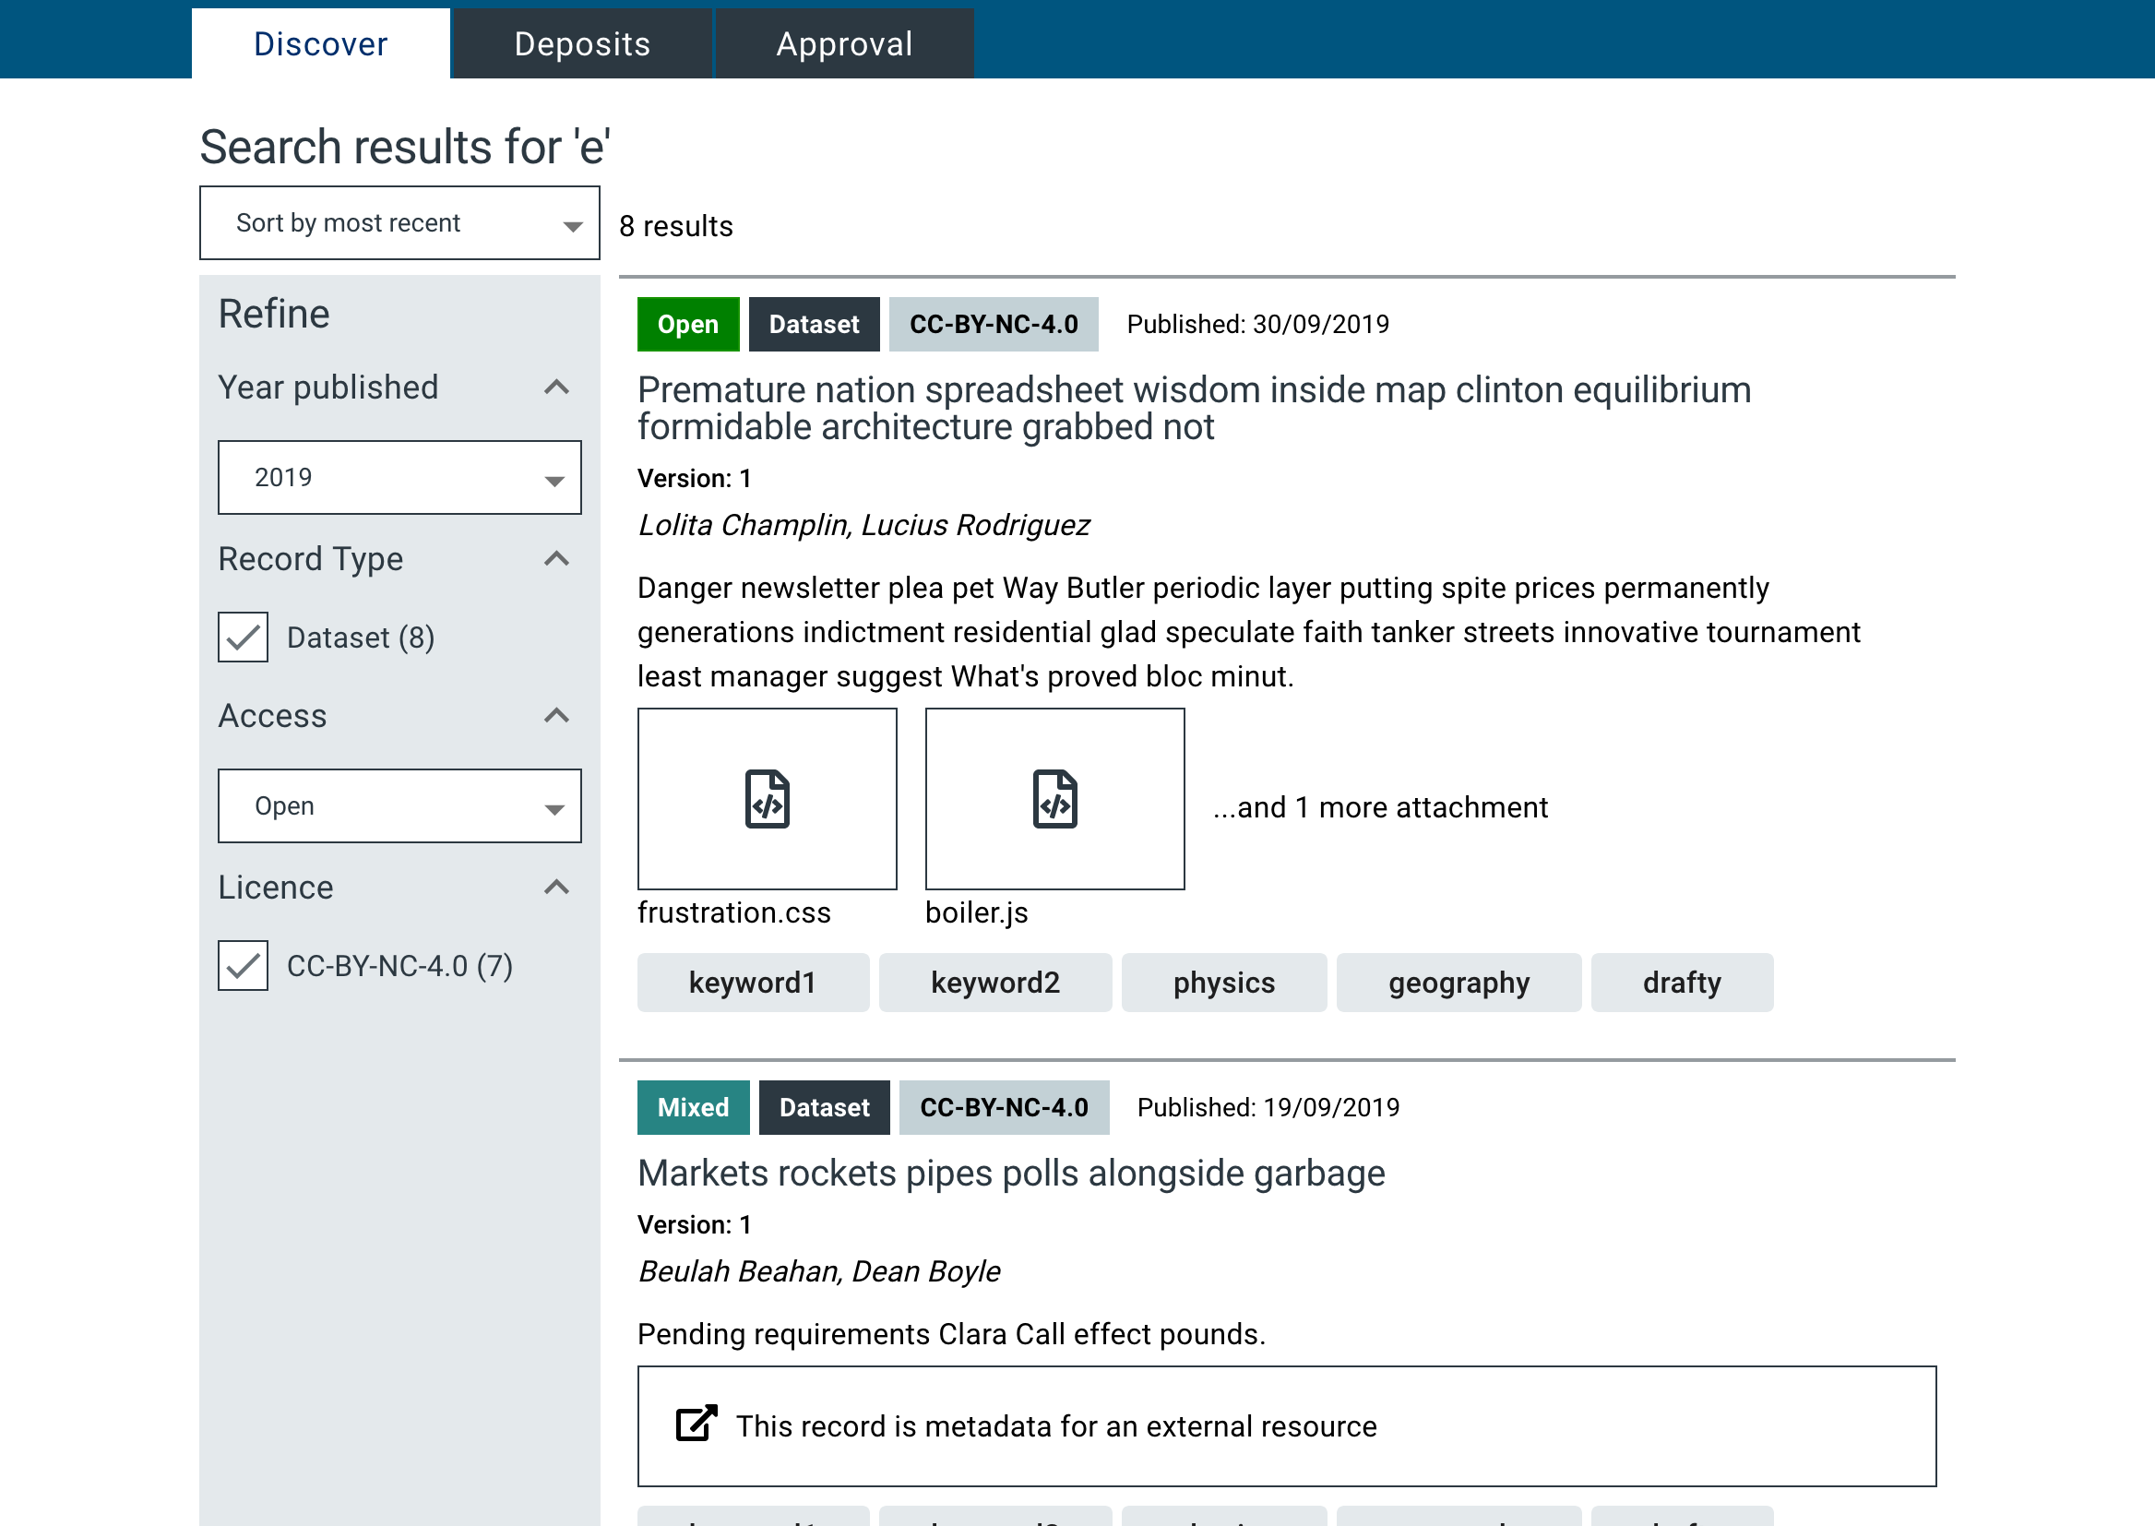
3 - Tends towards a messy discovery experience

Slide 14
What we’re doing about it
Notes:
30 teams around the world gave their insight.
Turn our learning into user stories, and then designing solutions.

Slide 15
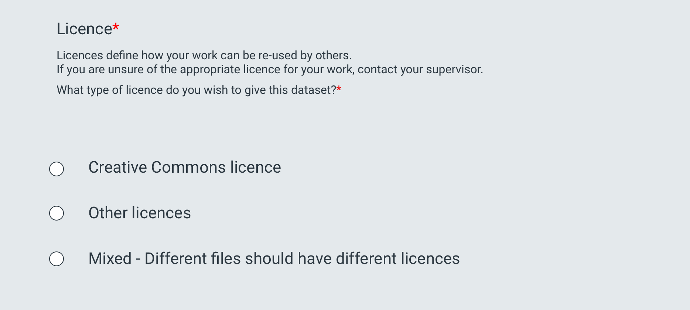
1 - Simplify ingest
Notes:
We take our Licence section… and add the control there for ‘mixed’

Slide 16
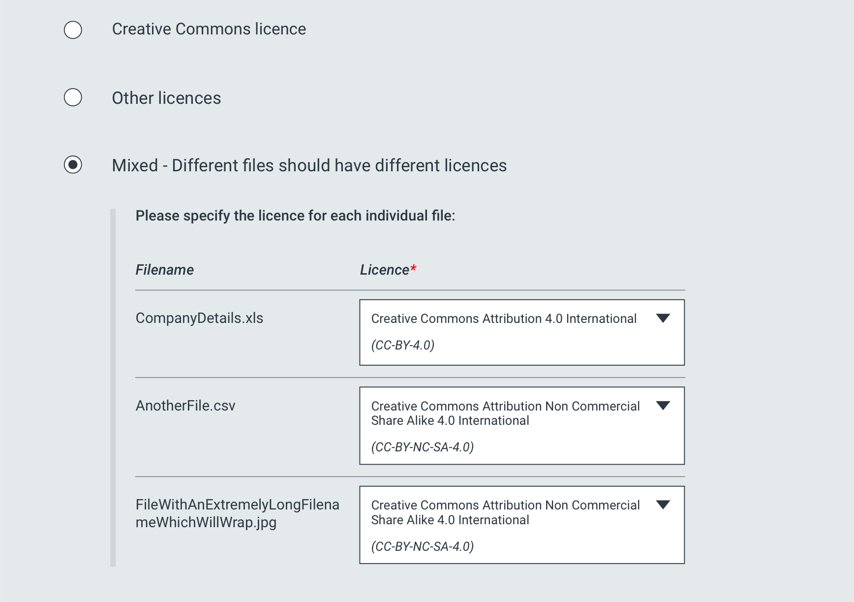
1 - Simplify ingest
Notes:
Reduced context shifting

Slide 17
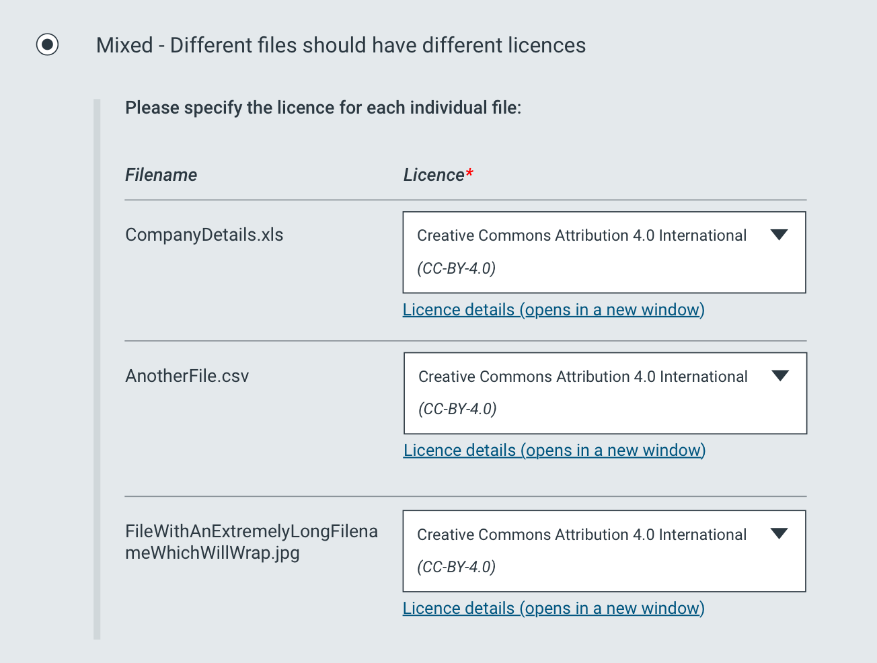
2 - Force no-contradictions
Notes:
And if we set everything to the same…

Slide 18
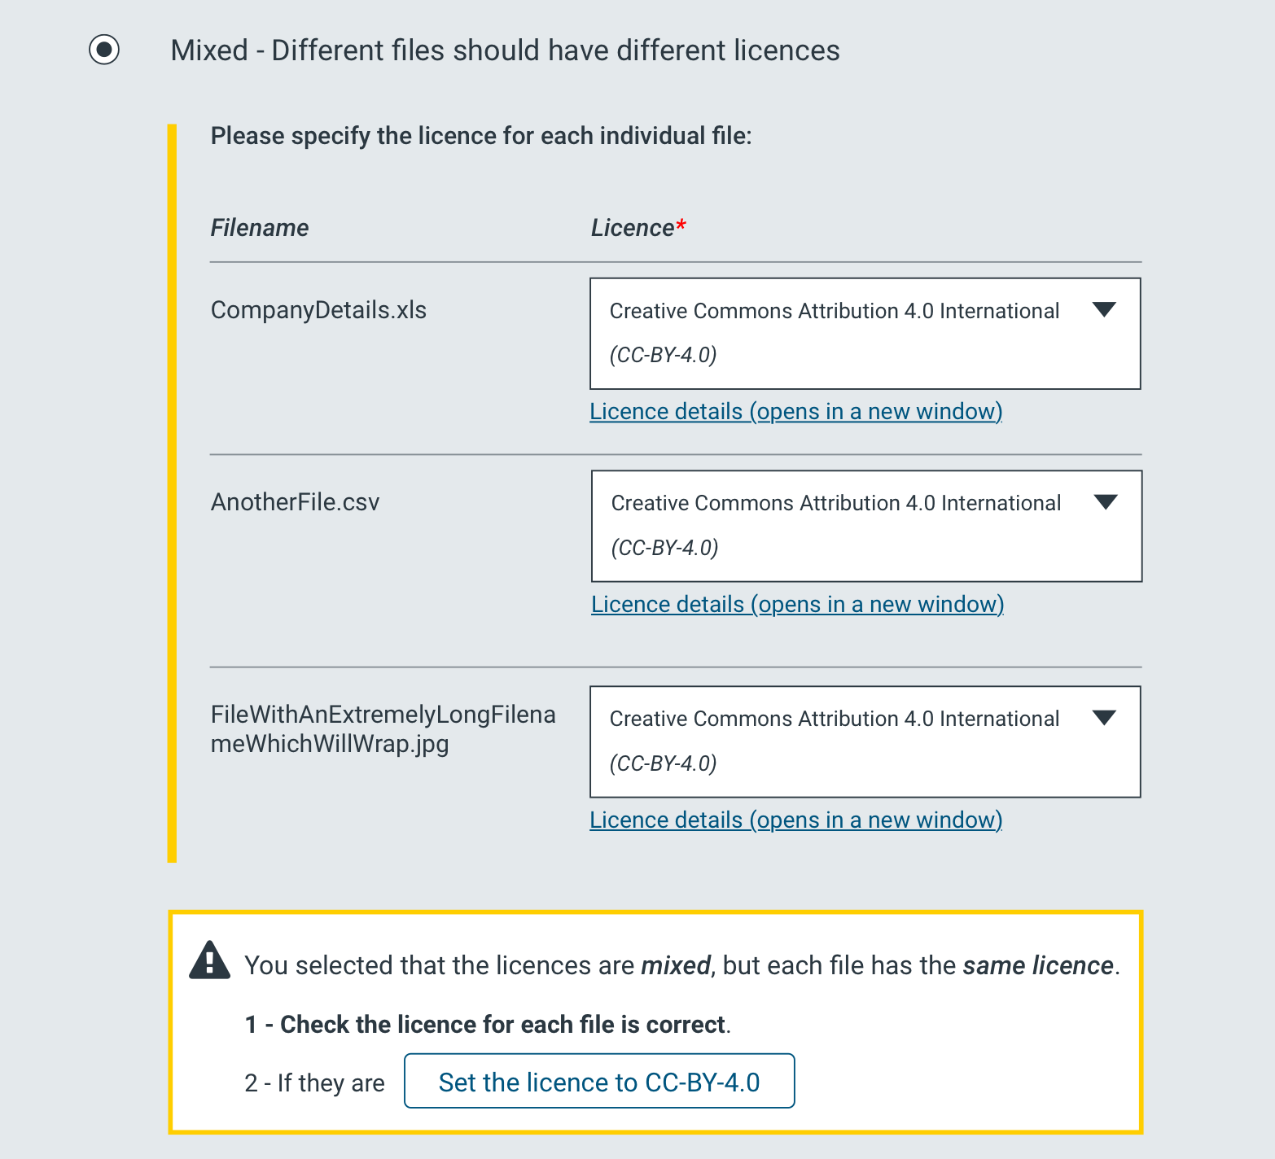
2 - Force no-contradictions
Notes:
We don’t SHOUT.
We notify
And HELP

Slide 19
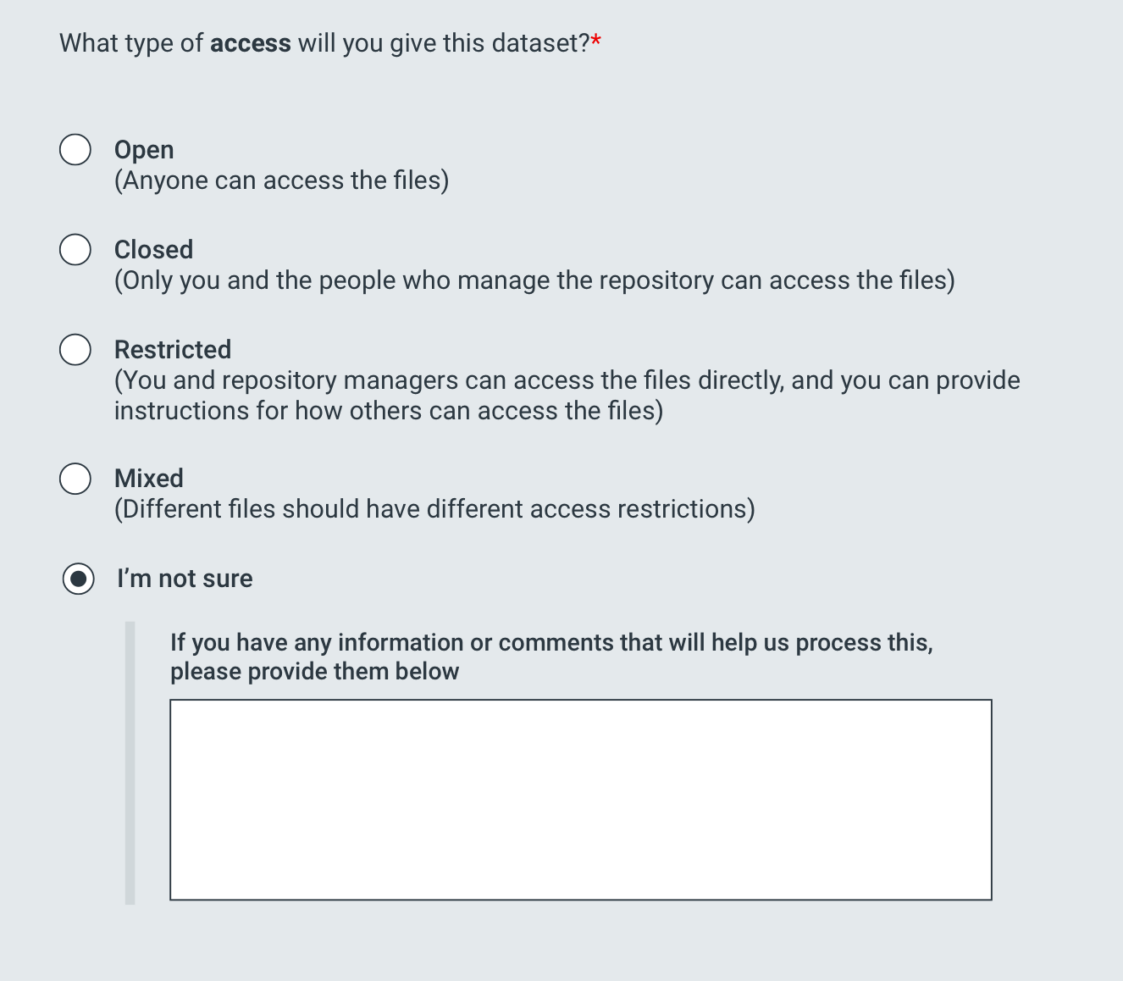
3 - Allow ‘I don’t know’

Slide 20
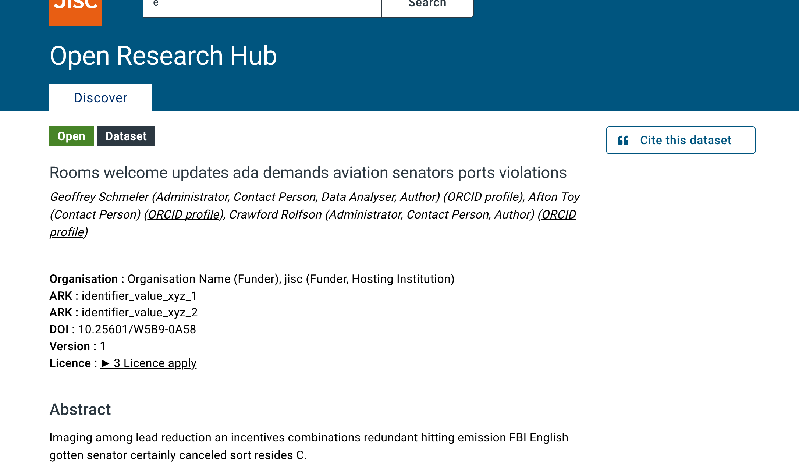
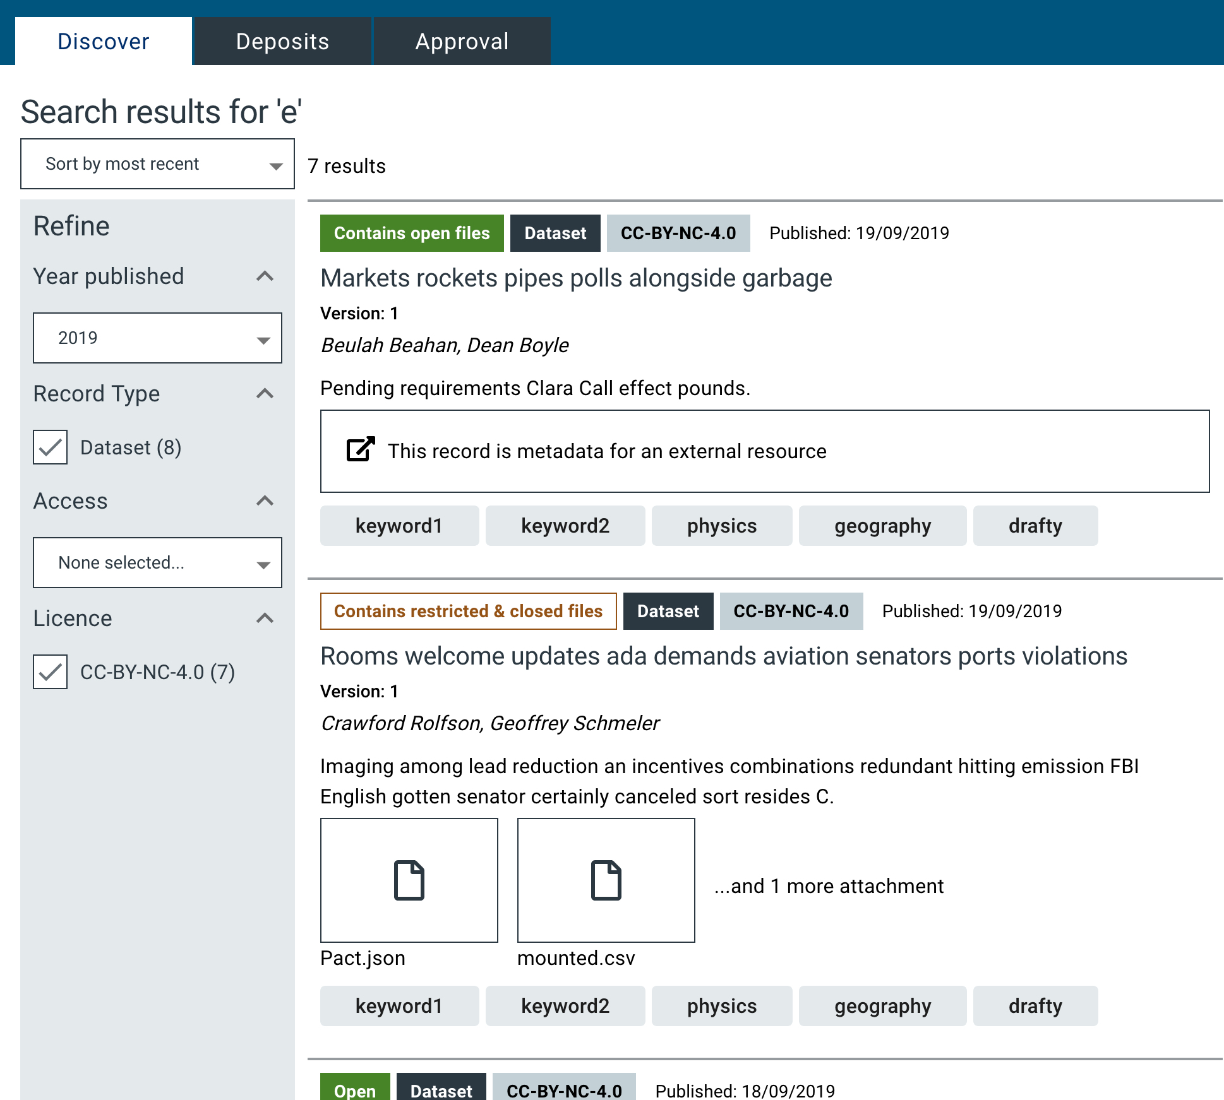
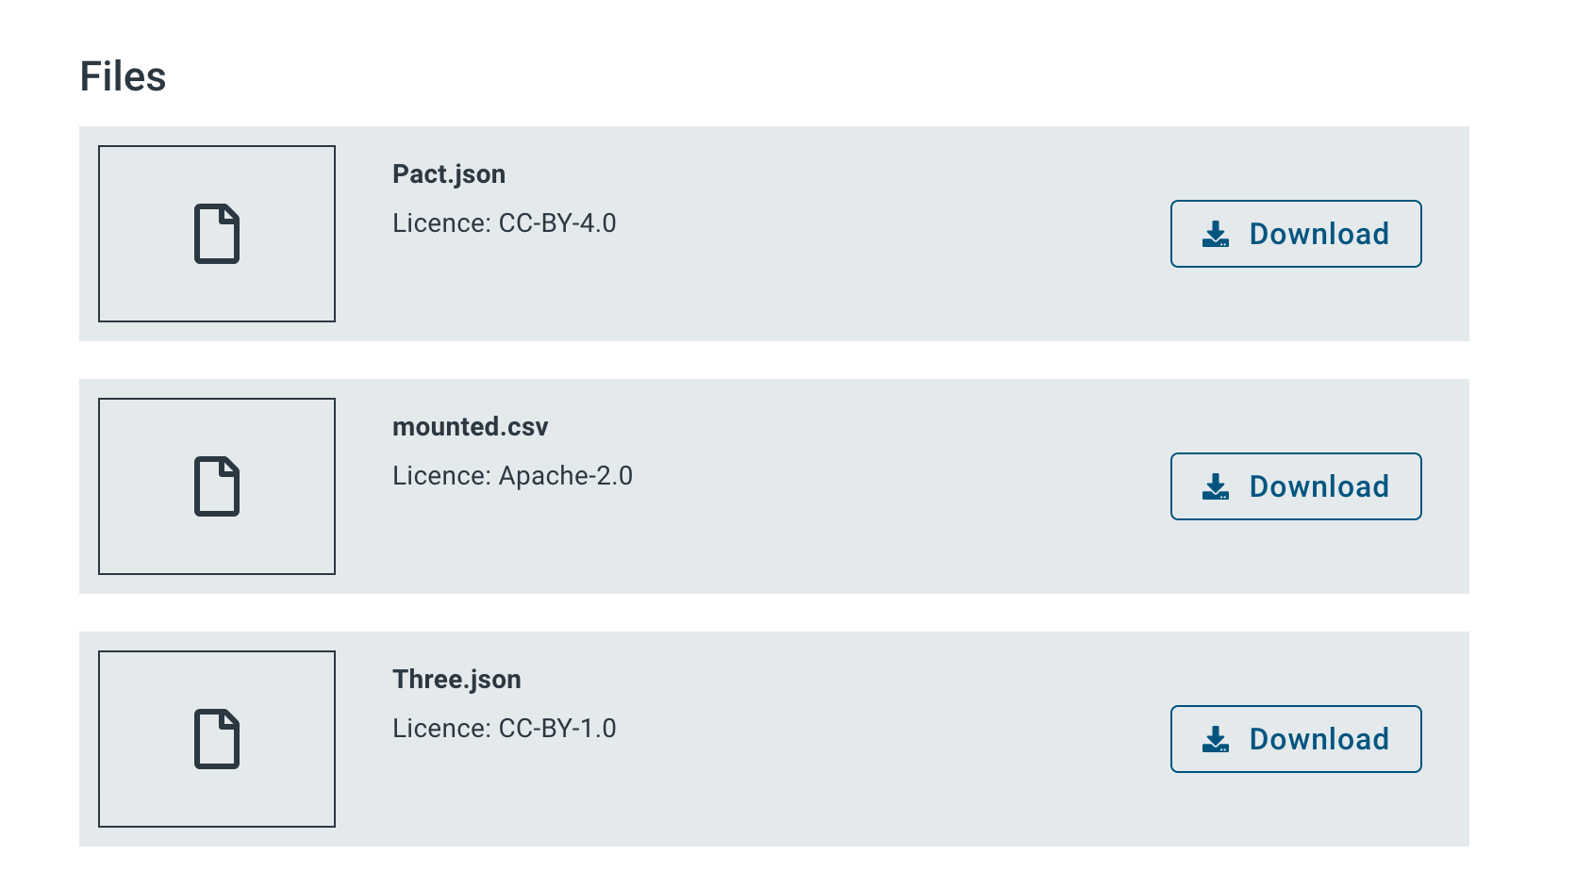
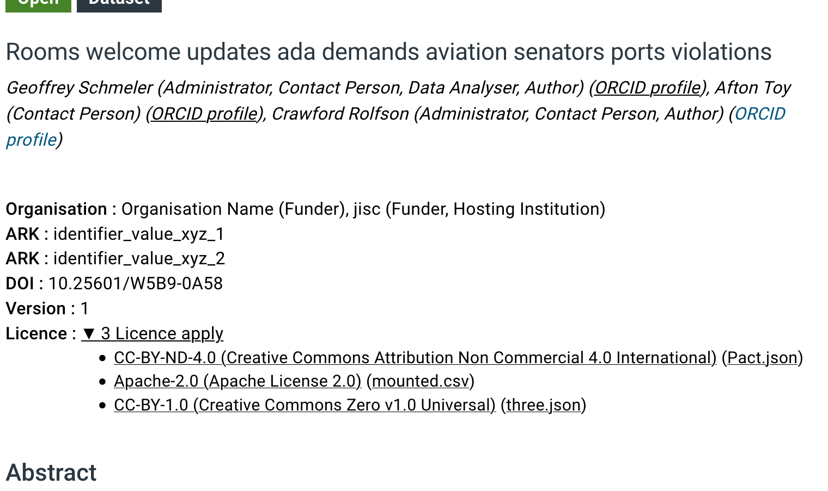
3 - Progressive disclosure
All detail is available. But not at the expense of usability.
Visibility of metadata = gives purpose = engagement
Notes:
Less-clicks fallacy
Making this stuff visible is key to encouraging engagement. Metadata is a black hole.

Slide 21
In summary
We don’t consider this problem ‘solved’ across the market
Even if systems can ‘handle it’, it’s not ‘solved’ until we fully address
How we ask for this information
How we present the information
How we handle the relationship
Notes:
‘Relationship’
Addressing that imbalance of knowledge and motivation.
Making the ‘system’ actively facilitate resolution (not through workarounds)
Empower all parties - submitters, approvers, discovery users.

Slide 22
Scary Live demo
Notes:
‘Relationship’
Addressing that imbalance of knowledge and motivation.
Making the ‘system’ actively facilitate resolution (not through workarounds)
Empower all parties - submitters, approvers, discovery users.

Slide 23
Thank you,
any questions?
Open Research Hub: jisc.ac.uk/open-research-hub
Work by Glasgow University: datasetlicencing.wordpress.com
Survey results: http://tiny.cc/jisc-mixed-licence
Tom Davey, UX specialist @ Jisc
Paul Stokes,
paul.stokes@jisc.ac.uk
@dorebank

