Slide 1
Residential field courses – aaargh!
Background
Animal biology degree students go on a week long field course to SCENE in either week 0, 1 or 2 of teaching of level 3. Additionally in week 5/6 they go on a second field course to FSC Millport for 6 days.
Noticed an increase in number of students with anxieties about going on residential field courses.
Aim
Create a portfolio of resources to try and increase confidence and reduce fears about residential field courses.
Evaluate if there is a reduction in levels of student apprehension after looking at these resources.
Where to start…
I contacted some past students to run my ideas past them and ask for their input in to what would have been helpful for them to know before the field courses.
Notes:
Exploring the use of artefacts to increase student confidence and address fears over transitioning into their junior honours year in the Animal Biology degrees and undertaking residential field courses.
Hi all, my name is Ashley Le Vin and my bitesize talk today is about residential field courses – aaargh! So to give a bit of background to my scholarship idea. I coordinate the level 3 Animal biology degree course and the students in zoology and Marine and freshwater biology go on a week long field course to the university field station at Loch Lomond SCENE (Scottish centre for ecology and the natural environment) in either week 0 ,1 or 2 of teaching of their level 3 course. Additionally in week 5/6 they go on a second field course to the Field Studies Council field station on Millport for 6 days. So these are quite intensive courses that start very early on/right at the start of the year, where they may or may not know any other students on the course.
And over the last few years I have noticed an increase in the numbers of students contacting us with anxieties about going on residential field courses. Or hearing from students after the fact about how worried they were about going. And I also realised that we tell them very little about the course – it’s basically – you are going to SCENE which is at Loch Lomond and you will be picked up from Zoology at 9am on this date… and that is basically it!
So my scholarship aim was to create a range or artefacts, or resources to try to increase confidence and reduce fears about going on these residential courses and then evaluate if these caused a reduction in the levels of student apprehension after they had had access to them.
So I had some ideas myself on what types of resources I would like to create that I thought would be helpful, but I thought it would be best to get some past students perspectives on them and ask for any further ideas, so I contacted some past students and asked for their input on what they think would have been helpful for them to have known before they went on the field courses.

Slide 2
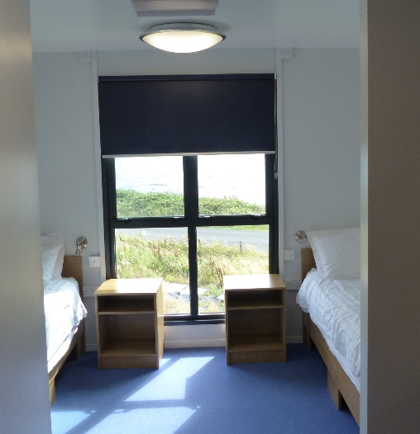
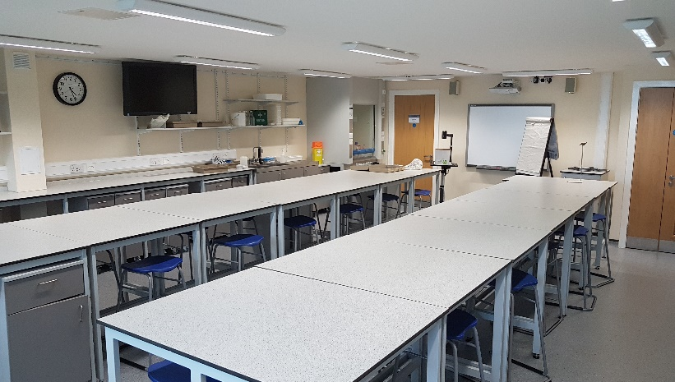
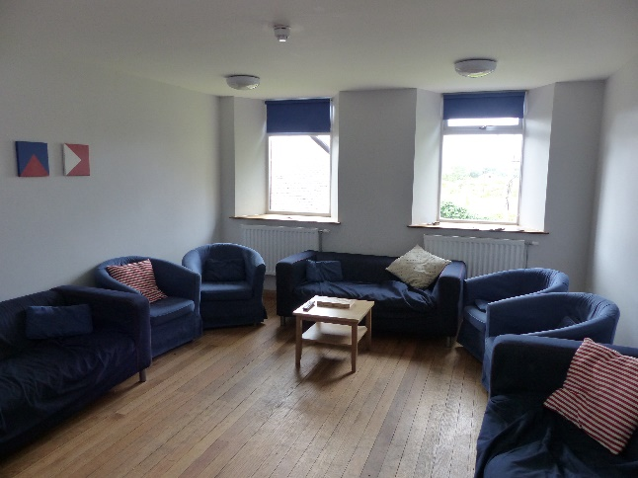
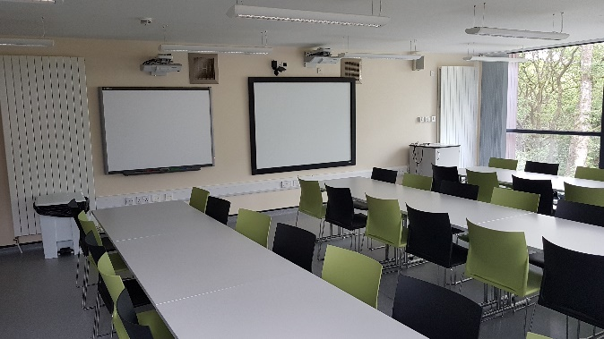
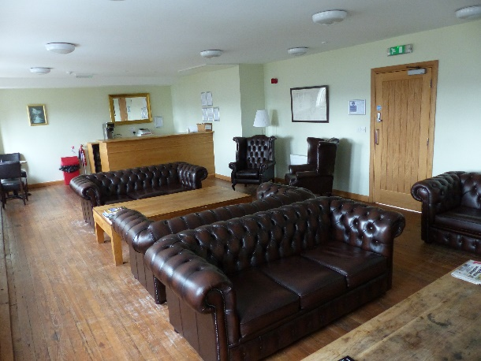
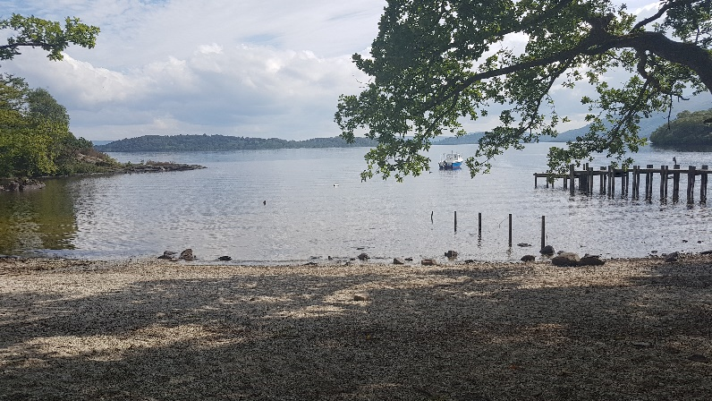
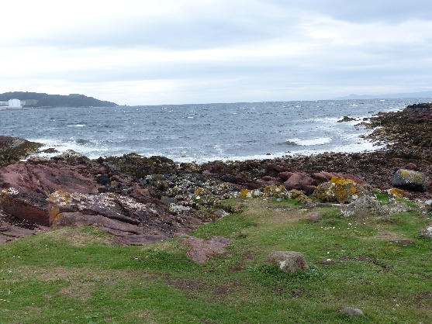
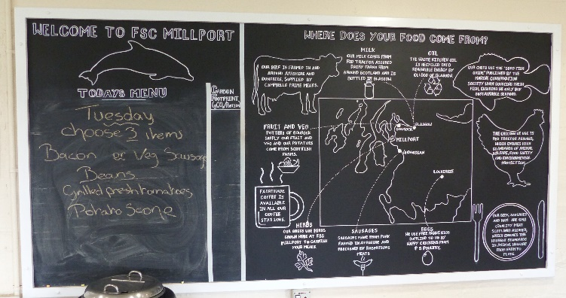
The story so far…
Ethical approval granted and 3 anonymous questionnaires created.
Resources created include (very amateur) videos & photos as well as general information and access to CID’s in advance.
Notes:
So what’s the story so far…
My study had to get ethical approval and I have created 3 questionnaires. Students are under no obligation to participate and the study is anonymous
The first questionnaire they need to fill in before looking at the resources, the second for after they have looked at the resources, but both of these need to be completed before they go on the field courses, and a final follow up questionnaire will be sent once both field courses are complete. The first two questionnaires are gauging student apprehension levels before and after seeing the resources and the final questionnaire is more to evaluate how accurate the resources were, now that they have been on the field course and if there is anything further we could do or create in future years.
And I have created a range of resources including (some very amateur) pictures, videos and general information about our two field stations. I have also given them access to the field course CID’s in advance so that they can look ahead at what they are doing on the courses which previously they couldn’t do.
In terms of my resources I created these included pictures of the teaching spaces, what the sleeping accommodation looks like/how many folk they will have to share a room with and the fact they have en-suite facilities, social spaces available to students, some of the study sites we uses. Additionally I have tried to give information on the types of food they will likely get throughout the day, what other Local amenities there is nearby. i.e the pub!

Slide 3
Data collection has only just started…
Any feedback or further suggestions of useful resources to add (for next year!)
Does anyone want to join in???
Any other field or just residential courses that might want to tag in to this study please contact me
Ashley.Le-Vin@Glasgow.ac.uk
Any Questions?
Notes:
So where am I now with the study. Well data collection just started a couple of weeks ago and is going slow as you can imagine as students don’t check their emails that regularly outwith (or indeed sometimes even within) term time!
But so far I have around 16 participants from a class of around 80.
And although my study is underway I wanted to get any feedback you guys may have or suggestions of additional resources that I could certainly add for next year
And also to put a call out to see if anyone else maybe wants to tag along in this study – so if your course has a field or just a residential element it is possible that it could be tagged in to this study – if your courses are at SCENE or Millport I have the resources made already and the questionnaires are pretty generic.
So if you are interested please have a chat with me today or drop me an email etc…

