Slide 1
Using Popular Media as a Learning Resource to Promote Independent Learning
Lightning Talks
Learning and Teaching Conference
University of Glasgow, 2018
Katherine Price
Katherine.Price@glasgow.ac.uk

Slide 2
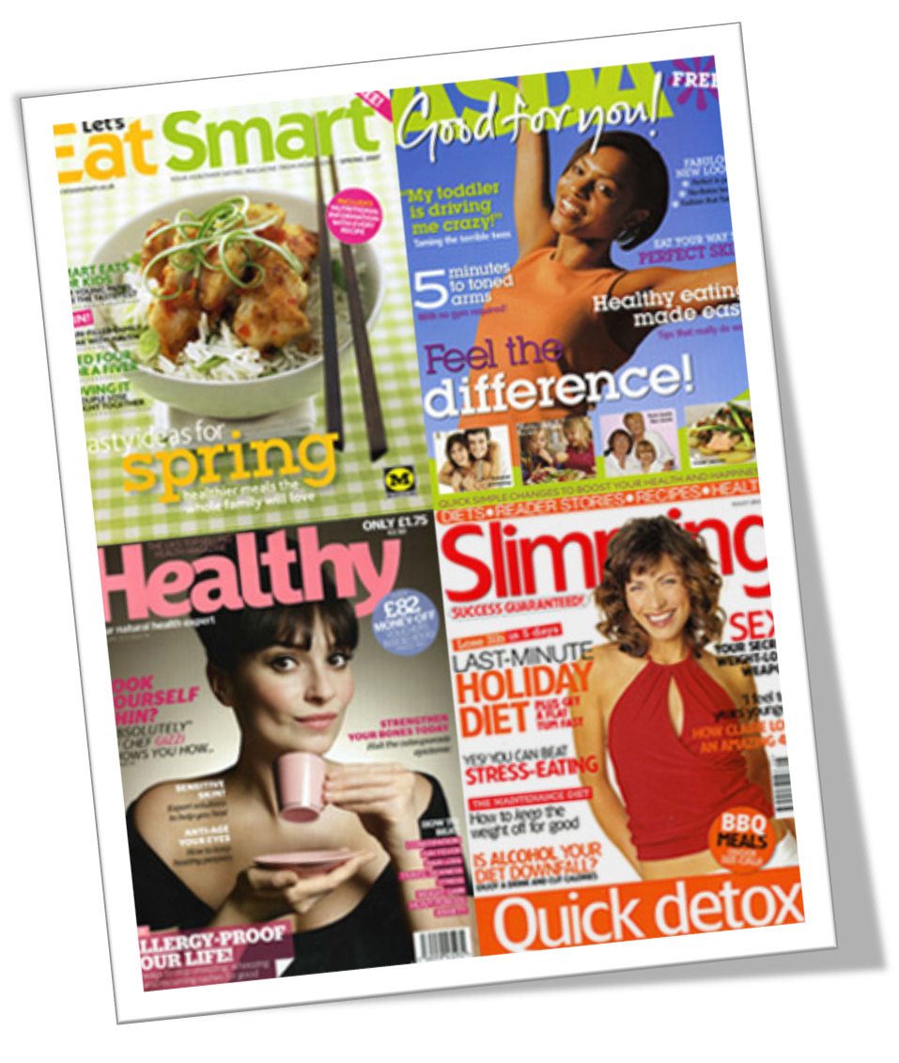
Independent Learning: Critical Investigation
Chocolate cake breakfast could help you lose weight
Cut Cancer Risks with Brazil Nuts
Why marmite could prevent miscarriages and birth defects

Slide 3
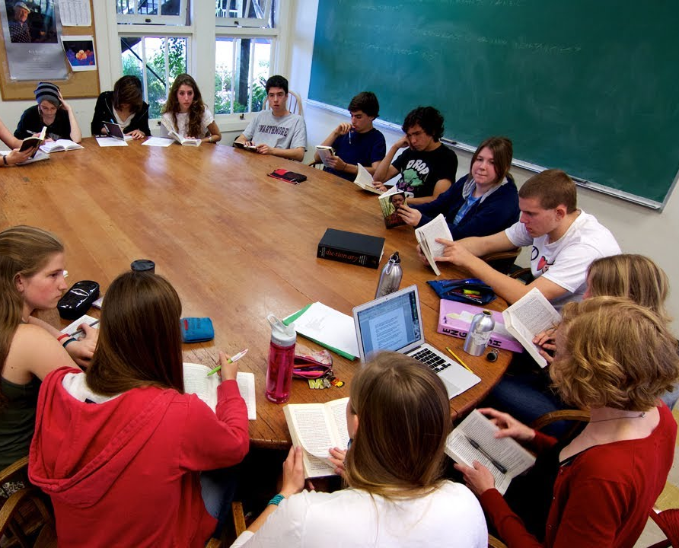
Locate Evaluate Communicate Link
© Edutopia; Source: https://www.youtube.com/watch?v=rWEwv_qobpU

Slide 4
Using Popular Media as a Learning Resource to Promote Independent Learning
Lightning Talks
Learning and Teaching Conference
University of Glasgow, 2018
Katherine Price
Katherine.Price@glasgow.ac.uk

