Slide 1

A blended course that includes a FutureLearn MOOC: Learner and teacher experiences
Vicki H.M. Dale and Jeremy Singer
FutureLearn Academic Network, 28 February 2018

Slide 2

Definition of blended learning
“At its simplest, blended learning is the thoughtful integration of classroom face-to-face learning experiences with online learning experiences … The real test of blended learning is the effective integration of the two main components (face-to-face and Internet technology) such that we are not just adding on to the existing dominant approach or method.”
(Garrison & Kanuka, 2004, p96-7)

Slide 3
Overview
FutureLearn Haskell MOOC and online course in Moodle developed as part of BOLD project (Blended and Online Learning Development)
One year development, one year implementation
Instructor motivations:
  To make learning more engaging and interactive
  Opportunity to showcase University of Glasgow as Haskell pioneer

Slide 4

Some previous studies of MOOCs in curricula
Course | Findings
Medical anatomy MOOC by Leeds, embedded in first year curriculum (Swinnerton et al., 2016) | Students appreciated videos & quizzes Less engaged with discussion boards Rejected replacement of campus-based teaching with MOOC
Students in Romania did a MOOC of choice as 10% of web programming studies (Holotescu et al.,2014) | Students valued discussions & feedback in forums Perceived lack of tutor engagement
Local course ‘wrapped’ around Stanford MOOC at Vanderbilt University (Bruff et al., 2013) | Students liked accessibility & flexibility of videos Preferred to interact with local learners Unhappy with ‘subject coupling’ of Stanford & Vanderbilt material

Slide 5
Methods
Experiences of 4th year Computing Science students (and some Masters students)
Online survey (n=36) followed by focus group (n=6)
Semi-structured interview with staff (Jeremy) as part of affiliated study

Slide 6

Student experiences
What were learners’ experiences of a MOOC as part of a blended learning design?
  What did they value most?
  What did they find most challenging?
How did students experience being part of a massive community of learners?
How did the MOOC prepare learners for the second part of the course?
How should the blended course be modified for a future iteration?

Slide 7
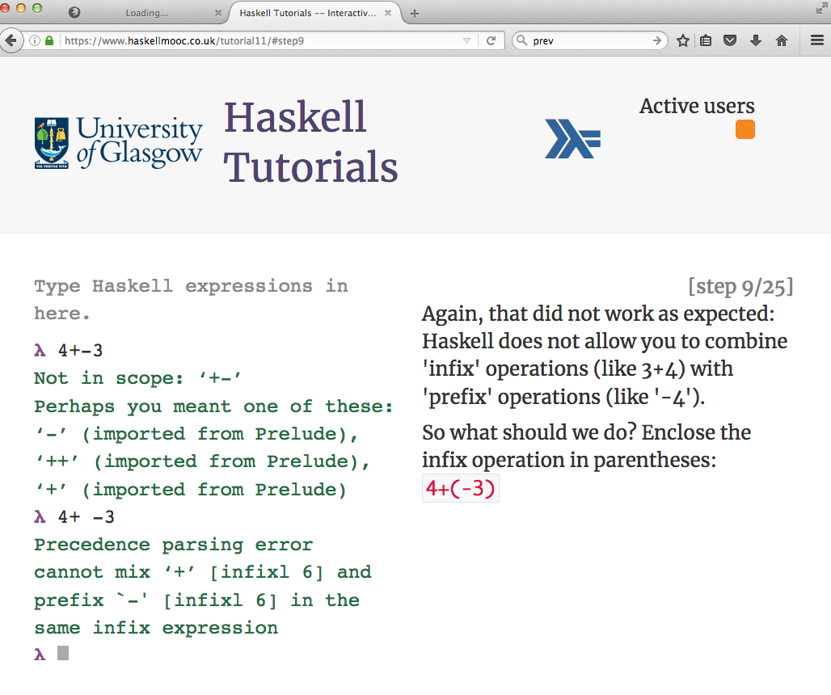

Slide 8
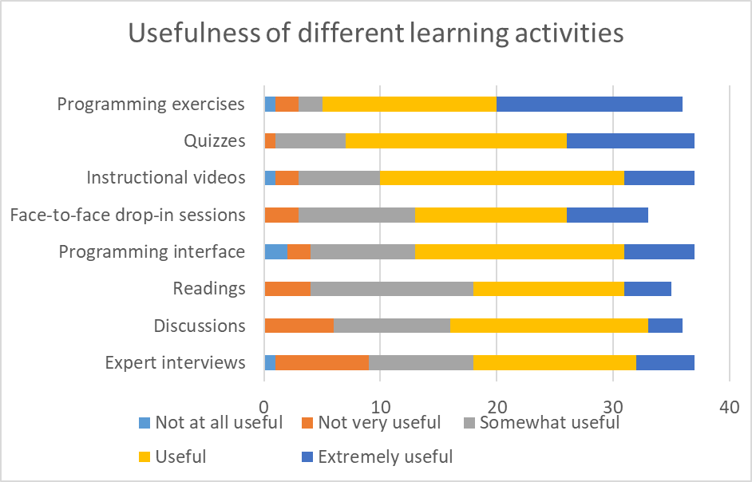
What learners valued most/least

Slide 9
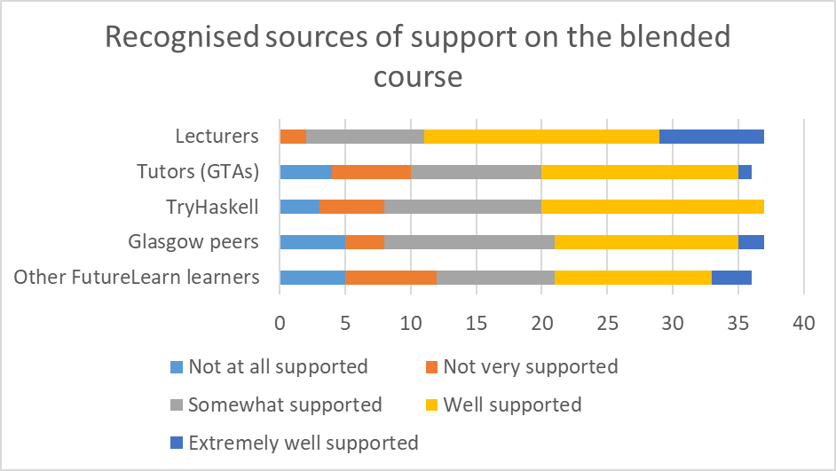
What learners valued most/least

Slide 10
What learners valued most
Combination of learning activities
Benefit of massive cohort
“The quizzes, videos, and exercises formed a very strong combination. The reading provided greater detail on topics given in the lighter materials e.g. videos. The discussions that sat alongside the materials were extremely useful.”
“When I got stuck at some of the exercises I had a look through the comments, and it turned out a few other people had similar problems.”
“For people with no functional programming experience it is useful to have online training (you can re-read, google stuff), while if done in classroom might not be able to go at the pace of the lecture. This is particularly good at the beginning of a new study area, when you have no base and foundation for it already.”
Flexibility (pace of new material)

Slide 11
What learners valued least
Reduced motivation to attend face-to-face
Getting to grips with difficult concepts online
“… non-mandatory face-to-face sessions made me feel less inclined to attend (and more likely to miss out on useful learning / understanding).”
“Explaining a difficult concept using a video or text is not as good as explaining it in class, where you can ask questions right away when it's still fresh in mind and face-to-face explanations are clearer as well.”
Lack of practical labs
“No labs. I feel like there should be like all upper case, like NO LABS … there definitely should be labs.”

Slide 12
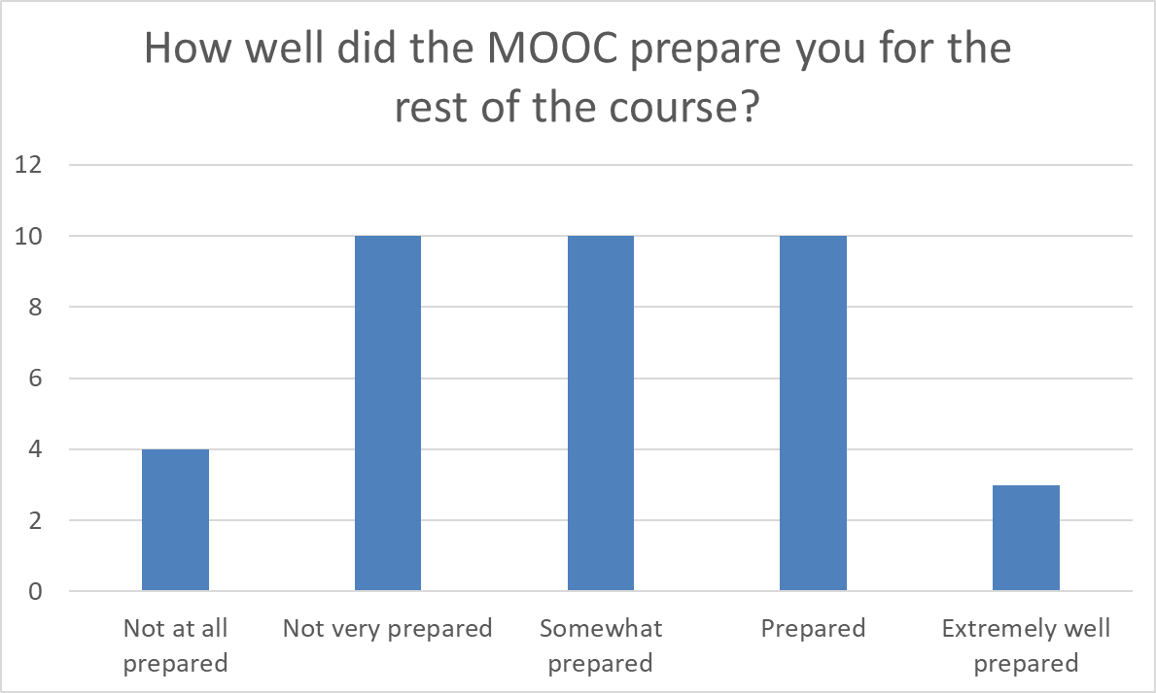
How did the MOOC prepare learners for the rest of the course?

Slide 13
How did the MOOC prepare learners for the rest of the course?
Difficult transition from small practice exercises to long-form programming for assessment
“Well, it’s very difficult for the assessed exercise in the sense that…at least for me I was faced with new stuff there because otherwise you’d made them really simple examples, like we have some optional exercises and that’s all easy. When you go into assessed exercise you’re actually faced with I/O and everything. So basically you, kind of, need some sort of experience with that sort of stuff beforehand and I don’t think MOOC really prepared us in any way for that or not really properly at least.”

Slide 14
Staff experiences
Benefits
  More managed learning and teaching process (front-loaded so less fire-fighting)
  Flexibility for learners
  Enjoyed experience of e-moderating
  Able to monitor learner experience in real-time and make changes as course was running
Challenges
  Time / deadlines (didn’t allow time for beta-testing)
  Students had to use TWO platforms; difficult if they ‘lost’ FutureLearn login details
  Not all students came to face-to-face drop-in sessions

Slide 15
Staff experiences
Enablers
  LEADS media team (videos); LEADS curriculum architect (project management and learning design); IT developer
  FutureLearn willing to add functionality e.g. colour-coded syntax
  PhD students who helped to deliver course
Impact on academic practice
  Developed confidence in chunking different types of content for online engagement
  Moved from a teacher-centred to student-centred approach to teaching; confidence to make lectures more interactive
  College now has an online and blended learning talking group
  BUT, has not impacted on colleagues’ appetite to extend online offerings

Slide 16
How should the blended course be modified for future?
Changes made in response to learner experience research
  More explicit signposting to additional sources of support including face-to-face drop-in sessions
  Bridge the ‘jump’ between MOOC and Glasgow components; gradually increase level of difficulty
  Continue to support students in Glasgow component through ongoing evaluation and addition of learning resources
  May convert second Glasgow component into an Advanced MOOC

Slide 17
Staff experiences
Advice to other educators
  Take or review other online courses
  Allow time for design, development and beta-testing
  Make full use of university support services available
  Use whatever material you can to write up Discipline-Specific scholarship papers, e.g. Trends in Functional Programming in Education 2017 conference
Advice to institution
  Continue to offer opportunities for blended/online educators to share experiences across disciplines and different L&T initiatives
  BOLD showcase:
  www.gla.ac.uk/myglasgow/leads/staff/telt/blended/showcase/

Slide 18
References and further reading
Bruff, D. O., Fisher, D. H., McEwen, K. E., & Smith, B. E. (2013). Wrapping a MOOC: Student perceptions of an experiment in blended learning. Journal of Online Learning and Teaching, 9(2), 187.
Firmin, R., Schiorring, E., Whitmer, J., Willett, T., Collins, E. D., & Sujitparapitaya, S. (2014). Case study: using MOOCs for conventional college coursework. Distance Education, 35(2), 178-201. doi:10.1080/01587919.2014.917707
Griffiths, R., Chingos, M., Mulhern, C., & Spies, R. (2014). Interactive online learning on campus: Testing MOOCs and other platforms in hybrid formats in the University System of Maryland. Retrieved from http://www.sr.ithaka.org/wp-content/mig/reports/S-R_Interactive_Online_Learning_Campus_20140710.pdf
Holotescu, C., Grosseck, G., Cretu, V., & Naaji, A. (2014). Integrating MOOCs in blended courses. Paper presented at the The International Scientific Conference eLearning and Software for Education.
Israel, M. J. (2015). Effectiveness of integrating MOOCs in traditional classrooms for undergraduate students. International Review of Research in Open and Distance Learning, 16(5), 102-118. doi:10.19173/irrodl.v16i5.2222
Koller, D. (2012). How online courses can form a basis for on-campus teaching [blog post]. Retrieved from https://www.forbes.com/sites/coursera/2012/11/07/how-online-courses-can-form-a-basis-for-on-campus-teaching/#6bc5ac2f2887
Swinnerton, B. J., Morris, N. P., Hotchkiss, S., & Pickering, J. D. (2016). The integration of an anatomy massive open online course (MOOC) into a medical anatomy curriculum. Anatomical Sciences Education, n/a-n/a. doi:10.1002/ase.1625

Slide 19
Acknowledgements
Funding:
UofG BOLD project (development)
QAA Scotland-funded Enhancement Themes and UofG LTDF project (evaluation)
Study participants from the University of Glasgow

Slide 20








Any questions?
vicki.dale@glasgow.ac.uk
jeremy.singer@glasgow.ac.uk
/glasgowuniversity
@UofGlasgow
@UofGlasgow
UofGlasgow
Search: University of Glasgow

