Slide 1
Jisc Open Access Dashboard

Slide 2
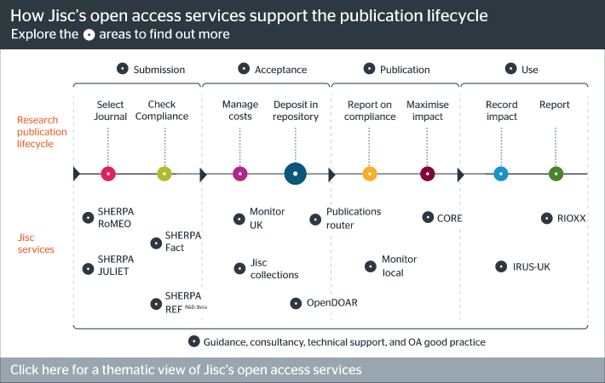
Jisc OA Dashboard project - Background
Institutions manage a wealth of data about their OA outputs at each stage of publication, in part supported by Jisc services.
However, it is difficult to make sense of this information as it is stored across disconnected systems, each with different baselines and scope.

Slide 3
Jisc OA Dashboard
A Jisc OA Dashboard will summarise statistics and information from Jisc services and other open sources to better inform institutions, funders and Jisc itself on the current status of open access development.
This project aims to:
Assess the technical feasibility of such a dashboard by developing a proof-of-concept technical prototype
Gather provisional evidence on the financial feasibility of a future production system.

Slide 4
The project at a glance
May - June
June - July

Slide 5
Dashboards: objective, use case, indicators, drill down
The Dashboard descriptions were prepared as follows:
Objective: For example Informing OA policy effects
Use case: For example Authors’ take-up of OA options
Indicators: % Green OA articles, % Gold OA articles etc.
Drill down options: per institute, per publisher, per discipline, benchmarking with national average etc.

Slide 6
Five possible prepared dashboards
Possible Dashboard | Use Case(s)
A. Informing OA policy effects | Authors’ take-up of OA options
B. Informing Green and Gold OA policy effectiveness | Usage of OA and non-OA articles Citations and Altmetrics of OA and non-OA articles
C . Informing APC financial implications and offsetting deals | Financial sustainability of OA approaches Budgeting and financial management
D. Reporting of/accounting for OA policy compliance | Level of compliance with funder policies (RCUK, COAF) and with REF
E. Repository management | Institutional repository statistics Statistics of Subject repositories with Green OA articles by institutional authors Efficiency and automation

Slide 7
Input by the institutional representatives
We received inputs from institutions via the following:
London workshop
Session at Edinburgh workshop
2 interviews with library directors
Follow-up interviews with representatives of Brunel University and Glasgow University
Users prioritised Dashboards A and B.

Slide 8
Data sources for Dashboards A and B
Dashboard A - Authors’ take-up of OA options
Dashboard B - Usage of OA and non-OA articles
Dashboard
Links between dashboards
Data
aggregation
Identify population of articles to include in the dashboards (DOIs per institution)
Enrich metadata and determine Gold OA status
Determine green OA availability
Combine data on OA status with usage information
Data
sources
CrossREF
OADOI
CORE
JUSP
IRUS
SHERPA/ RoMEO
SHERPA/ REF
Altmetrics from Impact story
CrossREF - Open Citation Index
Key
Third party service
Jisc service

Slide 9
Discussion
Would a dashboard with the features described be useful for HEIs?
Would the information gathered in the dashboard be valuable enough to justify paying for it?
If not, is anything specific missing?

Slide 10
OA Assessment Template

Slide 11
Overview
The project is jointly funded by HEFCE, RCUK, Jisc and Wellcome.
The aim is to gain understanding of how the higher education sector is progressing towards open access, in relation to funder policies.
Formal announcement due post-election!

Slide 12
General information
To achieve their objective, the funders wish to develop a quantitative assessment methodology in the form of an online survey.
The design of the survey will take place between May and July 2017.
The final assessment process will take place using the developed survey between September and December 2017.

Slide 13
Development of the assessment template (May-Jul 2017)
Creation of a first survey draft for initial feedback from HEI experts
Amendments to the first draft and dissemination to 18 pilot institutions for a trial data gathering phase
Consultation with the pilot institutions to highlight possible issues or potential improvements to the template
Finalisation of the evaluation template and reporting to the funders

Slide 14
Topics in the assessment template (Sept-Dec 2017)
In-scope compliance
OA compliance tools
Repository use
Costs of OA
Licenses
The survey will be circulated to all UK HEIs in the Autumn.
You will need to supply figures on levels of OA outputs in your institutions, as well as general information on the systems and processes in place to track and manage OA articles.

Slide 15
Thank you
Rob Johnson
rob.johnson@research-consulting.com
@rschconsulting
www.research-consulting.com

