Slide 1
ARMA Open Access
Special Interest Group
Photo by Ian S CC-BY NC 2.0 https://www.flickr.com/photos/ian-s/2909974300

Slide 2
Draft Agenda
1400-1415 Mini Brainstorming
1415-1430 UUK, RCUK, interoperability, REF Compliance and more
1430-1440 Jisc Dashboard for Open Access
1440-1450 UK Scholarly Communications Licence
1450-1500 Advocacy
1500-1515 Mini Brainstorming and actions

Slide 3
1400-1415 Mini Brainstorming
Note concerns and comments on sheets:
OA publications
Engagement/advocacy
Data
Outcomes reporting (ResearchFish/Interoperability)
What do we want from ARMA SIG?
Events?
Meet ups on specific topics to share best practice?
Start another sheet if you wish
Read comments – if you think something is important add a ‘*’

Slide 4
1415-1430
Updates
DMP Online – hoping that import will come – working on code for existing tools.

Slide 5
Universities UK
Bill Hubbard

Slide 6
Research Councils UK
Looking at ways to fund OA post March 2018
Update at RCUK OA Practitioner’s Meeting 18th July
Exploring open access data sources including ResearchFish
2017-8 grant instalment 2 due early June – email to dist list
Check your dist list contact by emailing openaccess@rcuk.ac.uk
FAQ recently updated – living document - http://www.rcuk.ac.uk/research/openaccess/policy/

Slide 7
Interoperability
Successful pilot –saved re-keying
Specification and guidance will be provided
Using acknowledgements well for OA helps harvest from web or research systems
Issues e.g. student identifier, award reference
Next steps? Books, Impact, Open Access compliance?

Slide 8
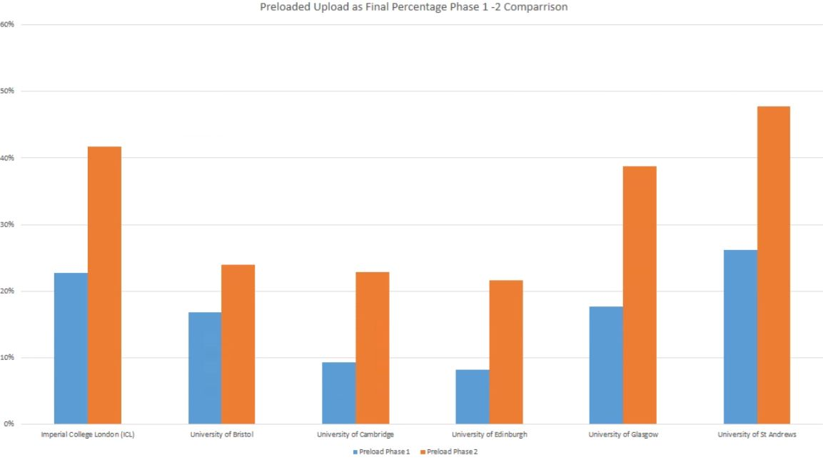
% Automatic Upload for Publications

Slide 9
Terminology – CASRAI UK
Consortia Advancing Standards in Research Administration Information (CASRAI)
Open standard definitions – better sharing of information
UK working groups consultations https://forum.casrai.org/t/2017-standards-open-review-now-live/378
Open Access
Impact
Career levels
http://docs.casrai.org/United_Kingdom_Chapter
Join or get on the mail list by contacting info@casrai.org
£580/year – bit more for very large orgs and less for very small
There is still space at the meeting – hear more, suggest future working groups https://casrai.org/uk17
See Jacqui and Valerie at the stall or get in touch

Slide 10
REF Open Access Compliance
Informal workshop Scotland – following up with HEFCE https://oascotland.wordpress.com/2017/05/02/ref-compliance-workshop-3rd-may-2017/
VM to add update on follow up
HEFCE Plans for Monitoring
2021

Slide 11
1430-1440 Jisc Dashboard Rob Johnson
Notes:
National Centre for the Replacement Refinement & Reduction of Animals in Research

Slide 12
1430-1440 UK-SCL Valerie McCutcheon (or you…..)
Notes:
National Centre for the Replacement Refinement & Reduction of Animals in Research

Slide 13
United Kingdom Scholarly Communications model policy and licence
Update May 2017
Prepared by Chris Banks on behalf of the UK-SCL Steering Group

Slide 14
Academics face the “policy stack” challenge
Many funder policies:
Different compliance requirements
Differently funded (or not)
HEFCE policy in particular, differs substantially from other policies and applies to all UK research academics
Many publisher policies
Some publisher have different policies depending on who funds the researcher
Many publisher policies are not in line with HEFCE policy
Difficult to know what to do to comply both with Funder and HEFCE policies (e.g. very easy to comply with RCUK but fall foul of HEFCE eligibility)
Institutional OA and IP policies not in alignment with funder policies, so don’t best support academics.

Slide 15
Institutions
Recognising that IP, copyright and open access policies were not necessarily supporting funder compliance – something needed to be done
Variety of approaches to academic IP across UK institutions
Legally, in the UK: employer is the first owner of any copyright in the work (subject to any agreement to the contrary). Created “in the course of employment” which courts have typically taken to mean ‘contract of service’ (eg as an employee) rather than a ‘contract for services’ (eg as a freelancer or independent contractor).

Slide 16
Publishers
Have varying approaches to copyright, from licence to first publish, to outright copyright transfer
Licenses not read by academics – more interest in the journal than in the agreement
A problem not confined to publishing – how many have read the android google agreement? Social media agreements?
In 2012 Time magazine reported Carnegie Mellon funded research which concluded: You’d Need 76 Work Days to Read All Your Privacy Policies Each Year

Slide 17
Library
Wanting to create frictionless services
Needing to upscale services to all academics – HEFCE policy
Can’t easily give answer to academics on OA options - need to ask them lots of questions first (who funds, where publishing) before advising of OA options/requirements
Working with academics to understand challenges and opportunities

Slide 18
Why an OA policy revision is needed
Need to ensure that institutional policies are in alignment with funder (RCUK, HEFCE, etc.) policies
Publisher policies vary considerably – many do not enable easy compliance with both funder(s) and HEFCE policies
Want to preserve academic choice as to where to publish, including academic freedom to sign whatever licence/© transfer agreement is necessary (whilst separately continuing to encourage scrutiny of those licenses)
Desire to maximise impact of publication
Desire to retain some re-use rights for use in teaching etc, including rights in diagrams and graphs produced for the publication. Presently, items deposited in the repository often cannot be used in teaching until after the embargo has passed

Slide 19
Harvard model policy chosen
Key components:
Implemented as part of university OA policy
Academics deposit Author Accepted Manuscripts (AAMs) and grant a non-exclusive licence to the university for all journal articles
Well established policy – has been in use since 2008
Where a journal seeks a waiver, this can be managed by exception (happens <5% in the USA)
Used by over 60 institutions worldwide
From Harvard and MIT
To smaller institutions, including two in Kenya

Slide 20
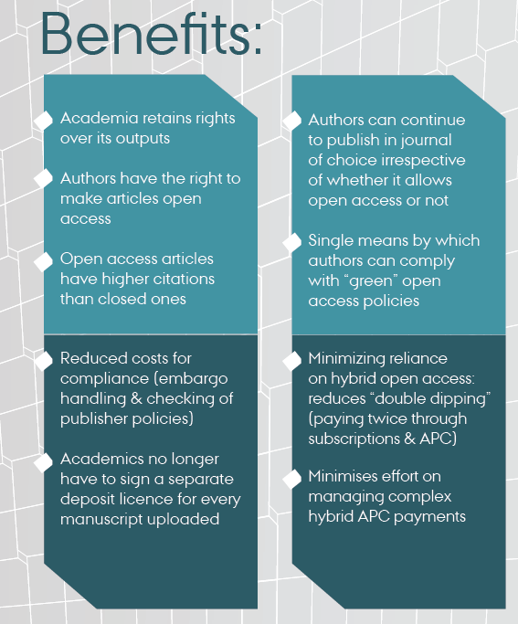

Slide 21
Next steps by the community
60 institutions interested
First mover group ~ 12 institutions
Ongoing discussions with JISC, funders, Russell Group
Wider engagement with the academic, library, research office and legal office communities
Text for waivers and communications are being drafted
Steering Committee established
UK launch October 2017 meeting over 2 days – max 3 per org:
https://forms.office.com/Pages/ResponsePage.aspx?id=7qe9Z4D970GskTWEGCkKHhK-nzQJDOpNhn4-jFCmrNJUMFFPTDBXSFBZRVhGNTQ3WFVDMk44UjhKNS4u

Slide 22
Publisher responses
Some very positive responses including pure gold (e.g. PLoS) but also learned society (Royal Society)
Other publishers less happy but now in dialogue with the Steering Group through membership bodes: Publishers’ Association and the Association of Learned and Professional Society Publishers

Slide 23
Summary of current publisher questions
Q: UK-SCL goes “beyond” requirements of Finch
A: UK-SCL is intended to support HEFCE eligibility in addition to RCUK etc compliance. Policy does not take a view on green/hybrid/gold and retains academic freedom to publish
Q: Policy would undermine the publishing process
A: Harvard policy has been around since 2008, has been adopted by 60+ institutions and publishers request waivers <5% of the time

Slide 24
Q: The Author Accepted Manuscript will be made available on publication
A: yes, as per the Harvard model which has been around since 2008
Q: There would be an administrative burden on UK authors/institutions as publishers would *have* to ask for waivers (est 65-70% of all articles)
A: The Harvard-adopting institutions experience is <5% and we do not yet know why UK authors would be treated differently. We currently check 100% of all articles anyway.

Slide 25
Q: If the problem this is trying to solve is only 8% of all articles, should we not sort out the 8%? (this relates to the % articles submitted in the last REF for which there was estimated not to be a compliant option)
A: institutions currently have to check 100% of articles, both for HEFCE and for other funder policy requirements
Q: Elsevier claim to have agreement from RCUK that CC-BY-NC-ND is RCUK-compliant
A: RCUK website states: “The licence should also allow for the sharing of adaptations of the material. This means a CC-BY-NC licence, or equivalent is acceptable. A CC-BY-NC-ND licence is not compliant.”

Slide 26
Next steps
Further meetings with the PA/ALPSP to take place during the summer
Finalise website, waiver system, advocacy materials and boilerplate texts
Gain agreement on early mover institutions, and on the date of first adoption
Notify publishers

Slide 27
Further reading & watching
Banks, C., (2016). Focusing upstream: supporting scholarly communication by academics. Insights. 29(1), pp.37–44. DOI: http://doi.org/10.1629/uksg.292
Torsten Reimer, UK Scholarly Communications, Licence and Model Policy, https://zenodo.org/record/153928#.WLaz9G-LREY
“Focusing upstream” – recording of talk given at UKSG 11 April 2017: https://tv.theiet.org/?videoid=10043

Slide 28
Credits
Dr Torsten Reimer (formerly Imperial, now British Library)
Simon Bains (Manchester)
RCUK (Mark Thorley)
HEFCE (Ben Johnson and Stephen Hill)
Wellcome (Robert Kiley)
Many RLUK and LERU librarians
All those who originally developed the “Harvard” model

Slide 29
1450-1500 Advocacy Sarah Whalley
Notes:
National Centre for the Replacement Refinement & Reduction of Animals in Research

Slide 30
1500-1515 Mini brainstorming key points/action plan
Notes:
National Centre for the Replacement Refinement & Reduction of Animals in Research

Slide 31
What Next?
Write up and sharing of summary
What else?
Thank you

