Slide 1
Improving transition into university life through real and virtual groups
Shazia Ahmed
Sarah Honeychurch
Lorna Love
1 May 2014

Slide 2
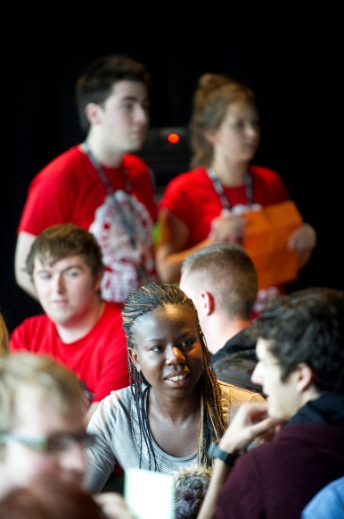
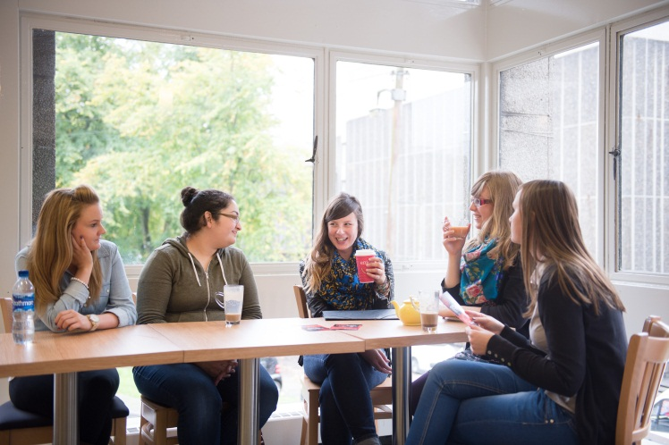
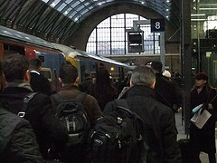
Issues
Diversity of students
Range of backgrounds
3 subjects – lack of community
Commuting students ~40%

Slide 3
Using existing model
Successful Facebook groups for Maths and Comp Sci
Extend model to pre-entry support for all Schools in College of Science & Engineering

Slide 4
Facebook Groups
Over half of 2013-14 cohort joined main group before arriving
Links to subject-specific groups

Slide 5
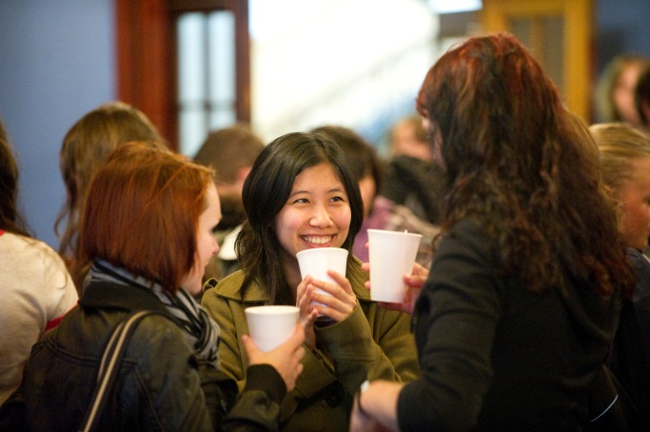
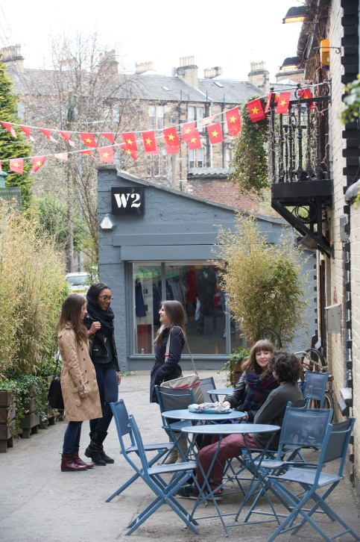
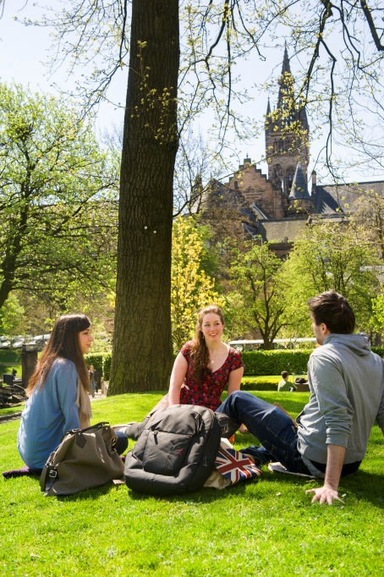
Advantages
Conversations with each other
Conversations with more experienced members
Questions relating to:
Course
Glasgow generally

Slide 6
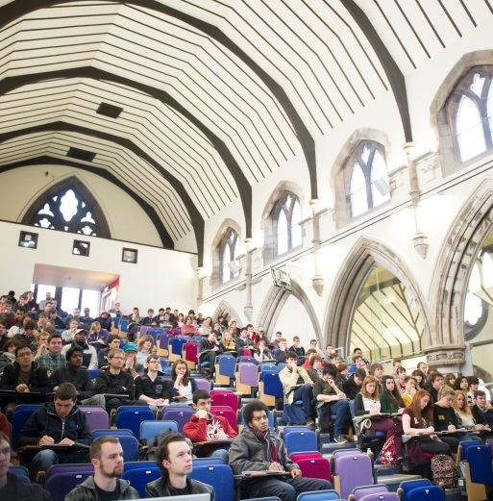
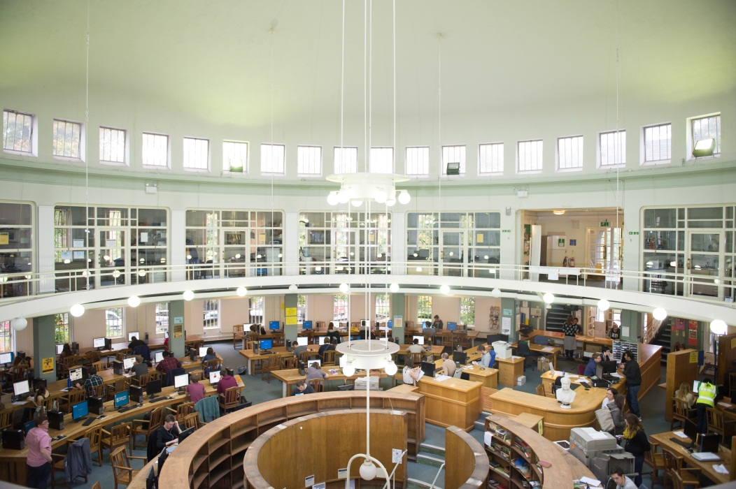
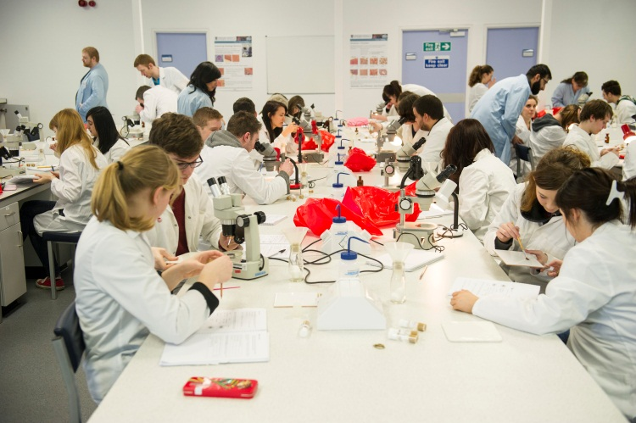
Advantages
Conversations with staff
Reassurance
Pre-entry resources (Maths)

Slide 7
Film afternoon

Slide 8
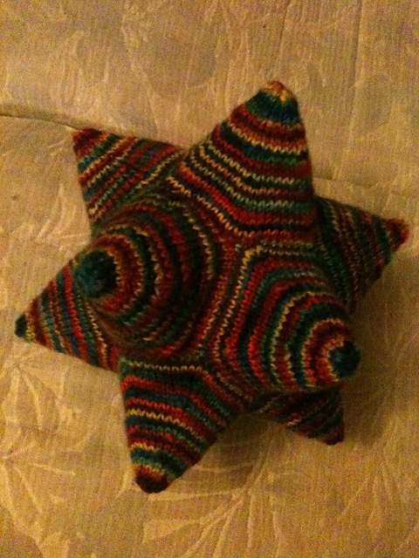
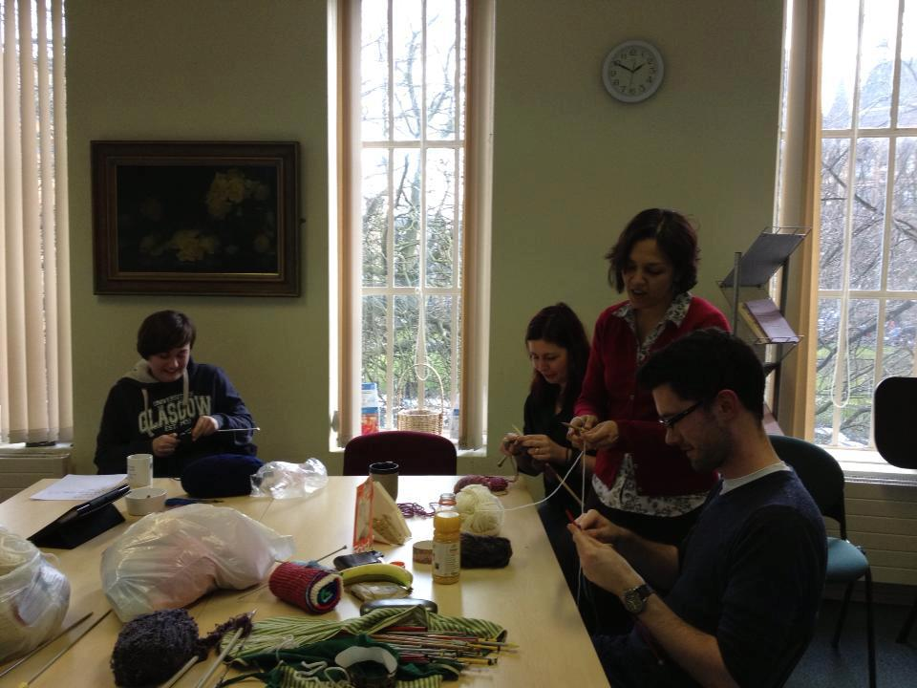
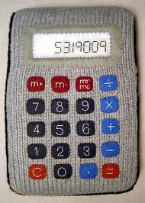
Knitting Group

Slide 9
A big success

Slide 10
Thank you
Shazia Ahmed
https://twitter.com/ShaziaAhmed
Sarah Honeychurch
https://twitter.com/nomadwarmachine
Social Media and Learning Communities
https://www.facebook.com/groups/12544718765832/

