Slide 1

Building collective capabilities with children and young people
'Opening the gate to your brain': a youth worker practice and research event
28th January 2020
Sarah Ward, Research Associate
Maureen McBride, Research Associate
Notes:
Slide 1
We’re going to start with the words of some young people from the case study with which we’ve been involved over the past eight months. These are taken from a devised theatre show, first performed in Glasgow in February 2019.

Slide 2
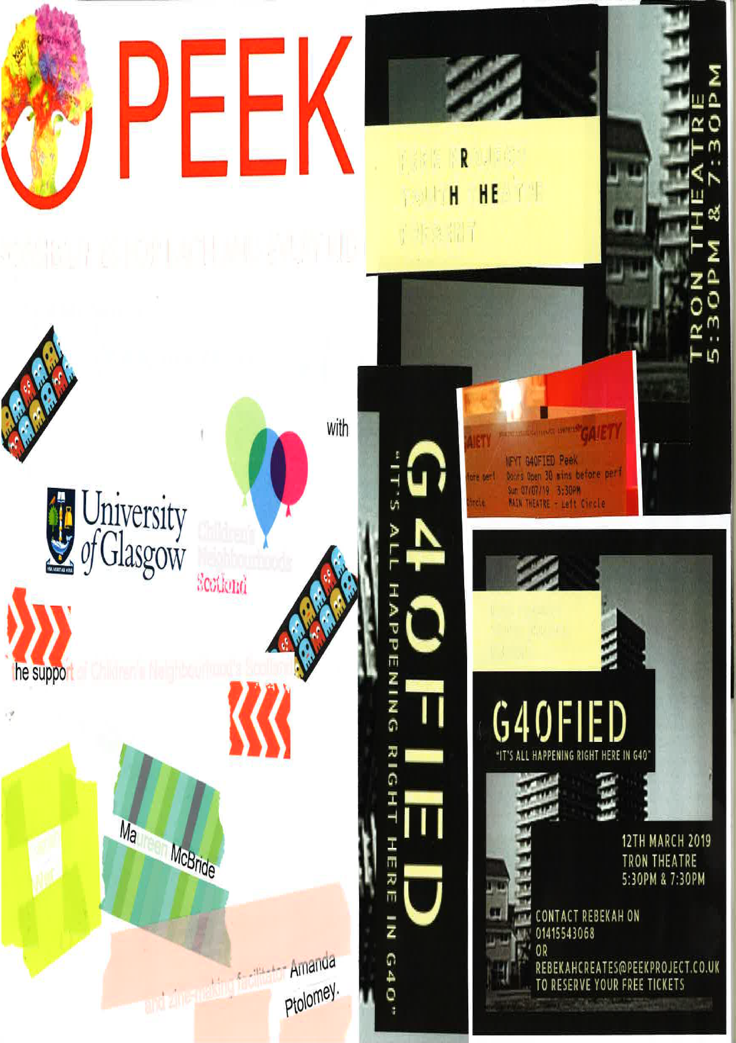
PEEK drama group
We all came into this world fighting​
And we all shed the same tears​
As humans we grow and learn to understand other humans.​
But, that’s not always the case,​
What if you find it difficult to understand others?​
What if you chose not to understand?​
What we choose to ignore,​
what we choose to accept, ​
what we choose to applaud, ​
all of our actions will shape the lives of many humans​
in the Gallowgate.​
In the Calton.​
In the Barras.​
In Parkhead.​
In Tollcross.​
In Bridgeton.​
In Duke Street.​
Right here in G40.
Notes:
Slide 2
Earlier this year, we began work with a youth project in the East End of Glasgow. Established in 2000, the project is a third-sector organisation employing twenty-two staff to offer a range of programmes around the themes of ‘play, create and thrive.’ The project was created by a local person to give creative opportunities to young people, and now runs a range of activities for children and young people aged five to twenty years. Our work – the mini-case study that we are going to refer to today - focused specifically on a drama project, a theatre show devised and performed by young people on the theme of their local neighbourhood.

Slide 3
Children’s Neighbourhoods Scotland
Scottish Government (2018) ‘Every Child, Every Chance: Child Poverty Delivery Plan 2018-22’:
  a. Focus on poverty mitigation
  b. Attention to quality of life
Children (Scotland) Bill 2020 (UNCRC).
Children’s Neighbourhoods Programme (2018 – 2022, £2.2m, 6 neighbourhoods)
CNS as facilitator for participation, collaboration and change in neighbourhoods of high social deprivation
Child-centred approach to improving wellbeing goals for children and young people: deliberation, dialogue and decision-making
Research and evaluation integrated into programme
Background of austerity, threat to youth work services & increased pressure to deliver outcomes and impacts
Notes:
Slide 3
First we'll set some background context to our research.
We are employed by Children’s Neighbourhoods Scotland. This is a programme funded by the Scottish Government as part of their Child Poverty Delivery Plan, ‘Every Child, Every Chance'. The aim of our programme is to support collaboration and change in areas of high social deprivation in the west of Scotland. We offer this by a combined programme of activity, and research and evaluation. Our role is to develop a child-centred approach to improving wellbeing goals for children and young people in the area. Enabling dialogue and deliberation by young people themselves is a key part of this.

Slide 4
CNS research based on CA
CNS Research Phases | Questions/participants | Methods
Phase 1 | Developing a Capabilities framework drawing on EMF Stakeholder interviews RQ: What are the key barriers/enablers to CYP wellbeing? | In-depth interviews
Phase 2 | Developing a Capabilities framework Research with CYP RQ: What opportunities do CYP need in their lives to ensure their wellbeing? Drawing on Nussbaum domains | Focus groups (2 x 10 participants x 8 weeks) Participatory workshops/deliberative dialogue
Phase 3 | Developing a Capabilities framework Research with CYP – Focus Groups RQ: What opportunities do CYP need in their lives to ensure their wellbeing? Drawing on Nussbaum domains | Questionnaires (CYP-led) x 120
Phase 4 | Research with youth drama group RQ: Disrupting power relations: how can CYP be supported to articulate their own social reality and what are the effects of this? | Observations Focus groups Zine making Analysis of script
Notes:
Slide 4
Phase one of the research was conducted with stakeholders in the local area, many of whom highlighted the concern that children and young people’s voices are largely absent from public decisions that concern them. To help respond to this issue, we have spent the past year working with local children and young people - mainly in primary schools, so far - to build a framework of Capabilities goals and functionings, as a means of bring children and young people’s voices to the fore. Our aim is that Children’s Neighbourhoods can then support CYP to call a wide range of stakeholders to account and ensure that the freedoms and goals they have reasons to value are central to planning resources and services.
As part of this process, we came across the youth project. It struck us that this project was doing some radical and empowering work – albeit in a quiet way, week in and week out – that seemed to be rooted in the values of empowerment. We wanted to capture some of this unique approach, as it seemed that the project embodied an ethos that resonated with the need to listen and act upon young people’s voices.

Slide 5
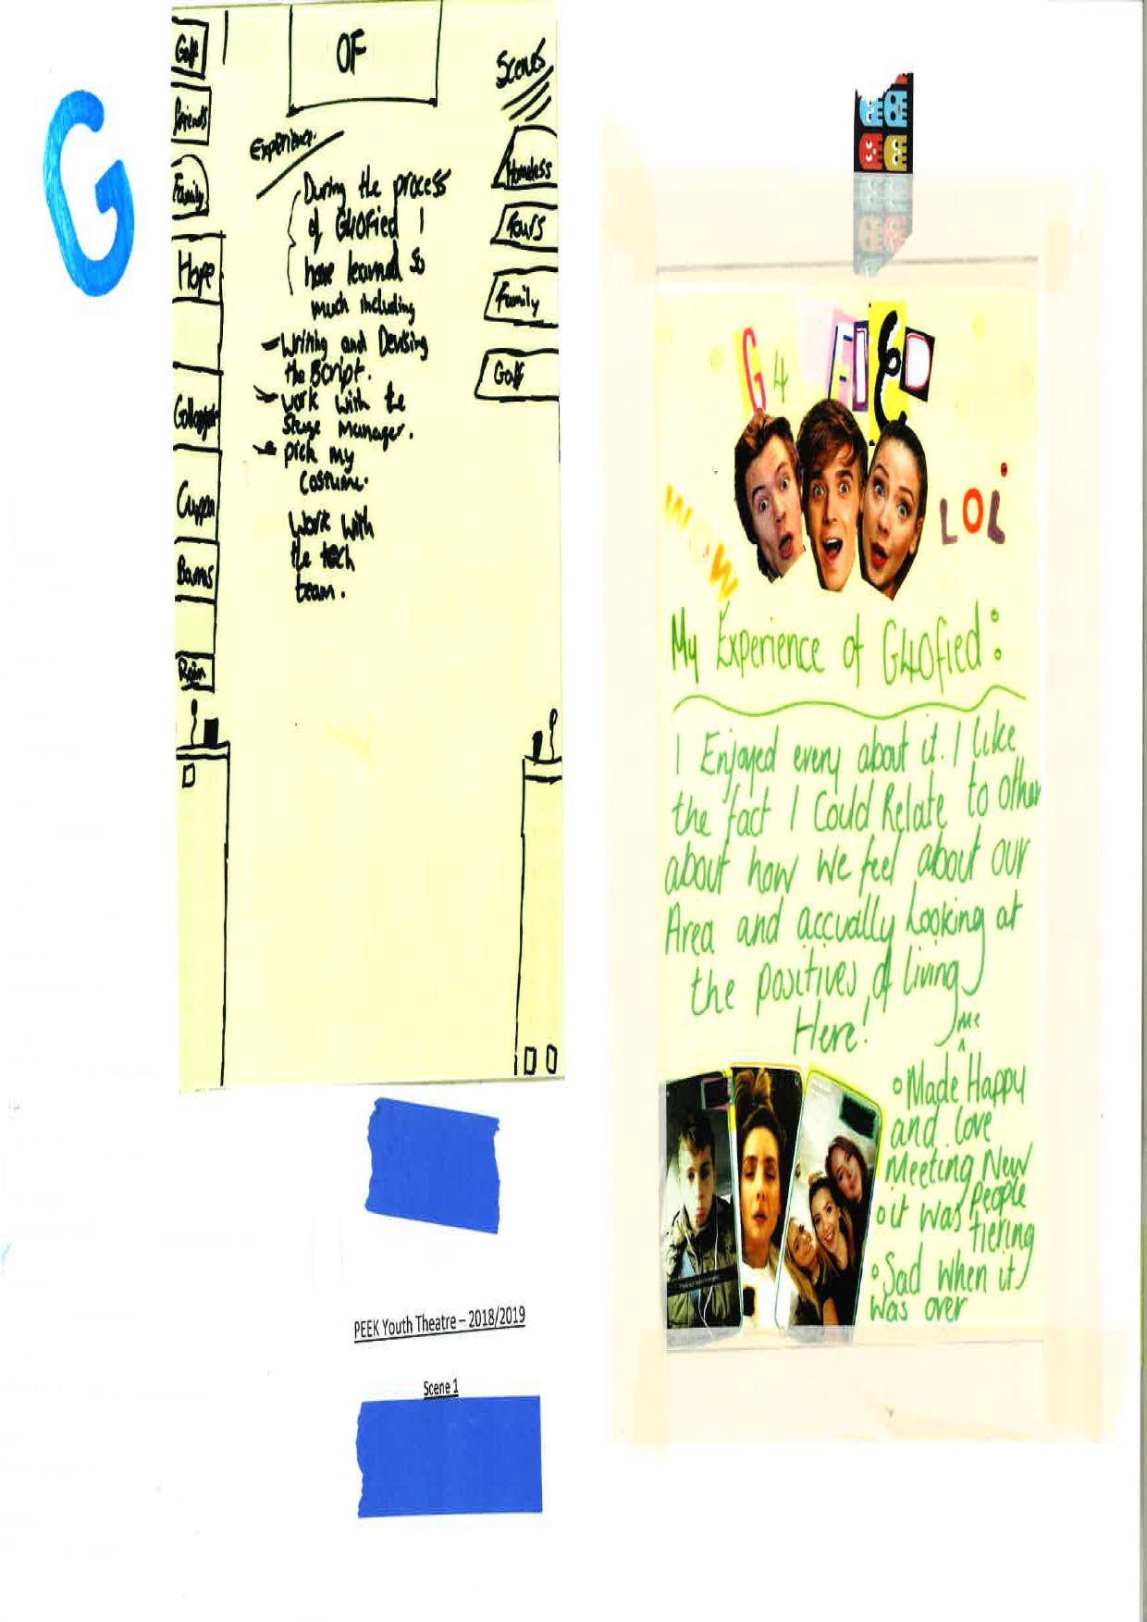
Phase four research methods
Observation of rehearsals and script development (x3)
Analysis of final script
Attended live performance
Focus group discussion
Zine-making workshop
Notes:
This strand of work encompassed various methods. We were fortunate enough to observe some of the rehearsals of the play, including when the young people were still in the process of developing the script. We conducted an analysis of the final script, and attended a live performance of the play. After the performance, we held a focus group discussion with some of the young people reflecting on their experience, and a subsequent discussion based on a zine-making workshop that was facilitated by one of our PhD students. We also intend to do some one-to-one interviews with the young people in the near future.

Slide 6

Building collective capabilities with CYP: drawing on the 3C-Model (Ibrahim, 2017)
3-C Model of Empowerment (Ibrahim, 2017)
1. Consciencization (Individual)
Gaining critical awareness
2. Conciliation (Collective)
Building a common vision
3. Collaboration (Institutional)
Ways to act/challenge power relations
Notes:
We chose to use Capabilities Approach because it offers what Alkire calls both an EVALUATIVE (normative) role and also a PROSPECTIVE (policy) role. In other words, Capabilities provides a useful tool for us to help small organisations such as PEEK to demonstrate the important work they are doing, but also allows us to see the potential for extending this, and the conversion factors required to maximise its social justice potential.
The theoretical frame that we found really useful was Ibrahim’s work on the 3Cs of empowerment in social innovations work: Conscienzisation, Conciliation and Collaboration. This was developed in the Global South, and based on social innovations, but we would suggest that it has relevance to issues of child poverty associated with the Global North. This process of the three Cs offers a way for us to break down the stages of critical pedagogy, and also to think beyond critical consciousness as a reflective state to what it can generate in terms of action for change – and specifically, how it can challenge issues of power.

Slide 7
Findings 1: Conscienzisation
Writing our own story
James: We realised there were pros and cons to living in the East End of Glasgow and we wanted to show people what the East End is about ... like how we see it as young people.
Katie: Some people say stuff about Glasgow, but then they see the real side of it.
James: We … worked on how the media sees the East End of Glasgow, and basically it is not a good place sometimes. We wanted to show it is a good place and there's good people in it.
Notes:
Slide 9
Another important aspect of Conscienzisation was the act of writing your own story - in itself a vehicle for critical reflection on the YP’s circumstances: READ.

Slide 8
Findings 2: Conciliation
Making compromises: deliberation and inclusive decision-making
Emma: We just disagree and then we kind of mix it together and then it becomes something …
David: Even if you can't mix it together we would sit and speak … right this is how I feel about this and then Emma would speak and say, this is what I feel about this and then maybe my ideas and my explanation has changed Emma's mind a bit and then we can collaborate and decide on that idea.
Notes:
Slide 11
Here again, the theme of Conciliation shows YP making compromises, and being okay with disagreements over content: READ

Slide 9
Findings 3: Collaboration
‘No-one’s in charge’/Changing power relations
James: No-one’s in charge. Rachel (drama worker) does lead the session but it’s us that put the work together and there’s not exactly anyone leading the group.
Emma: At school … the teachers are definitely in charge or somebody else is in charge and you’re just sitting there and they tell you to do everything.
Maya: When you come to (this group) you get the option to pick what you actually want to base the work on … I've always done topics that I felt passionate about … we never do something similar to anybody else, we always do it our way and how we see things.
Confronting audience assumptions
Katie: There was actually a woman who after seeing [a scene from the show on homelessness] went and bought … was it chips for a homeless woman?
Maya: She said that's something she would never normally do, so it was good to know that. It made me … a lot of people … feel very good.
Notes:
Slide 12
Now moving on to Collaboration, we were looking specifically here for ways that this work could challenge the power relationships commonly experienced by the young people involved. So here, we heard about how important the PEEK project’s approach was in empowering young people to lead the process of creating a play: READ.
Again, this highlights the shortcomings of more authoritarian school approaches to teaching and learning – what Freire might call the ‘banking concept’ of education. Some of these young people had dropped out of drama classes at school, despite feeling that it was an area of talent – because they had not been motivated by the school approach to learning.

Slide 10
Group Exercise
Notes:
Slide 12
Now moving on to Collaboration, we were looking specifically here for ways that this work could challenge the power relationships commonly experienced by the young people involved. So here, we heard about how important the PEEK project’s approach was in empowering young people to lead the process of creating a play: READ.
Again, this highlights the shortcomings of more authoritarian school approaches to teaching and learning – what Freire might call the ‘banking concept’ of education. Some of these young people had dropped out of drama classes at school, despite feeling that it was an area of talent – because they had not been motivated by the school approach to learning.

Slide 11

Revised framework
3 Cs of Empowerment | Enablers and Barriers
1. Conscienzisation | Personal Confidence Family problems
Gaining confidence and critical consciousness through dialogue
2. Conciliation | Social Precarity of voluntary sector Precarity of staff Scarcity of resources
Building a common vision through deliberation and inclusive decision-making
3. Collaboration | Structural (Environmental) Limited opportunities for participation Scope for socio-economic change
Challenging power relations through action
Notes:
To conclude, we found the 3-C Model useful in offering small organisations a tool to evaluate and extend the empowerment potential of their work, particularly by drawing on principles of critical pedagogy. Using the CA conversion factors alongside this model helped us to pinpoint where the barriers and enablers are to this kind of work, so that at Children's Neighbourhoods, we can develop policy guidance on – to quote Pawson - 'what works, for whom and in what circumstances' in the context of youth empowerment work.

Slide 12
Maureen McBride
Research Associate, CNS, University of Glasgow
Maureen.McBride@Glasgow.ac.uk
@mmcbride84
Sarah Ward
Research Associate, CNS, University of Glasgow
Sarah.Ward@Glasgow.ac.uk
@sward2205
Amanda Ptolomey (zine-making)
PhD candidate, CNS, University of Glasgow
a.ptolomey.1@research.gla.ac.uk
@amandasays
Notes:
Thank you for listening!

